Slide 1
Presentation Design
Mike Slater

Slide 2
Notes:
Communication is an important part of an occupational hygienists job – at all levels. Whether it’s talking to workers to persuade them to wear sampling equipment, explaining risks and the need for controls to managers or workers or delivering a presentation

Slide 3
Presentations
Meetings
Training
Conferences
Sales
Notes:
Often communication is informal, but there are many situations where occupational hygienists may be required to deliver a formal presentation
We wouldn’t expect to send out someone to take a sample or specify or design control measures without having the appropriate underlying training. Yet most people have had very little, if any instruction on how to prepare and deliver a good presentation.

Slide 4
Notes:
Consequently we tend to copy what others have done and make the common mistakes
Leading to awful slides like this one
A good example of “Death by Powerpoint”

Slide 5
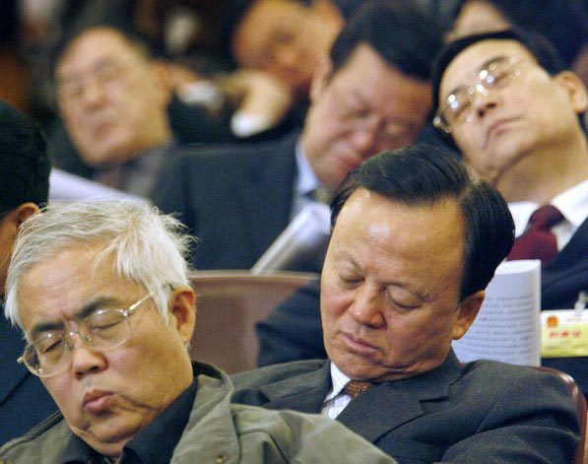
Notes:
Guaranteed to send you audience to sleep!

Slide 6
Problems with Presentations
Notes:
Before I look at what we can do to be better than that and prepare and present effective presentations that engage your audience, let’s have a look at some of the common problems

Slide 7
Objective
Content
Materials
Delivery
Notes:
As I see it there are four key stages to preparing and delivering a presentation. Problems occur at each stage
For example
Failure to set a clear objective based on the audience’s needs and what can be achieved in the time available
Trying to cram too much content into the available time and not matching it to the needs of the audience
Poor quality materials with slides crammed with bullet points that are uninteresting
Poor delivery – reading out bullet points from slides, mumbling etc.

Slide 8
Notes:
Some of the main problems are associated with the content and the materials, particularly the slides that everyone uses. And Powerpoint, the way it’s designed, is often one of the main culprits for this. Opening it you are faced with this standard templates which invites you to create an outline full of wordy bullet points.

Slide 9
Notes:
Resulting in this
Does anyone really like this type of slide?

Slide 10
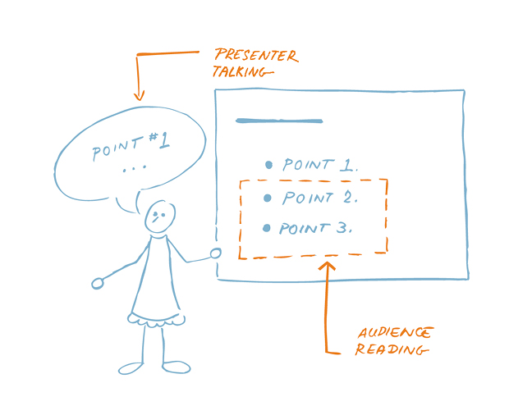
Notes:
This is the main problem with bullet points
Hopefully the diagram makes the point very well
A carefully selected or designed picture is worth a thousand words
They can be supplemented with a few words
Slides should be visual aids to what you’re saying. They’re NOT the presentation. You (and what you’re saying) are
Source : http://www.duarte.com/book/slideology/#www

Slide 11
Notes:
Nancy Duarte, an American expert on presentation design, suggests that there are three common types of slide
(Which of the above do you slides look like?)

Slide 12
Notes:
This is the “slidement”
It’s really a document, more suitable for a handout to be taken away and read later

Slide 13
PPE
All operatives and visitors to production areas should wear the appropriate PPE
The standard PPE consists of safety helmet, safety glasses, overalls, high viz jacket and safety shoes
Chemical protective gloves should be worn when handling chemicals
Notes:
Here’s a typical example
There’s too much information
If you’re reading this you won’t be listening to me
And will the audience have time to read it before you move on to the next one?
Many audience members will be trying to copy it down (again, they won’t be listening if they’re concentrating on doing that)
How many times do you hear someone shout out “can you leave that up a little longer please?”

Slide 14
Notes:
This probably the most common type of slide design
The bullet pointed list
In most cases this type of slide is a teleprompter

Slide 15
Standard PPE
Safety helmet
Safety glasses
Chemical protective gloves
Overalls
High viz jacket
Safety shoes
Notes:
Here’s an example
This is a little better than the previous one
It’s summarised
But it’s not very interesting
And the audience can read it quicker than you can say it
Really it’s a script for the presenter rather than something useful that reinforces what they are saying

Slide 16
Notes:
It’s a crutch for the presenter

Slide 17
Notes:
The third type of slide relies on visuals – pictures, graphics, diagrams etc, with just a few words

Slide 18
Standard PPE
Notes:
Here’s an example
It illustrates the point. In making the presentation I can talk, the audience can listen and the slide illustrates and supplements what I have to say. I can refer to the picture and point things out. But hopefully the audience will be listening to what I have to say rather than copying out a list

Slide 19
Presentation Design Good Practice
Notes:
So lets develop this further and look at some current ideas on good presentation design

Slide 20
Objective
Content
Materials
Delivery
Notes:
Remember the four key steps
Lets take them one by one

Slide 21
Objective
Content
Materials
Delivery
Notes:
First of all our objective.
It needs to be clear

Slide 22
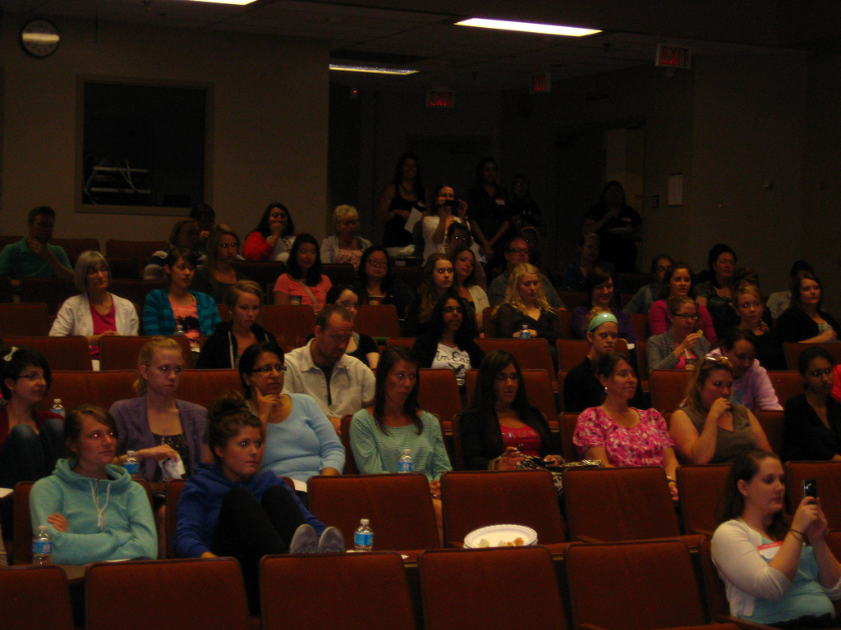
Audience
Notes:
And should be focused on the audience
Image source: http://www.flickr.com/photos/ufv/7693637100/

Slide 23
What are the key points you want your audience to remember?
Notes:
A good starting point is for the presenter to ask themselves this

Slide 24
Objective
Content
Materials
Delivery

Slide 25
Don’t start here!
Notes:
As we’ve seen going straight into Powerpoint will lead the presenter to producing bullet heavy slides.
So when planning the presentation it’s best to leave the computer switched off.

Slide 26
Notes:
Go analog
A good technique is to use post it notes. Write one idea or point on each note They can then be moved around and reorganised at will

Slide 27
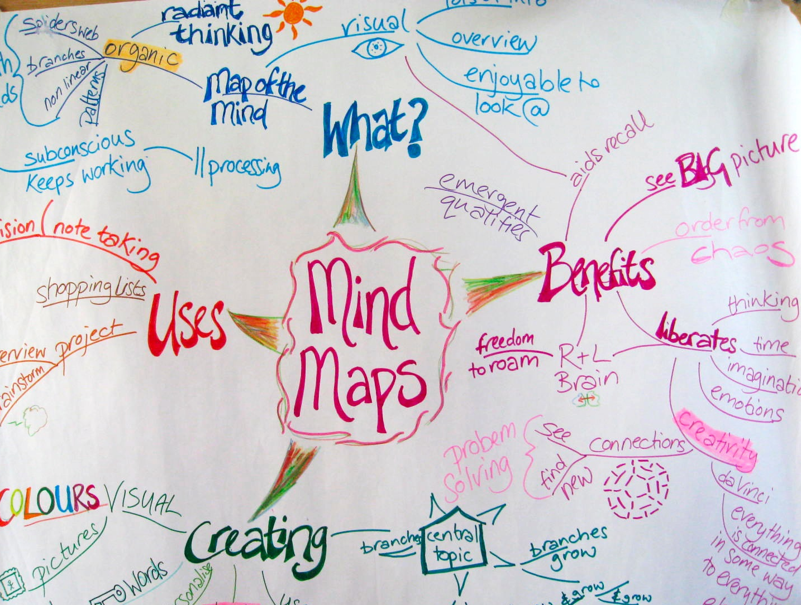
Photo used under CC License:
http://bit.ly/e3rizW
Notes:
Or use a mind map – a favourite technique of mine

Slide 28
Time
Notes:
And make sure you bear in mind what can be reasonably achieved in the time available
Too many presentations try to achieve too much

Slide 29
Objective
Content
Materials
Delivery
Notes:
Presentation materials are often poor
As we’ve seen, often bullet pointed lists that are a crutch for the presenter.
So what is good practice
Well in many ways there is a good analogy with the news

Slide 30
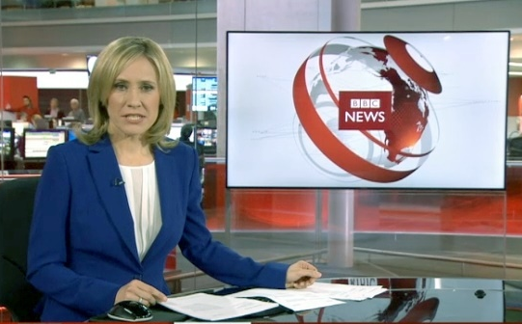
Notes:
I guess you all watch the TV news
Do you see a long list of bullet points listing everything the newsreader says?
No of course not
We listen to the newsreader
There are visuals, but they are usually images (moving or still) that supplement what the newsreader is saying
Occasionally using a list of bullets to summarise key points
We don’t expect the news bulleting to list everything the newsreader is saying
Also we don’t expect the newsreader to give us every detail about the story.
It’s a summary – the key points

Slide 31
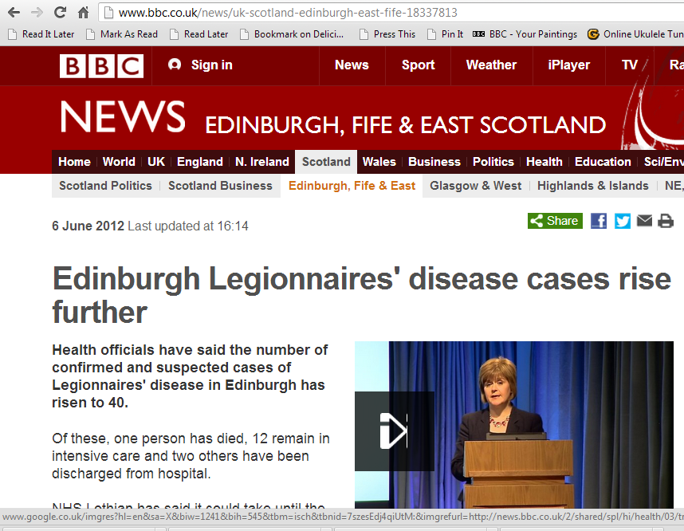
Notes:
If we want more information we can go to the website afterwards

Slide 32
Notes:
Or read a newspaper

Slide 33
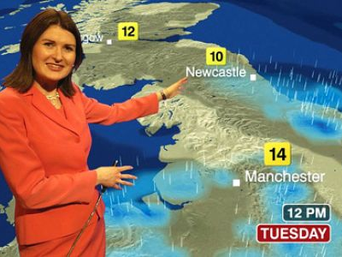
Notes:
It’s the same with the weather.
The presenter tells us what the weather will be like tomorrow with images to supplement what she is saying
We don’t expect to see everything she says written down on the screen in a long list of bullets

Slide 34
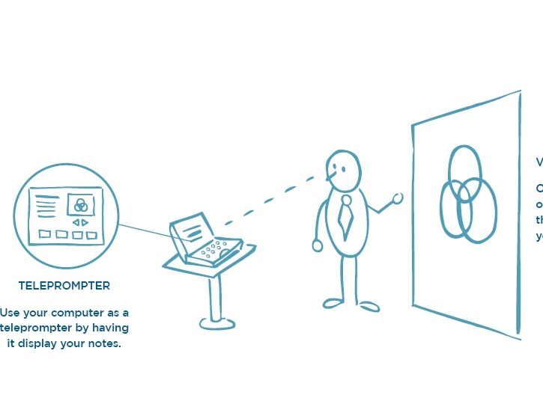
Notes:
We can learn from this
Our presentations are similar to the TV news bulletin
It’s what we say that’s the presentation
Our slides should supplement what we say not duplicate it
We have limited time and should recognise we can only summarise
So we might need to supplement with other things – a handout, for example

Slide 35
PowerPoint slides are NOT the presentation
Notes:
And this is an important point

Slide 36
What are slides good for?
Notes:
So....

Slide 37
Pictures, graphics, charts
Emphasising key points
Summarising
Notes:
Slides should be used to provide visual interest and SUPPLEMENT what the speaker is saying.
They should be visual aids
They shouldn’t be used as a teleprompter or crutch for the speaker
So use them for
Pictures to illustrate or add interest
Graphics and charts
They can be used to emphasis key points – keep the word count to a minimum though and don’t cram with a list of bullets. The best approach is to use one slide per idea. Slides are free! So use as many as necessary
- I sometimes find it useful to use a bulleted list to summarise, but keep the list as short as possible and if necessary spread the points over several slides

Slide 38
Avoiding bullets
Notes:
So how can we avoid bullets? (or at least minimise them)
Lets look at some examples
2 examples from past BOHS conferences and another teaching style slide used in a University lecture

Slide 39
Notes:
Here’s 2 slides from a presentation

Slide 40
Notes:
It’s a real slideument. You can either read the slide or listen to the speaker but probably not both
Is all this detailed information really necessary
Does the audience really need it?
Can they actually absorb it in the time available?
And what is he/she going on about?

Slide 41
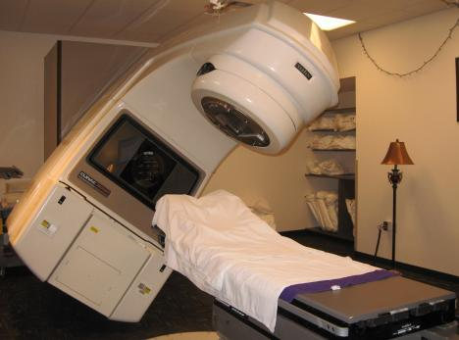
Therac 25
Notes:
Why not show a picture of the machine and then describe what it does in enough, but not too much, detail`

Slide 42
Therac 25
Direct electron beam therapy
Megavolt X-ray therapy
Notes:
Add in a few words to summarise if necessary

Slide 43
Notes:
This is very typical of a teaching slide
Too much information
Uninteresleprompter for the lecturer
And anyone who has never seen a centrifugal fan will be none the wiser after the classing
Really a te

Slide 44
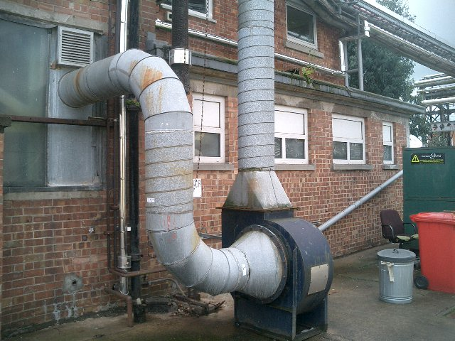
Notes:
So why not show a picture of a centrifugal fan and describe what it does

Slide 45
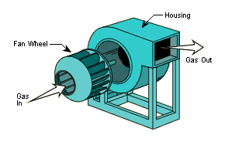
Centrifugal Fans
Notes:
An exploded diagram might help
And I’m sure the students would have a much better understanding of what a centrifugal fan is, what it looks like and how it works at the end of the talk

Slide 46
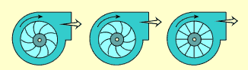
Centrifugal Fans
Forward curved
Backward curved
Radial
Notes:
Perhaps include another slide with some pictures on it to explain the different types of centrifugal fan.
Overall I think that this is a much better approach that leads to understanding.

Slide 47
Notes:
From a presentation at BOHS Conference 2012
http://www.bohs.org/oh2012/presentations/6b(ii)/
Good - it shows a picture of the instrument
But is all that detail really necessary?
Could it be summarised?
We certainly need to cut down the word count.
31 slides in total
Most text heavy
Better than most
Used pictures
used colour

Slide 48
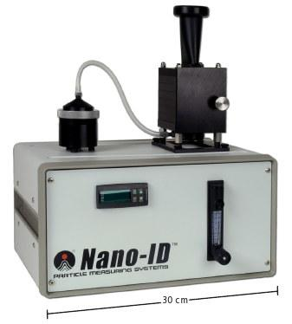
Collects particles from 2 nm up to 20 µm
Notes:
This is what I would do
2 slides perhaps
This one

Slide 49
Size distribution
Mass distribution
Morphology
Chemical composition
Notes:
And that
Any extra detail should be provided and explained by the speaker

Slide 50
Minimise the number of words
Notes:
In summary, for good effective slides used as visual aids to supplement the presentation
1. Minimise the number of words

Slide 51
Use pictures, diagrams and graphics
Notes:
2. Use pictures, diagrams and graphics to illustrate, clarify or supplement what the speaker is saying

Slide 52
Notes:
But be careful you don’t overdo it!

Slide 53
Notes:
So, what are the key points I want YOU to remember?
Well, I said bullets can be useful sometimes, particularly when summarising
So that’s what I’m going to do now

Slide 54
Objective
Content
Materials
Delivery
Clear objective
Consider needs of audience

Slide 55
Objective
Content
Materials
Delivery
Clear and well structured
Matched to objective
Relevant to the audience

Slide 56
Objective
Content
Materials
Delivery
Well designed
Fit for purpose
Engage the audience

Slide 57
Objective
Content
Materials
Delivery
Good slides DO NOT make good handouts
Notes:
And I think this is a good point
That’s what I don’t like about the practice of making slides available on websites after the conference
Slides are designed as handouts
In such cases they are usually not good slides
And they are not good handouts either

Slide 58
Objective
Content
Materials
Delivery
Notes:
Of course delivery is important too
But today I haven’t the time to discuss that to

Slide 59
Notes:
I hope this presentation has given you some food for thought
If you’re interested, here are a couple of books that I find particularly useful and have given me a lot of ideas

Slide 61
Your presentation
What you say
Your presence and delivery
Your handout
Your slides
Notes:
So in summary, when you have a presentation to prepare, remember that the presentation isn’t a deck of PowerPoint slides An effective presentations is
- principally what you say
- How you put it across and engage your audience
Supplemented by well designed slides that are visual aids
- and with a handout that provides additional detail

Slide 62
mike@diamondenv.co.uk
http://www.slideshare.net/mikeslater
http://diamondenv.wordpress.com
Twitter @diamondenv

