Slide 1
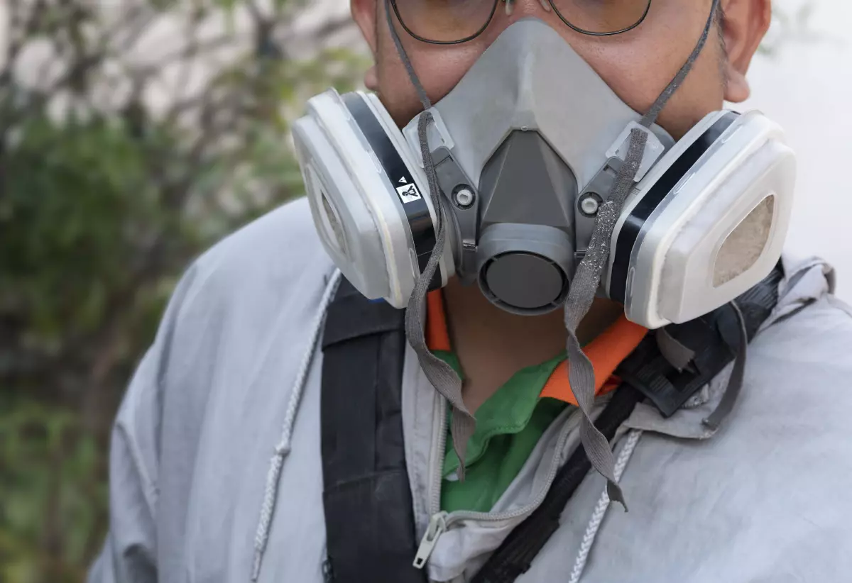
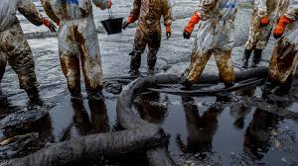
30th March 2023
Oil Spill Investigation and Remediation
Ensuring worker protection, monitoring exposure to hydrocarbons and setting suitable guidance values

Slide 2
Content
Oil Spill Incident
Ensuring worker Protection
Monitoring exposure to hydrocarbons
Setting suitable guidance values
Closing Discussions and Q&A

Slide 3
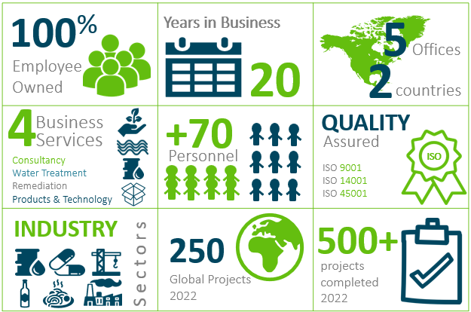
About us

Slide 4
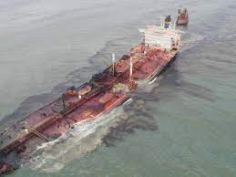
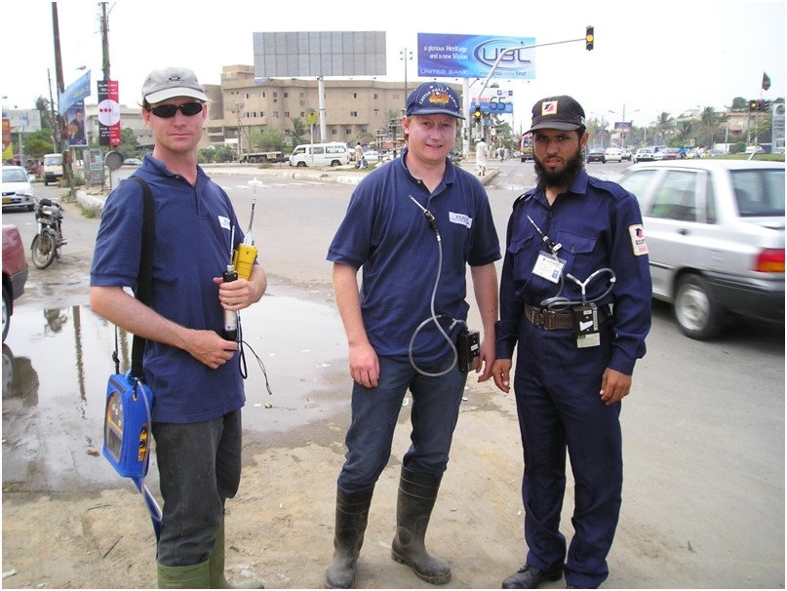
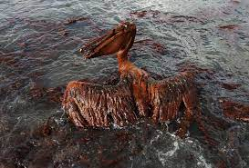
Oil Spills
International Large Scale Oil Spills (Marine)
2003 Tasmin Spirit: 27,000ton
2010 BP’s Deepwater Horizon Oil Spill: ~180,000ton

Slide 5
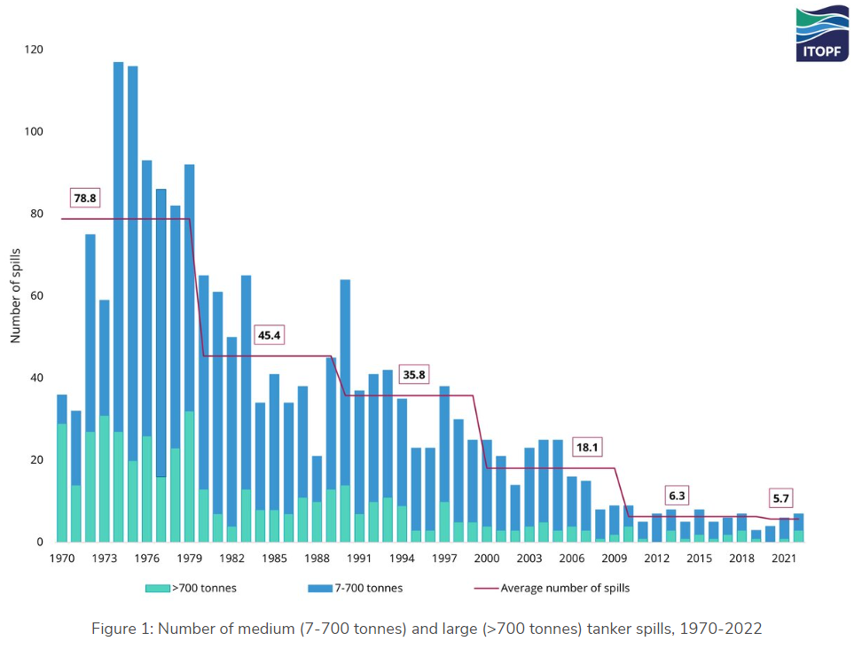
International Large Scale Oil Spills (Marine)
The total volume of oil lost to the environment from tanker spills in 2022 was approximately 15,000 tonnes.

Slide 6
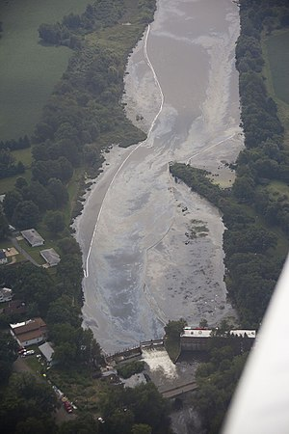
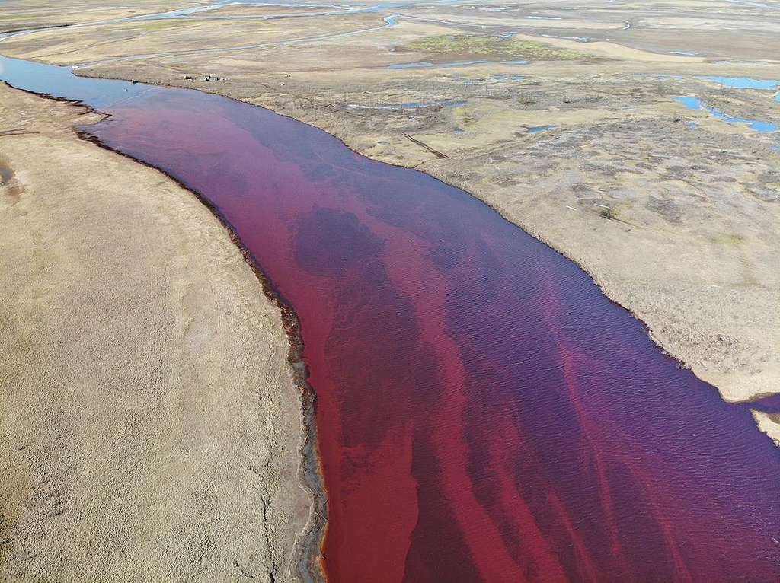
International Large Scale Oil Spills (Inland)
2010 Kalamazoo River oil spill (US) : ~13,000ton
2020 Norilisk Oil Spill (Russia): ~17,500ton

Slide 7
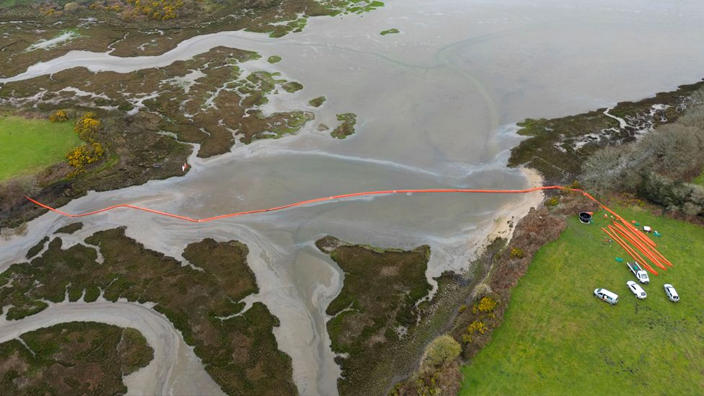
Oil was visible in the water of Poole harbour, Dorset, on Monday
International Large Scale Oil Spills (Inland)

Slide 8
Domestic Oil Spills
Oil remains the single dominant home-heating fuel in Ireland, accounting for 40 per cent of all supply (Energy in Ireland Report 2020 - SEAI)

Slide 9
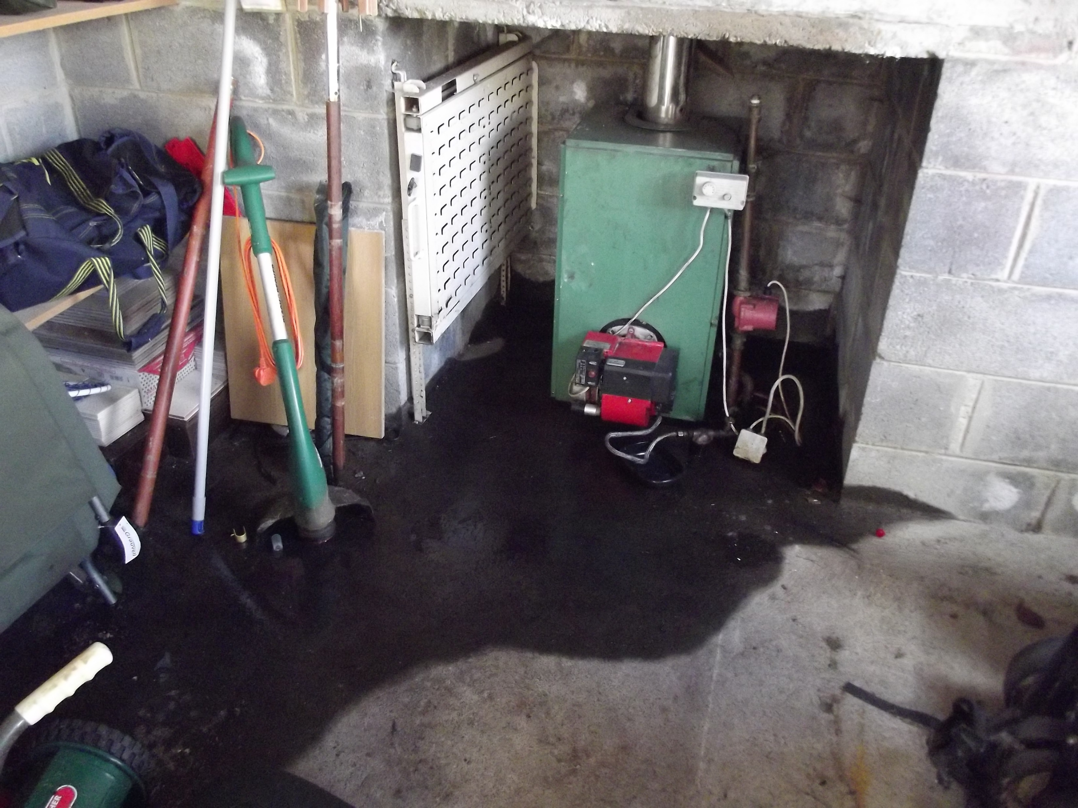
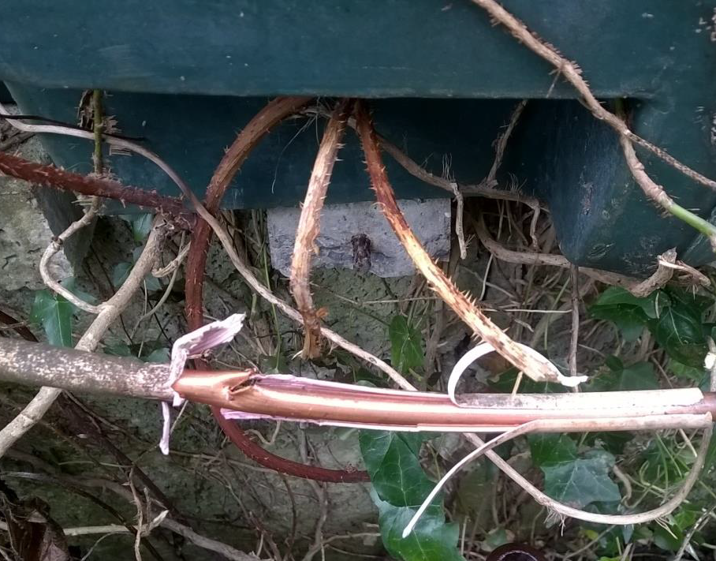
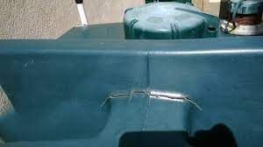
Domestic Oil Spills

Slide 10
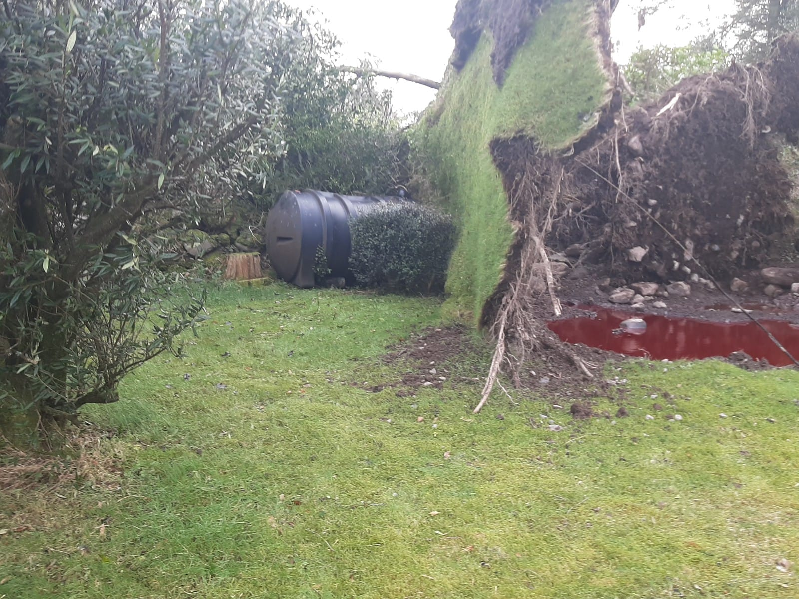
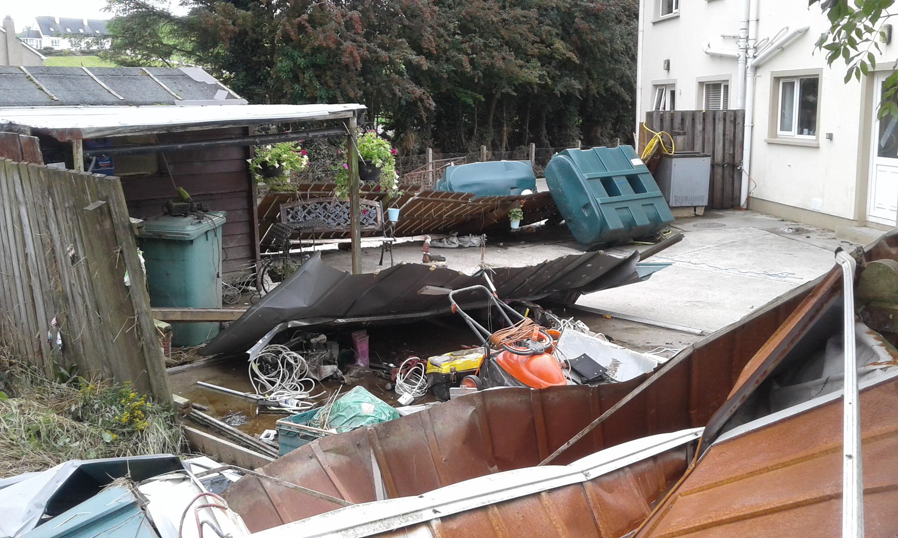
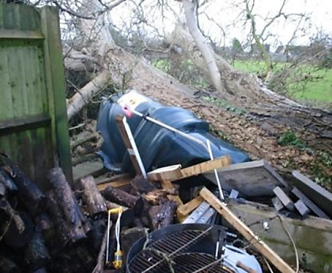
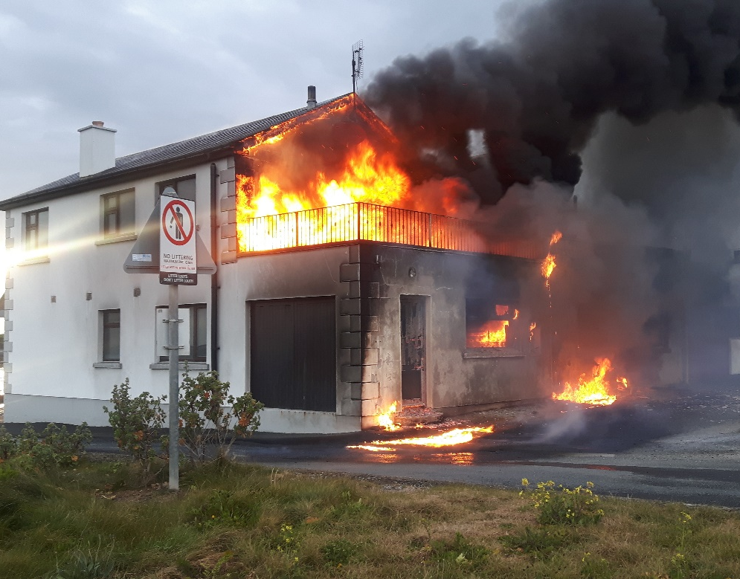
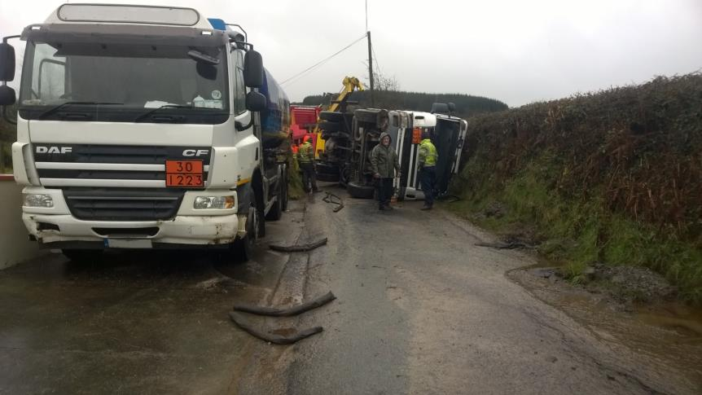
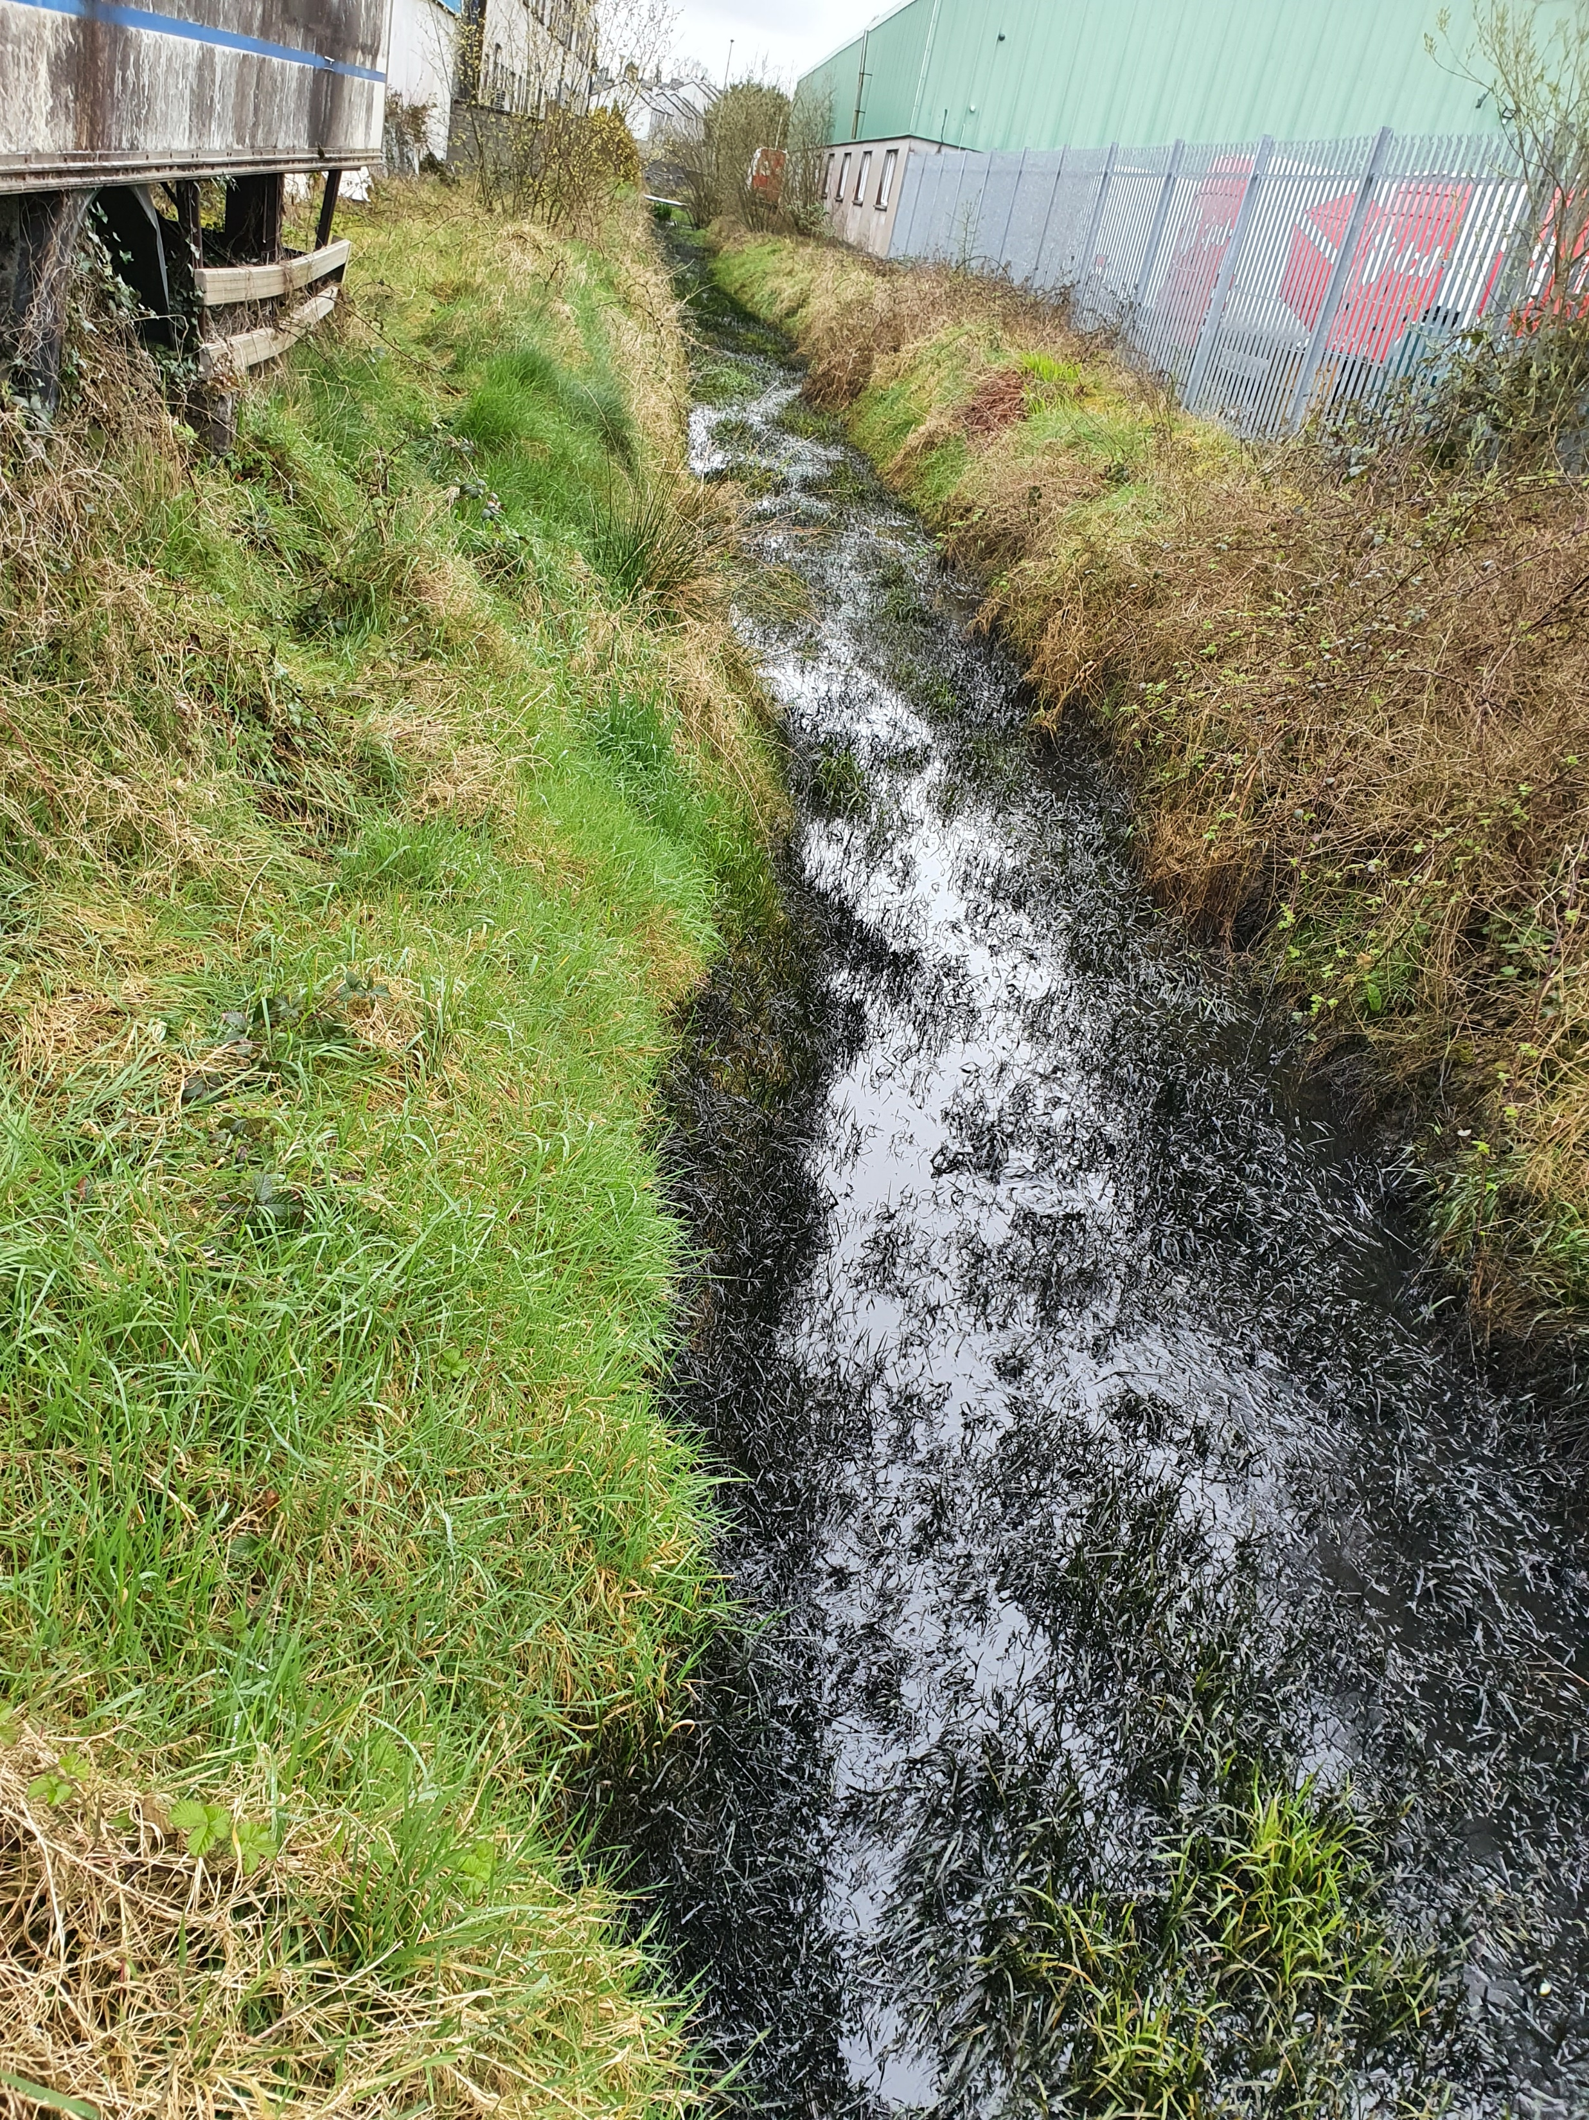
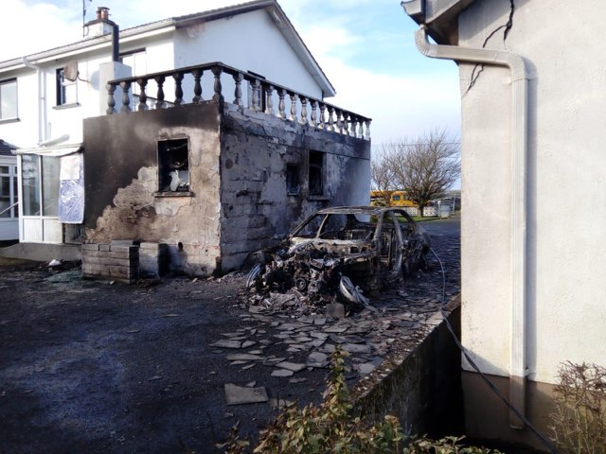
Domestic Oil Spills

Slide 11
Ensuring worker Protection
Why Worry about Oil
Kerosene/diesel are liquid fuel, obtained from the distillation of crude oil
Can be referred to as home heating oil
It is not found naturally in the environment
Exposure may occur through accidents or misuse of domestic products

Slide 12
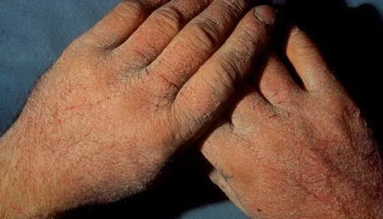
Ensuring worker Protection
Why Worry about Oil
Breathing kerosene or diesel vapour or drinking kerosene-based liquids may cause dizziness, headache and vomiting
Repeated skin exposure may result in rashes
Lung damage may occur if kerosene enters the lungs after being swallowed

Slide 13
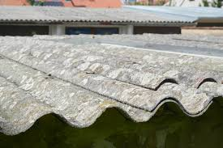
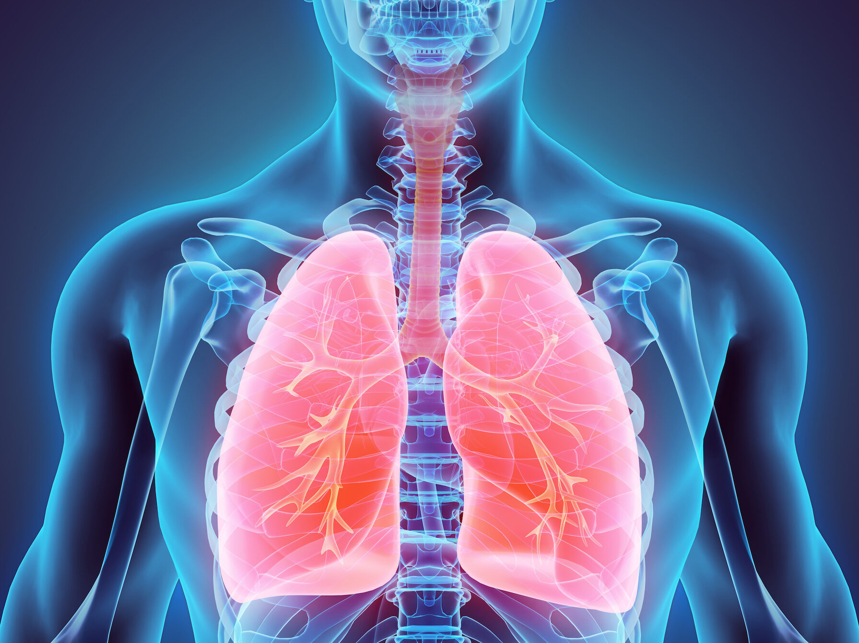
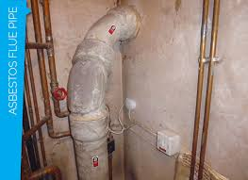
Other dangers associated with oil Spill work
Dust
Volatile Organic Compounds (VOCs)
Asbestos

Slide 14
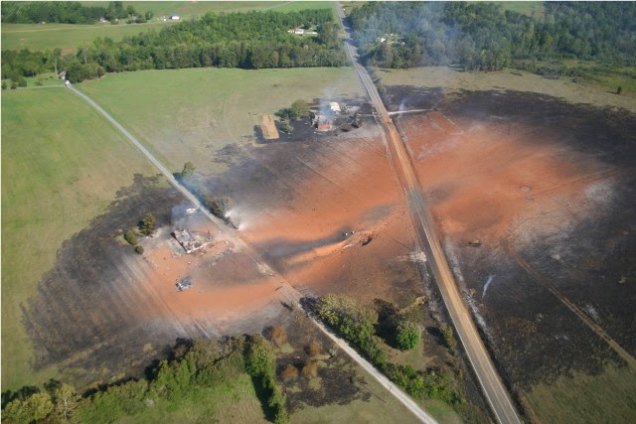
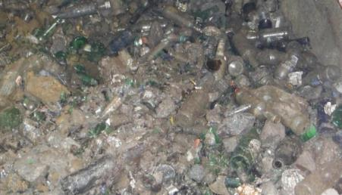
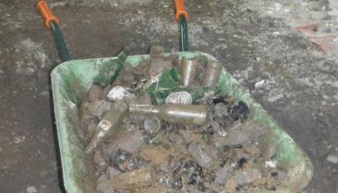
Other dangers associated with oil Spill work
Services
Gas
Electric
Telecommunication/Fibre
Unforeseen
Glass Bottles

Slide 15
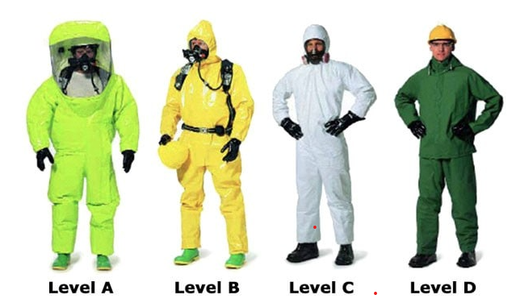
Personnel Protection Equipment

Slide 16
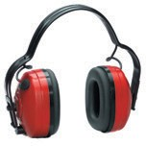
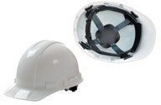
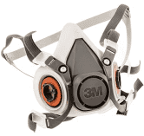
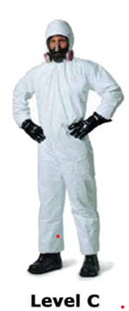
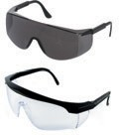
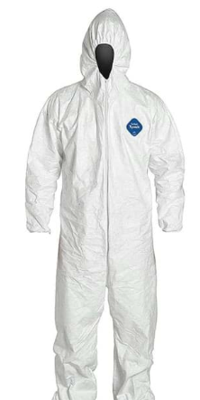
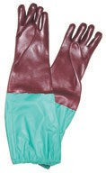
Personnel Protection Equipment

Slide 17
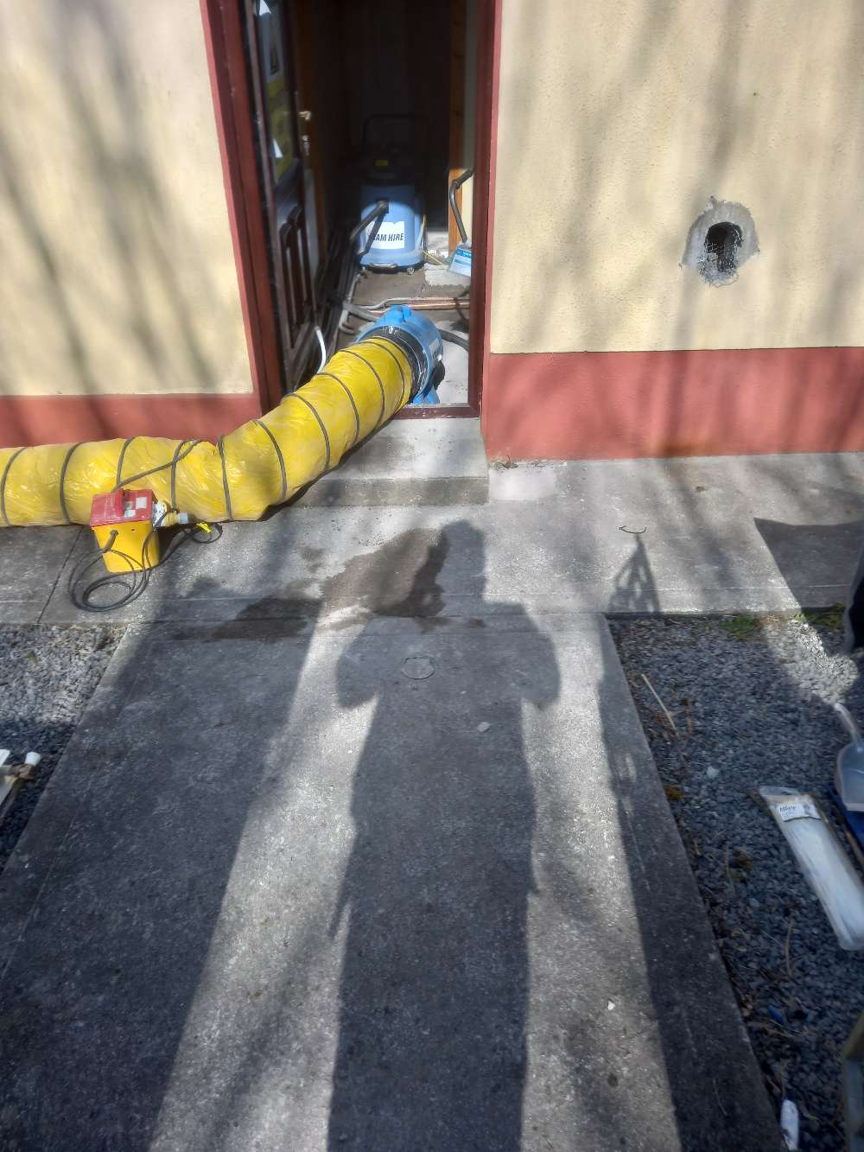
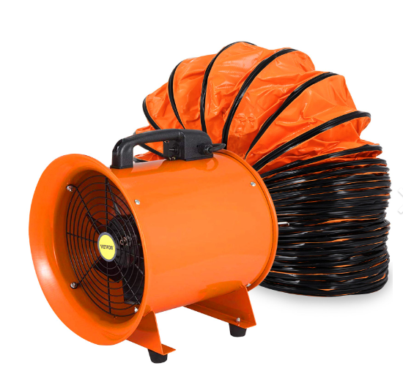
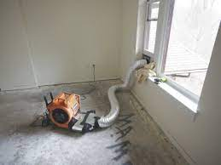
Protection Equipment
Dust extractors

Slide 18
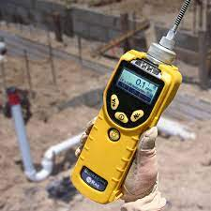
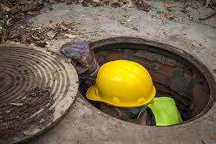
Monitoring exposure to hydrocarbons
PID – Photo Ionisation Detector
PID are the world's most popular hand-held devices for volatile organic compound (VOC) measurement.
They offer a wide range of VOC monitoring capabilities and can be used for confined space entry, emergency response to hazardous spills, indoor air quality, personnel monitoring, survey instrument for sample collection, and work place monitoring.
They can detect from 0-15,000 parts per million, have a rapid three-second response time, and built-in correction factors for 200 compounds.

Slide 19
PID – Photo Ionisation Detector
Useful in experienced hands….deadly in inexperienced hands!!
They don’t identify or differentiate out individual compounds.
For example….

Slide 20
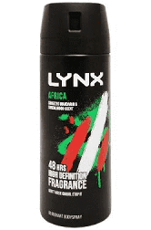
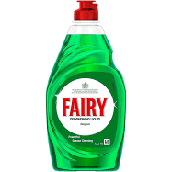
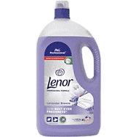
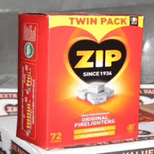
PID – Photo Ionisation Detector
Product | VOC reading
Washing up liquid | 20+ppm
Air Fresheners | 50+ppm
Deodorant | 100+ppm
Fabric Conditioner | 200+ppm
Fire Lighters | 400+ppm

Slide 21
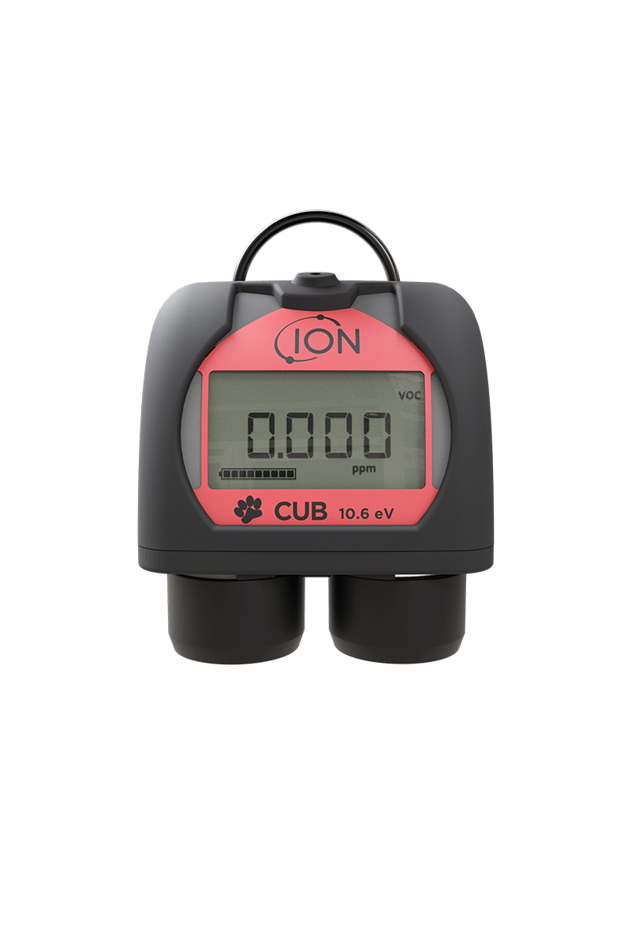
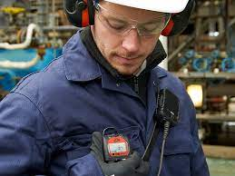
CUB – Photo Ionisation Detector
The Cub 10.6 eV personal VOC gas detector is worn within the breathing zone to detect volatile organic compounds.
It is the worlds smallest and lightest wearable VOC gas detector.
When worker exposure exceeds pre-set limits, the VOC detectors audible, vibrating, and flashing LED alarms alert you to the gases present.

Slide 22
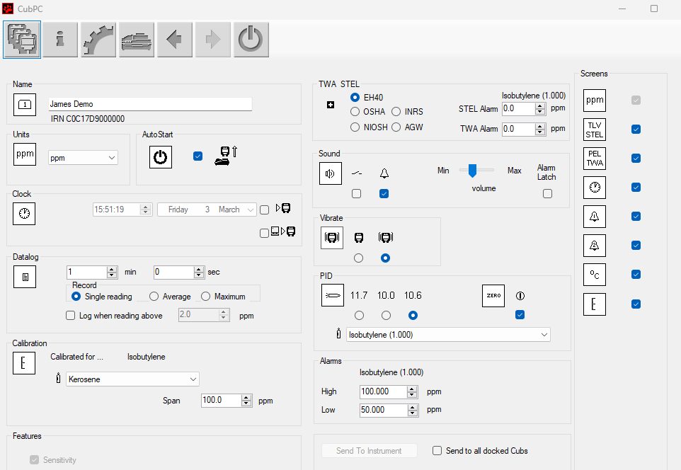
CUB – Photo Ionisation Detector

Slide 23
CUB – Photo Ionisation Detector

Slide 24
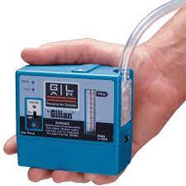
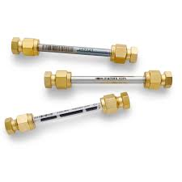
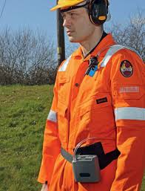
Personnel air sampling

Slide 25
Quantitative air analysis
2-ethylhexanol

Slide 26
qualitative air analysis

Slide 27
Setting suitable guidance values

Slide 28
Occupational Exposure Limit Value
In general, the occupational exposure limit (OEL) indicates the level of admissible exposure, for a length of time (usually 8 hours), to a chemical or physical hazard that is not likely to affect the health of a worker even when repeated regularly throughout a working lifetime
8 hours per day, 5 days per week, 48 weeks per year for 45 years.
Remember! A legal limit or guideline (such as an occupational exposure limit) should never be viewed as a line between "safe" and "unsafe". The best approach is to always keep exposures or the risk of a hazard as low as possible.

Slide 29
Occupational Exposure Limit Value

Slide 30
Occupational Exposure Limit Value
Compound | Occupational Exposure Limit Value (8-hour reference period)
 | ppm | mg/m3
Benzene | 1 | 3.25
Toluene | 50 | 192
Ethylbenzene | 100 | 442
Xylene | 50 | 221
Naphthalene | 10 | 50

Slide 31
Setting suitable guidance values for specific scenarios
OEL are not suitable for
Domestic situation – Adult
Child
School environment
And other situations where there are possible 24/7 exposure

Slide 32
Setting suitable guidance values for specific scenarios
We can derive site specific guidance values if we know
The chemicals Tolerable Daily Inhalation intake (THI (inhal). i.e. the amount of a substance in air, that can be taken in daily over a lifetime without appreciable health risk (ug/kg/bw/day)
Body weight (kg)
Daily Inhalation rate (m3/day)

Slide 33
Setting suitable guidance values for specific scenarios
The European Food Safety Authority states 70kg for a adult and 20kg for a child, although the Agency for Toxic Substances and Disease Registry suggest a default of 80kg
Agency for Toxic Substances and Disease Registry average for 2-11 yr old is 10 m3/day
Compound | TDI/ID (inhal) ug/kg/bw/day | TDI for 70kg (mg) | TDI for 20kg (mg) | GV for Adult (mg/m3) | GV for Child (mg/m3)
Toluene | 1400 | 0.098 | 0.028 | 0.0049 | 0.0028
TDI from the LQM/CIEH 'Suitable 4 Use Levels'
Agency for Toxic Substances and Disease Registry recommend default of 15.3 m3/day

Slide 34
Setting suitable guidance values for specific scenarios
Compound | TDI/ID (inhal) ug/kg/bw/day | TDI for 70kg (mg) | TDI for 20kg (mg) | GV for Adult (mg/m3) | GV for Child (mg/m3)
Benzene | 1.4 | 0.098 | 0.028 | 0.0049 | 0.0028
Toluene | 1400 | 98 | 28 | 4.9 | 2.8
Ethylbenzene | 220 | 15.4 | 4.4 | 0.77 | 0.44
Xylene | 60 | 4.2 | 1.2 | 0.21 | 0.12
Naphthalene | 0.86 | 0.0602 | 0.0172 | 0.00301 | 0.00172
Aliphatic
C5-C6 | 5000 | 350 | 100 | 17.5 | 10
>C6-C8 | 5000 | 350 | 100 | 17.5 | 10
>C8-C10 | 290 | 20.3 | 5.8 | 1.015 | 0.58
>C10-C12 | 290 | 20.3 | 5.8 | 1.015 | 0.58
>C12-C16 | 290 | 20.3 | 5.8 | 1.015 | 0.58
Aromatic
C5-C7 | 1400 | 98 | 28 | 4.9 | 2.8
>C7-C8 | 1400 | 98 | 28 | 4.9 | 2.8
>C8-C10 | 60 | 4.2 | 1.2 | 0.21 | 0.12
>C10-C12 | 60 | 4.2 | 1.2 | 0.21 | 0.12
>C12-C16 | 60 | 4.2 | 1.2 | 0.21 | 0.12

Slide 35
Thank you for your time
Q & A

