Slide 1
Asbestos
Darren Arkins, Senior Inspector, Occupational Health Division
OHSI Conference, Limerick
30th March 2023

Slide 2

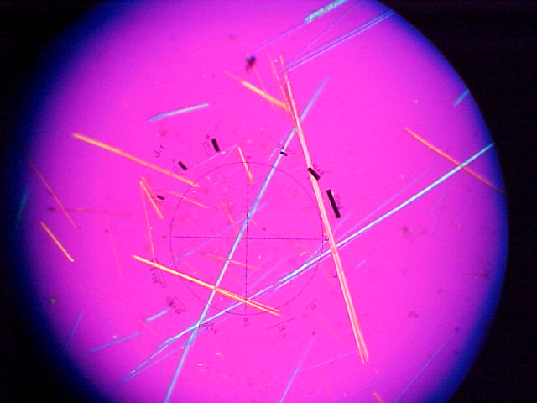
Overview
Basis of existing EU policy on asbestos
New EU asbestos proposals
HSA & asbestos

Slide 3
Basis of existing EU policy on asbestos

Slide 4
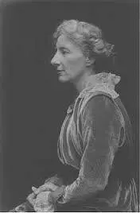
EU asbestos policy – a potted history
1800s - Health effects observed in 1898 and scientifically in early 1900s
1930s – asbestos manufacturers/ insurance companies knew and in 1934 – Textbook of medicine ‘ asbestos diseases incurable’
1970s - Asbestos remained popular and production peaked 1970/early 80s. First legislative EU initiative – EU Council resolution 1978 – UK MEP John Evans
1980s - Council Directive 83/477/EEC – e.g. included prohibition of spraying and introduced limit values - concentration of asbestos fibres other than crocidolite 1f/cm³ 8hrTWA; Crocidolite 0.5. f/cm³ 8hrTWA
Lucy Deane
British Factory Inspector

Slide 5
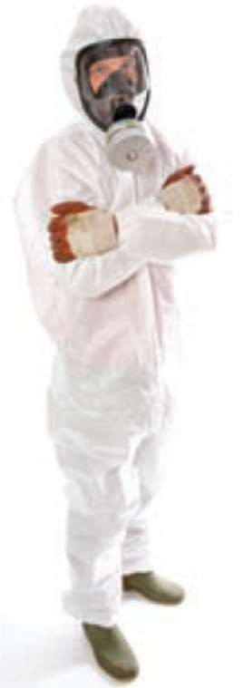
EU asbestos policy – a potted history
1990s – 91/382/EEC e.g. introduced limit values - for chrysotile - 0.6 f/cm³ 8hr TWA and for other forms of asbestos 0.3 f/cm³ 8hrTWA
2003 – Directive 2003/18/EC – All workers covered, removed derogations for some sectors, notification system, low and sporadic exposure and reduction in OELs and one single limit value - 0.1f/cm³ 8hrTWA.
2009 – Codified Directive 2009/148/EC replaced and consolidated 83/477/EEC and a number of amendments.

Slide 6
New EU asbestos proposals

Slide 7

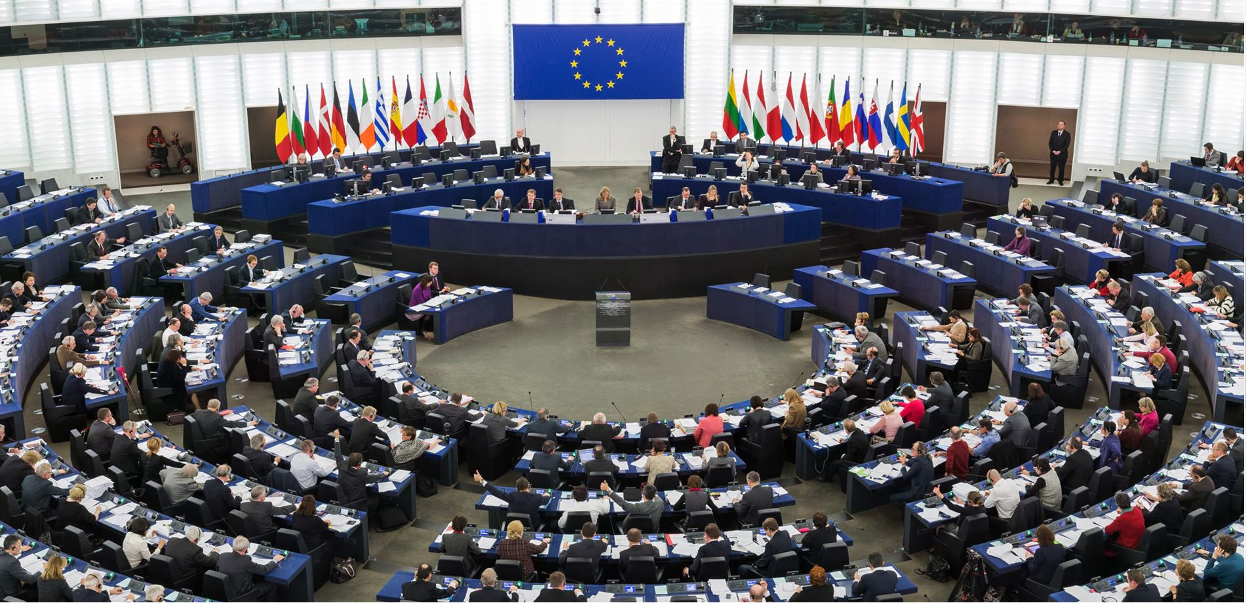
EU policy context
Tackling work-related exposure to asbestos is:
  one of the priorities under the EU OSH strategic framework 2021-2027
  an important action of the cancer prevention pillar of Europe’s Beating Cancer Plan
  a key initiative under the Commission Work Programme 2022
In 2019, the European Parliament published Resolution 2019/2182 INL called for
  the lowering of the existing limit value
  screening buildings, energy renovations, waste management and pollution
Notes:
In 2019, European Parliament called for the lowering of the existing limit value for asbestos and for actions in an enlarged scope: buildings, energy renovations, waste management and pollution, international actions

Slide 8
Call to Action!
Key occupational carcinogen - no safe exposure level
Cancer - second leading cause of mortality in the EU
78% of occupational cancers recognised in the Member States are asbestos-related
88% of occupational lung cancers are asbestos-related
Banned since 2005, but it is likely still present in many older buildings
220 million building units built before the ban are likely to contain asbestos. Those will be renovated or demolished in the near future following the implementation of the EU Renovation Wave
The number of exposed workers (4.1-7.3 million) is expected to increase by 4% every year for the next 10 years with a subsequent plateau and then a decrease in the number of exposed workers expected only after 25 years (reduction of around 10% per year).

Slide 9

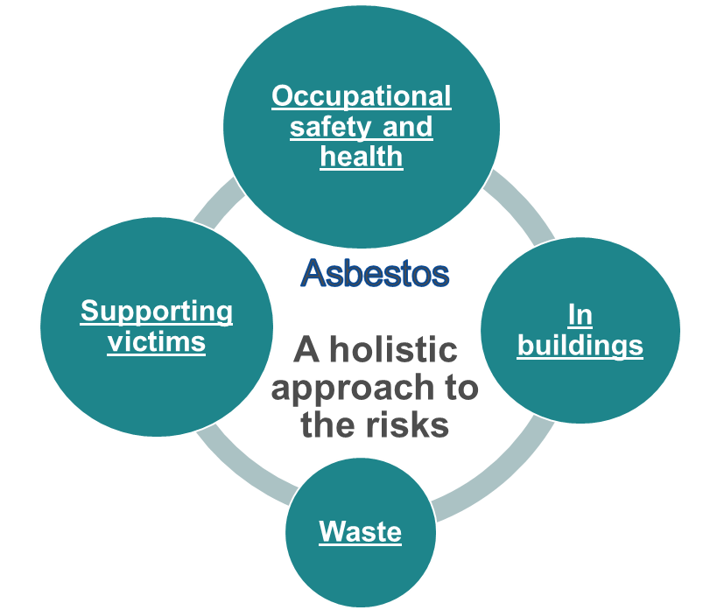
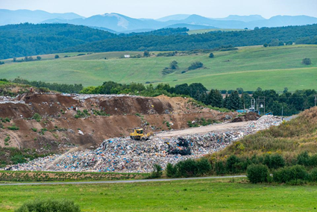
Communication on working towards an asbestos-free future: a European approach to addressing the health risks of asbestos
Supporting victims of asbestos-related diseases
Protecting workers against exposure to asbestos
Addressing asbestos present in buildings
Ensuring safe disposal of asbestos waste and zero pollution
Providing EU financing support
Positioning the EU as a global leader in the fight against asbestos

Slide 10
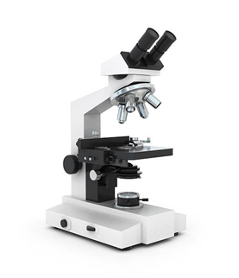
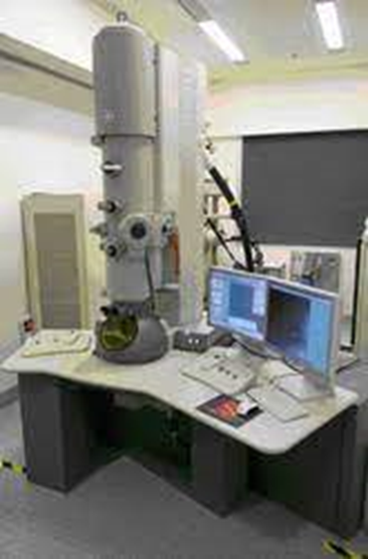
Proposal to amend the Asbestos at Work Directive
The Commission proposes to amend the Asbestos at Work Directive to reduce the occupational exposure limit for asbestos to 10 times lower than the current value (from 0.1 fibres per cubic centimetre (f/cm³) to 0.01 f/cm³)
The proposal is based on: a scientific assessment by ECHA, an opinion by the tri-partite Advisory Committee on Safety and Health at Work which also considers socio-economic and feasibility aspects and an impact assessment
663 cases of cancer (lung cancer, mesothelioma, laryngeal cancer and ovarian cancer) could be avoided over the next 40 years. In economic terms, this health benefit translates into between EUR 166 million and EUR 323 million
Proposal to use a more modern and sensitive methodology based on Electron Microscopy (EM), wherever possible, in addition to the recommended fibre counting by Phase Contrast Microscopy (PCM), as a method giving equivalent or better results than PCM

Slide 11
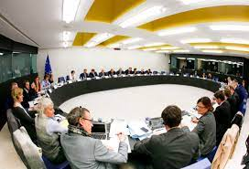

EU Proposals - Next Steps
The proposal for amending the Directive will be negotiated by the European Parliament and the Council
The Council General Approach on the Asbestos at Work Directive was adopted at the EPSCO meeting on 8 December 2022.
The European Parliament is currently preparing its position (the vote of the report in EMPL Committee is foreseen on 13 April 2023, and the week after in the Plenary)
The interinstitutional discussions are expected to start shortly after European Parliament adoption of its position.
Also, discussions have commenced on:
A legislative proposal on the screening and registration of asbestos in buildings

Slide 12
H.S.A & asbestos

Slide 13
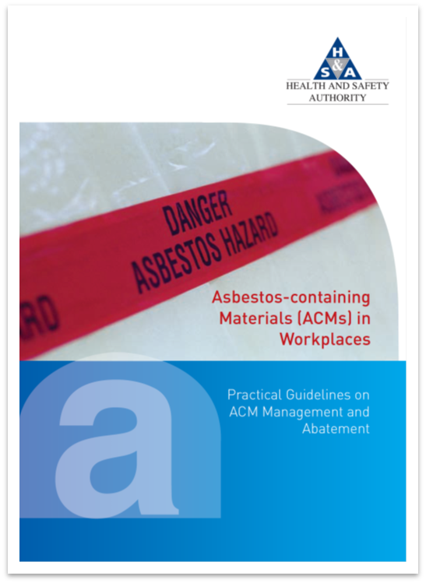

Legislation, guidance and online tools
The Safety, Health and Welfare at Work (Exposure to Asbestos) Regulations, 2006 (S.I. No. 386 of 2006) amended by S.I. No. 589/2010
The REACH Regulation (EC) No. 1907/2006 prohibits the placing on the market, the supply and use of asbestos fibres of all types and of products containing asbestos fibres
The Chemicals (Asbestos Articles) Regulations 2011
The Safety, Health and Welfare at Work (Construction) Regulations 2013 (S.I. No. 291 of 2013)
ACM guidelines (2013), e-learning for tradespeople, safety representative resource handbook (May), asbestos webpages & BeSMART.ie

Slide 14
Asbestos notifications 2015-2022

Slide 15
Asbestos notifications - Risk Rating - 2021 - 2022

Slide 16
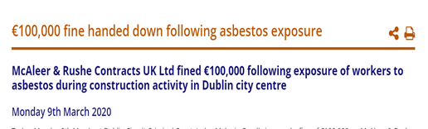
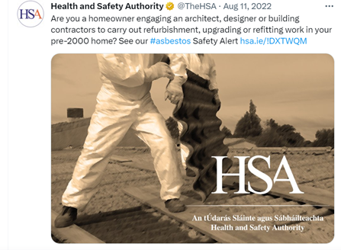
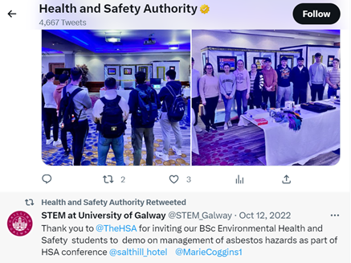
Recent enforcement & stakeholder engagement
Approximately 100 inspections per year/ 70 complaints per year
Prosecutions –2020/2021
Safety alerts issued to industry along with Summer social media campaign in 2022
Engagement with next generation
of OSH advisors

Slide 17
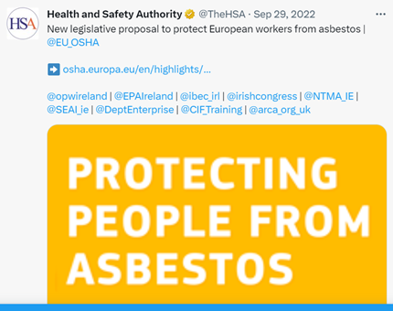

Next Steps & other initiatives
Continue to support DETE with EU asbestos legislative developments
DETE and H.S.A currently engaging with a range of government & other stakeholders on new EU proposals
Increase focus on Occupational Health requirements – exposure registers & health surveillance
New Code of Practice on Indoor Air Quality will address asbestos management
Engagement with asbestos consultants on current guidelines & EU proposals on lower limit value and analytical methods.

Slide 18
Useful links
EU Commission webpages on new proposals
H.S.A asbestos webpages
#AsbestosFreeEurope
#EUCancerPlan

Slide 19
Go raibh maith agaibh
Thank you
T: 0818 289 389
E: contactus@hsa.ie
W: www.hsa.ie

