Slide 1
REACH, CLP and Chemical Legislation Updates
Caroline Walsh MSc,
February 20th 2014
Notes:
CLP 2015, SME support for REACH 2018, making guidance on mixture classiﬁcation easier to navigate and understand, alignment of 5 Directives with CLP, REACH processes including authorisation and much more.

Slide 2
Outline
HSA: What we do, how we do it, our new structure.
HSA: Programme of work for 2014
CLP update
REACH update
Chemical Handling Directive
Stakeholder Communication and engagement
Chemical and Biological Agents
Conclusions

Slide 3
What We Do Our Mandate
Regulate the safety, health and welfare of people at work and those affected by work activities.
Promote improvement in the safety, health and welfare of people at work and those affected by work activities.
Regulate and promote the safe manufacture, use, placing on the market, trade and transport of chemicals while enhancing innovation and competitiveness.
Act as a surveillance authority in relation to relevant single European market legislation.

Slide 4
How We Do It
Promote
Inspect & Enforce
Inform & Guide
&

Slide 5
Our Structure
CEO
Operational Compliance & Prevention
Brian Higgisson
76.3 FTE
Corporate Support, Communication& Education
Robert Roe
39.7 FTE
The Authority (The Board)
Chemicals & Prevention Division
Sharon McGuinness
45.4 FTE

Slide 6
Chemicals & Prevention Division
REACH
WRVS
ADR
EDUCATION
STF
CHEMICALS
MANUAL
HANDLING
COMAH
DSA
RPPS
OCCUPATIONALHEALTH.
MARKET SURVEILLANCE
HEALTH CARE
SMALL BUSINESS SUPORT
PUBLIC ADMINISTRATION
OCCUPATIONAL HYGIENE

Slide 7
Operational Compliance & Prevention
AGRICULTURE
Work Related Vehicle
Safety
CONSTRUCTION
MANUFACTURING
LEGAL
FISHING, DOCKS & DIVING
MANUAL
HANDLING, STF’S.
MINES & QUARRIES
ENGINEERING
EXPLOSIONS.
MARKET SURVEILLANCE
HEALTHCARE
SMALL BUSINESS SUPORT
PUBLIC ADMINISTRATION
INVESTIGATIONS

Slide 8
Corporate Support Communications and Education
CORPORATE GOVERNANCE.
PROCUREMENT
COMMUNICATIONS.
EDUCATION
FOI.
STATISTICS AND RESEARCH
WORKPLACE
CONTACT
UNIT
FINANCE.
ICT.
RECORDS MANAGEMENT.
HR.
FACILITIES
BOARD SUPPORT.
OMBUDSMAN.
DJEI
LIASION.

Slide 9
HSA POW 2014
HSA Programme of Work 2014
This is the second Programme of Work prepared as part of our strategy for the period 2013 to 2015. Our vision is a country where worker safety, health and welfare and the safe management of chemicals are central to successful enterprise. This Programme of Work is designed to move us closer to achieving our vision.

Slide 10
HSA POW 2014
REACH and CLP Policy
Fulfil Lead Competent Authority role in relation to the REACH and CLP Regulations
Stakeholder support and communication
Provide the REACH and CLP National Helpdesks.
Conduct awareness raising campaign with NPIC to alert consumers to 2015 changes in product labels due to CLP.
Continue communication campaigns to maintain awareness of REACH and CLP among stakeholders.

Slide 11
HSA POW 2014
REACH & CLP policy
Evaluate one substance from the 2014 Community rolling action Plan (CoRAP) under substance evaluation, complete relevant follow-up from substance evaluated in 2013 and participate in screening activities to secure substances to evaluate in subsequent years
Contribute to EU Commission’s goal to identify all relevant substances of very high concern (SVHCs) by 2020 under the SVHC roadmap.
Host a meeting of the Risk Management Experts (RIME) group of experts from the Member States, ECHA and the Commission.

Slide 12
HSA POW 2014
REACH and CLP enforcement
As the National Enforcement Authority, we will complete a programme of inspections (desk based assessments and on-site visits) to assess the compliance with REACH and CLP. In completing this programme, we will:
- Target ‘Only Representatives’ and assess their compliance on all their REACH and CLP obligations.
- Target distributors and chemical formulators to assess compliance with the requirements of REACH and CLP/Dangerous Preparations Directive, and will look in particular at the provision of information in the supply chain (e.g., Safety Data Sheets) as well as classification, labelling and packaging rules for hazardous substances.

Slide 13
HSA POW 2014
REACH and CLP Enforcement
Follow up and enforce all ECHA communications including Article 36, 40(3) and 41(3) decisions.
In relation to market surveillance on REACH Restrictions under Annex XVII, check that identified carcinogenic, mutagenic or repro-toxic (CMR) substances are not being sold to consumers as chemical substances or mixtures.
Participate in EU Forum project on REACH enforcement to coincide with our ‘Only Representative’ inspections

Slide 14
CLP Update
4th ATP (Reg. No 487/2013)
Entry into force on 21 June 2013
Main objective: Alignment to 4th revision of GHS
Modified criteria for ‘explosives’, ‘flammable gases’, etc.
Revision of some precautionary statements and consolidated classification for all aerosols
Clarification for use of pictograms for substances ‘corrosive to metals’ but not ‘corrosive to skin’
Labelling exemptions for small packaging
How to deal with differentiation for chemicals toxic to reproduction (H360/H361)
Applicable from 1 December 2014 (substances) or 1 June 2015 (mixtures)

Slide 15
CLP Update
5th ATP (Reg. No 944/2013)
Entry into force on 24 October 2013
Main objective: New substances (Annex VI)
39 new or revised entries including Epoxiconazole and Gallium arsenide
Precautionary Statement P210 amended in alignment with the 5th Revision of the UN GHS.
CLH entries valid from 1 January 2015 except for the entry pitch, coal tar, hightemp. (EC Number 266-028-2), from 1 April 2016
Amended Precautionary Statement applicable from 1 December 2014 for substances and from 1 June 2015 for mixtures.

Slide 16
CLP Update
Update on forthcoming ATPs
6th ATP: New substances (Annex VI): 23 new or revised entries (including Formaldehyde and Styrene)
7th ATP: New substances (Annex VI 2013 RAC opinions)
8th ATP: Alignment with 5th revision of GHS
New test method for oxidising solids
Amended criteria for skin corrosion/irritation, severe eye damage/irritation, and aerosols
Revised and simplified C&L summary tables
Amendments in information for safety datasheets (SDS)

Slide 17
CLP Update
 | 6th ATP (new/revised entries) | 7th ATP (new/revised entries) | 8th ATP (GHS rev.5)
ISC | March/April 2013 | March 2014 | Sept 2014
WTO notification | 15 July 2013 | April 2014 | Sept 2014
REACH Committee | End of October (Written consultation) | June 2014 | Nov 2014
Scrutiny EP / Council | Nov 2013 –Jan 2014 | June–Sept 2014 | Nov 2014– Feb 2015
Adoption by college | Q1 2014 | Oct 2014 | March–May 2015
Provisional timetable for forthcoming ATPs

Slide 18
CLP Update
CLP 2015 ACT NOW!
CLP Deadline for mixtures ‘placed on the
market’ is 1st June 2015
Derogation until 1st June 2017 for mixtures already on market on 1st June 2015.
Many millions of mixtures need to be reclassified
Guidance and supports available from ECHA
Support available NOW from HSA via chemicals @hsa.ie
HSA and NPIC looking at initiatives to raise awareness about chemical hazard communication among workers and consumers like the Dutch labelling lottery See link
Notes:
Just drilling down into some of the aspects of our POW, one in particlar which I am directly involved in is the CLP 2015 campaign. We have already gone thorough one deadline for substances and this is the second one for mixtures.

Slide 19
CLP Update
TOOL BOX
CLP 2015 Act Now!
Supplier Safety Data Sheets
ECHA guidance, FAQ’s, factsheets
ECHA C&L inventory
HSA website www.hsa.ie/chemicals
HSAS Chemicals Helpdesk
Industry forums

Slide 20
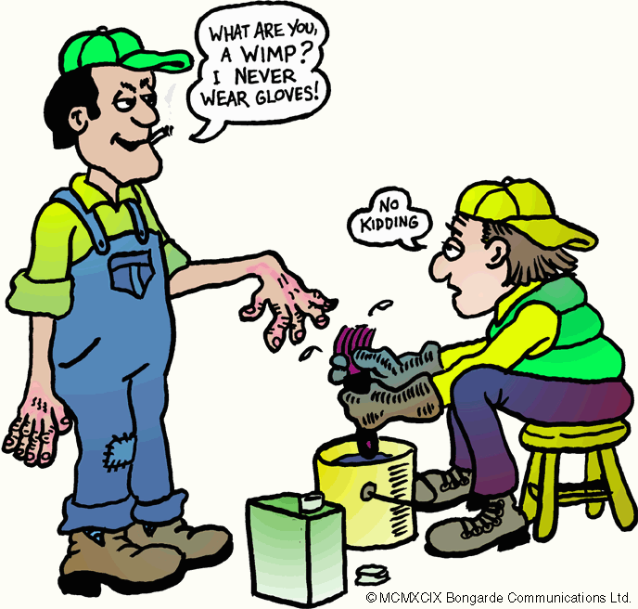
CLP Update
CLP 2015 Act Now!
Chemical Hazards remain the same!
CLP is changing the way hazards are
communicated to a global system
CLP is not going to change our habits!
CLP is an opportunity to raise awareness about the importance of chemical hazard communication

Slide 21
CLP Update
ECHA- HelpNet group working on simple guidance for SME’s
Aim is to have easily accessible information on
mixture classification for SMEs on the ECHA website
Plan for the development of ECHA website for
SME’s
To be launched at Workshop in Brussels in Sept
Ireland are part of this working group
Using existing guidance not creating more…

Slide 22
CLP Update
Review Art 45(4) CLP – Information for Poison Centres
Template agreed for submission of information by Industry
Unique Product Identifier for each formula
SDS sufficient for industrial chemicals
Further information required for consumer products
Longer term goal for an EU wide single submission tool
COM to propose for a new Annex to CLP

Slide 23
Update on REACH
Registration
Registration process continues….
Registration Database contains 12276 unique substances and contains information from 47097 Dossiers.
Registration 2018 for substances placed on the market at 1-100 tonnes per annum
Learn about the experiences from 2010 & 2013 deadlines e.g. substance identity and quality of data
NOT too early to prepare for 2018
Further information on www.hsa.ie/chemicals and ECHA

Slide 24
Update on REACH
Authorisation
Authorisation process continues….
151 substance on Candidate list for Authorisation
22 substances on Authorisation list
5 more substances prioritised for Authorisation
12 applications for Authorisation received/in process
0 decisions from Commission on applications as of 12th February 2014

Slide 25
Update on REACH
Evaluation
Evaluation process continues….
CoRAP: Community rolling Action Plan 2013-2015
115 substances currently subject to evaluation
3 processes:
Compliance check of dossiers: ECHA quality check of registration dossiers
Examination of testing proposals submitted by registrants: ECHA evaluates proposals to conduct Annex IX and X tests
Substance evaluation: MSCAs evaluate all registration dossiers for a certain substance(s) to evaluate whether their use poses a risk to human health or environment

Slide 26
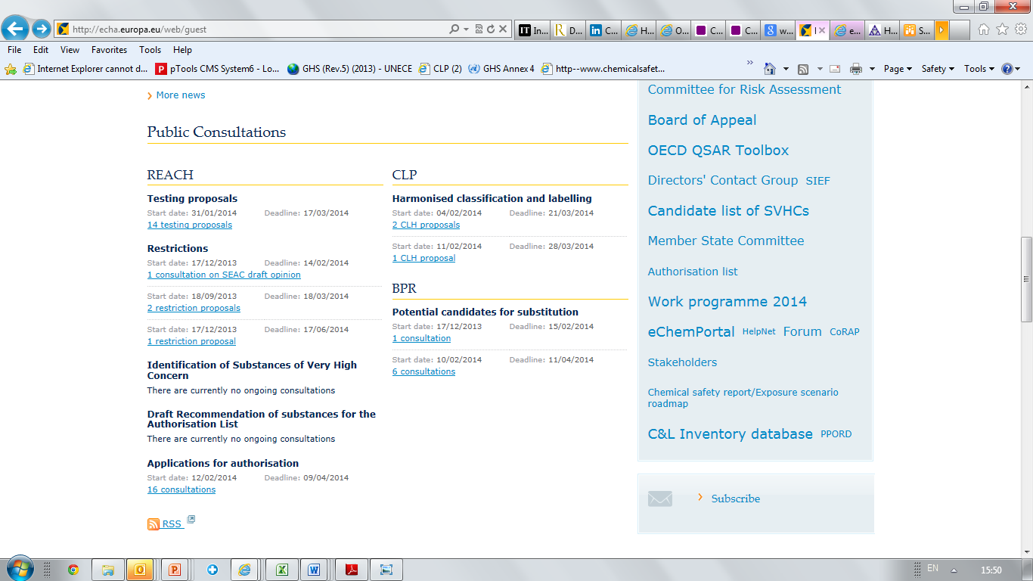
Update on REACH
Public Consultation

Slide 27
Chemical Handling Directive
Updates 5 Occupational Safety & Health ( OSH) Directives to align with CLP Regulation
Council Directive 98/24/EC - chemical agents at work,
Directive 2004/37/EC - carcinogens or mutagens at work,
Council Directive 92/58/EEC - the provision of safety and/or health signs at work,
Council Directive 92/85/EEC - the safety and health at work of pregnant workers and workers who have recently given birth or are breastfeeding,
Council Directive 94/33/EC - protection of young people at work.

Slide 28
Chemical Handling Directive
Mostly relates to changes in references and terminology
Amendments required as Directives 67/548/EEC and 1999/45/EC being repealed from 1st June 2015.
Will result in amendment to all Statutory Instruments transposing these Directives in Ireland
Lead to an improvement in information between the OSH Directives and CLP
Shall enter into force in Ireland on 1st June 2015
Guidance will be made available to highlight the changes.

Slide 29
Chemical Handling Directive
Main changes
References to 67/548/EEC and 1999/45/EC
changed to CLP 1272/2008
References to risk phrases changed to hazard
statements
Safety Signs Directive amended to remove
the St Andrew’s cross safety sign
Exclamation mark sign to be used for
stores of chemicals only and not for
Chemicals assigned GHS07

Slide 30
Stakeholder communication
Chemicals Helpdesk
Chemicals Helpdesk established Sept 2011 chemicals@hsa.ie using a SINGLE counter approach for ALL stakeholders
Scope of Helpdesk includes REACH,CLP, Export Import and Detergents
Standardised process and signature used
All communication between Authority and stakeholders on chemicals via the chemicals mailbox

Slide 31
Stakeholder Communication
Safe Supply, Use and Management of Chemicals
www.hsa.ie/chemicals
Targeted at chemical manufacturers, suppliers, users
Includes a Latest News and Quick links section
Updated with news from ECHA
Incorporates ALL aspects of occupational chemical safety incl. REACH and CLP

Slide 32
Stakeholder Communication
E-Bulletin and Newsletters
Quarterly chemicals E-bulletin produced by helpdesk team. See Link
Covers all updates on chemical issues
Subscriber service
Articles on REACH, CLP and other chemical topics included in separate quarterly HSA newsletter
ECHA Newsletter: see link

Slide 33
Stakeholder Communication
Publications/Articles
REACH leaflets
At entry into force
ECHA leaflet on 2013 registration deadline
REACH postcards used for pre-registration & registration
CLP pocket leaflet, postcards & posters
Information sheets
‘Use chemicals safely’ booklet
Articles on REACH and CLP in publications

Slide 34
Stakeholder Communication
Education/Training/Tools
Choose Safety Programme- unit 3 on chemical safety for post primary students. link
Steps to chemical safety: as part of tacking care of business initiative. link
CLP leaflets, posters. link
Information sheets on chemical topics incl REACH and CLP link
BeSmart tool for workplace risk assessment www.besmart.ie includes chemical safety module
Chemical safety on farms video link

Slide 35
Stakeholder Communication
Communication campaigns
Media/advertising campaign
Radio and newspapers advertisements
Postcards
Seminars/Conferences/Workshops
Press releases
Specific campaigns run for REACH Registration, Authorisation, Restrictions and CLP deadlines
CLP 2015 awareness raising campaign initiated..

Slide 36
Stakeholder Communication
Social Media
New initiative since Q2 of 2013
Weekly updates on chemicals included in
social media including
Twitter
Facebook
LinkedIn planned for 2014

Slide 37
Stakeholder engagement
Stakeholder Network
Network of interested parties in chemicals, especially REACH and CLP
Includes Government Departments/Agencies, Chemical Industry Representatives, SME representatives
Acts as multiplier in dissemination of targeted information; mostly via email
Email alerts sent to this group regularly

Slide 38
Stakeholder engagement
HSA Policy Inspectors
Meet with industry upon request to discuss
specific issues/topics on chemicals
Participate in Interdepartmental group meetings
on common areas relating to chemicals
Give presentations at seminars, workshops conferences on request
Provide internal training to HSA staff

Slide 39
Stakeholder engagement
HSA compliance inspectors
Provide information and advice
Distribute information and guidance on chemicals to stakeholders they visit.
Followup on queries with chemicals policy inspectors
Receive annual training/ongoing updates on chemical legislation
Distribute information on chemical safety
Give presentations at events on chemical safety

Slide 40
Chemical Agents
New updated CoP 2014
“Schedule 3” agents
New list of intended changes
Public consultation – mid year
Recommend CoP to Minister 3rd Qtr.
Notes:
The Authority intends updating the Chemical Agents Code of Practice by the 4th quarter of 2014.
The updates are already known in that Schedule 3 of the current (2011) code has notice of intended changes and these will be incorporated into schedule 1 of the new code.
A new list of intended changes will be drawn up based on the latest scientific information. We will draw chiefly on the CION’s proposed 4th indicative list, the advice of the Scientific Committee on Exposure Limits and the work of the American Conference of Governmental Industrial Hygienists (ACGIH) for proposed future changes.
Subject to the advice of the Legal and Guidance sub-committee of the HSA board, we are likely to hold a public consultation on the draft code by mid-year. We will notify OSHI and individuals at the commencement of the consultation process.
Having considered correspondents’ comments, with Board approval, we will recommend the CoP to the Minister for Jobs, Enterprise and Innovation during the 3rd quarter and subsequently have it approved and published.

Slide 41
Biological Agents
New Regulations
New CoP
New Guidance
Notes:
The new Safety Health and Welfare at Work (Biological Agents) Regulations, S.I. No. 572 of 2013 and their related Code of Practice were signed by Minister Richard Bruton T.D., Minister for Jobs, Enterprise and Inovation on 20th December 2013.
The Regulations and the Code of Practice can be viewed on the HSA website and the code and the guidance is with the printer and we will make hard copies available.

Slide 42
Biological Agents
What’s New
Restructured Regulation
Dispensation
Notification Process
Code of Practice
Lists of Agents
Containment Measures
Guidelines
Notes:
Transpose in full the requirements of the Biological Agents Directive. Simplify and improve on the existing regulations by reference to the Safety, Health and Welfare at Work Act 2005 Act and the General Application Regulations 2007.
Allow the employer, having completed a risk assessment, to dispense with certain group 3 containment measures for specific agents identified in the relevant code of practice. and allow the Authority to publish guidelines, as deemed necessary, specifying minimum containment measures which shall be applied.
Clarify the notification process and clearly align the Regulation with the requirements of the Directive
Enable by regulation, the publication of the Schedule of the Safety Health and Welfare at Work (Biological Agents) (Amendment) Regulations 1998 as a Code of Practice. The Code of Practice, contains the approved list of biological agents, their classification, minimum containment measures and dispensation from minimum containment measures, where appropriate. It is proposed, in the interest of the safety of the relevant workforce, to regularly update the Code of Practice, having regard to the latest and most up to date scientific information.
The overall purpose of the guidelines is to give general guidance on the prevention of risks to safety and health related to exposure to certain biological agents in the workplace.
The guidelines emphasise, in particular, the importance of adequate and appropriate risk assessment as laid down in Regulation 7 of the regulations. The aim of these guidelines is to assist in the understanding and implementation of the requirements and responsibilities as set out in the Safety, Health and Welfare at Work (Biological Agents) Regulations, 2013. The guidelines include advice on non-intentional exposure, protection measures, containment levels, vaccination, health surveillance, emergency plans and notification to theAuthority.
.

Slide 43
Conclusions
HSA structure and POW 2014 overview
REACH and CLP updates and processes continue
CLP 2015 the next big challenge.
Chemical Handling Directive aligns OSH with CLP
Stakeholder communication important focus
More engagement via social media
Chemical Agents CoP under review
New Biological Agents Regulation
Questions: chemicals@hsa.ie

