Slide 1
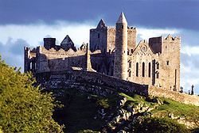
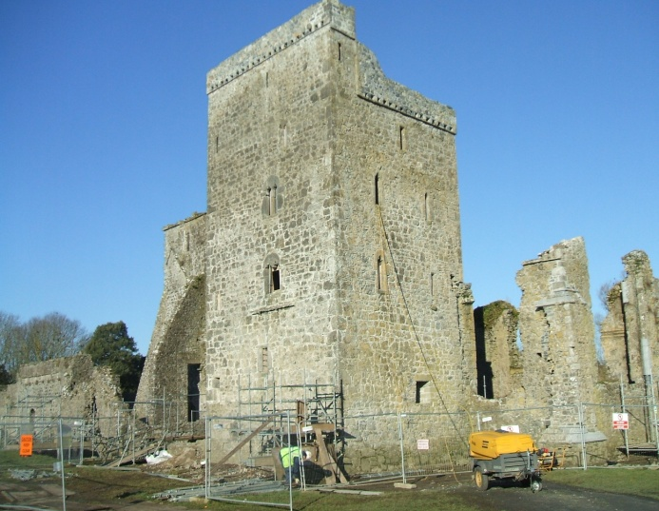
Effective Communication Aids
Restoration Stoneworkers
Catherine Healy, NUI Galway
Notes:
The title of my presentation today is Respirable crystalline silica exposures among restoration stone masons

Slide 2
Presentation overview
Background
Training needs analysis
Training design
Training methods
Assessment and evaluation of training

Slide 3
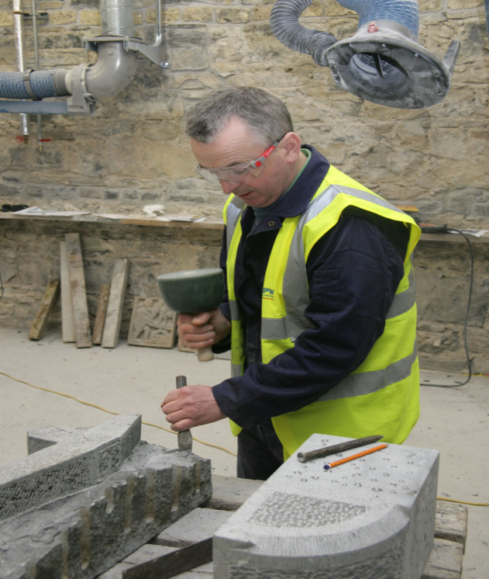
Training background
Worker group
Regularly overexposed (compared with 0.1 and 0.05 mg m³ 8hr TWA) to RCS*
Workplace intervention
*Healy C, Coggins M, Van Tongeren M, MacCalman L, McGowan P. (2014) Determinants of respirable crystalline silica (RCS) exposure among stone workers involved in stone restoration work. Ann Occup Hyg; 58(1): 6-18.
Notes:
Restoration stoneworkers are regularly overexposed (compared with 0.1 and 0.05 mg m−3 8-h TWA) to RCS dust when working with sandstone.
In order to decrease exposure to RCS, efforts should be focused on developing and implementing interventions
which focus on these high-risk tasks.
Very few workplace exposures are controlled by using one control measure alone, and some type of administrative controls are always integrated in an exposure control program.

Slide 4
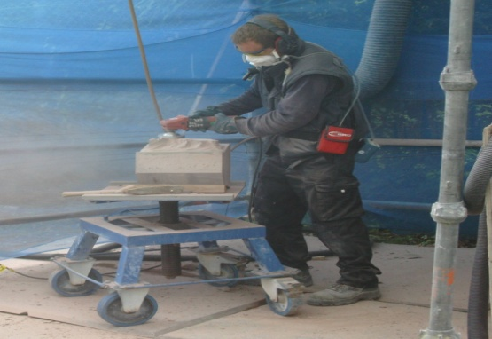
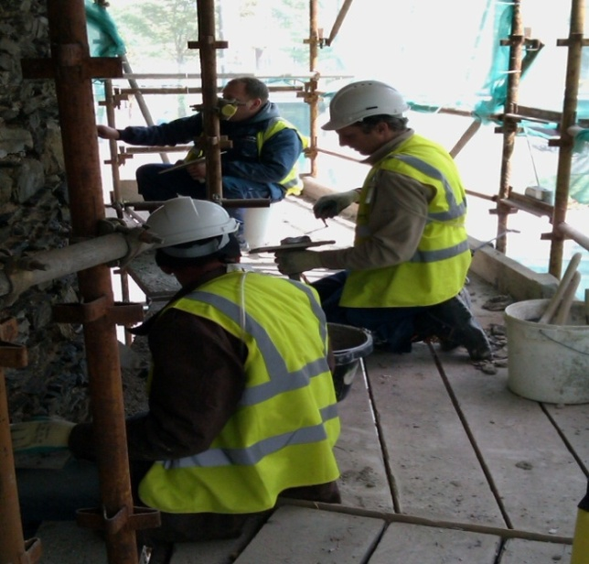
Training background
Exposure assessment
Workplace intervention
Technical intervention
Worker intervention
Notes:
Training – hazards associated with RCS, RPE, Tech inter

Slide 5
Training needs analysis
Questionnaire
Individual factors
Organisational factors
Notes:
Only administered to workers
(a) worker demographics; (b) self-reported use of a dust mask/other type of respiratory equipment and other exposure control devices while working with stone; (c) factors which influence worker use of exposure control devices (d) the worker’s perceived impact of stone dust on their respiratory health.

Slide 6
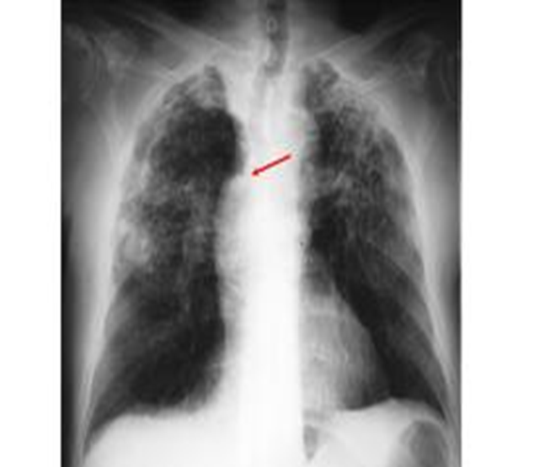
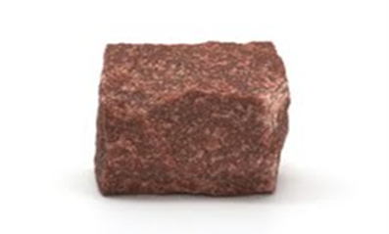
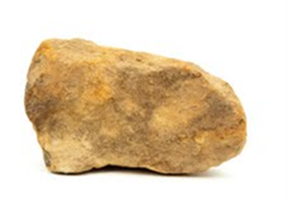
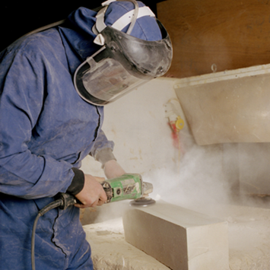
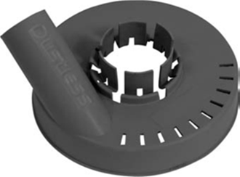
Training needs analysis
Specific adverse health outcomes
High silica content materials
High exposure tasks
Exposure controls
Notes:
Since social pressures were not found to have an influence on a workers choice to use exposure controls, it was not deemed beneficial to include in the training, an element on social pressure

Slide 7
Training design
Developed following the training cycle model (FETAC, 2013)
Occupational health and safety courses

Slide 8
Training methods
Instructor led training methods
Interactive methods
Multimedia clips
Visual aids
Notes:
Training material - Perception of risk,
Health effects
Practical skills/control measures
Appropriate training methods for each element of the training session were considered. Appropriate training methods for each element of the training session were considered. These included; instructor led training methods for example PowerPoint® presentation and use of a whiteboard and interactive methods such as quizzes, demonstrations, small group discussions and question and answer sessions.

Slide 9
Training methods
Notes:
Multimedia clip - Respirable dust can be invisible to the naked eye!
9

Slide 10
Training methods
Notes:
The purpose of this card was to supplement the training and carry home an information card that the workers could refer to with regards working safely with RCS dust.
All of the key messages from the training session.

Slide 11
Assessment and evaluation of learning
Questionnaire
Specific adverse health outcomes
High silica content materials
High exposure tasks
Exposure controls
Notes:
Administered questionnaire to assess knowledge transfer.
Contained questions on key aspects of the training and was administered to each worker individually followed by discussion of the answers in a group session
Assessment and evaluation of the training was applied through two methods; immediate and reaction.
The aim of the immediate assessment was to measure if the training delivered the learning objectives to the workers
The purpose of the reaction evaluation was to collect feedback from the workers via a training evaluation form

Slide 12
Conclusions
Learning objectives delivered
Multi media clips
Interactive group activities
Post intervention sampling/questionnaire
Notes:
Post inter – overall conclusion will be derived from this
Interactive group activities very effective at delivering important information, improving retention of information and creating interest and discussion around topic

Slide 13
Acknowledgements
The Commissioners of Public Works, Ireland
Stoneworkers, depot managers and foremen
Martie Van Tongeren, Laura MacCalman, Institute of Occupational Medicine, Edinburgh
Martina Kelly, College Engineering and Informatics NUIG
Victoria Hogan, Aoife Gavin, School of Health Sciences, NUIG

Slide 14
Thank You for your attention Questions? Catherine Healy School of Physics National University of Ireland, Galway. c.healy5@nuigalway.ie

