Slide 1
RCS – controlling exposure, managing risk, protecting health
Chris Keen CMFOH, BOHS President

Slide 2
Not a new problem !
Notes:
RCS dust is ubiquitous in many work environments
And it’s not a new problem – most industries with potential for significant RCS exposures have been established for centuries, millennia even
The health effects of RCS have been known for around 300 years, but it’s still a major cause of harm in the 21st century
All ill health related to occupational exposure to RCS is preventable
I believe that effective control solutions exist for almost any situation – the problem is that they aren’t being implemented properly

Slide 3
With its potential to cause progressive and permanent physical disability, silicosis continues to be one of the most important occupational health illnesses in the world.
Crystalline silica has been classified as a definite carcinogen (Group 1) causing lung cancer by the International Agency for Research on Cancer

Slide 4
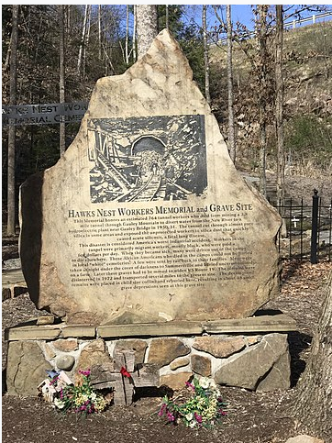
Hawks Nest Tunnel – USA 1927
Official deaths 476
Estimated deaths 1,000

Slide 5
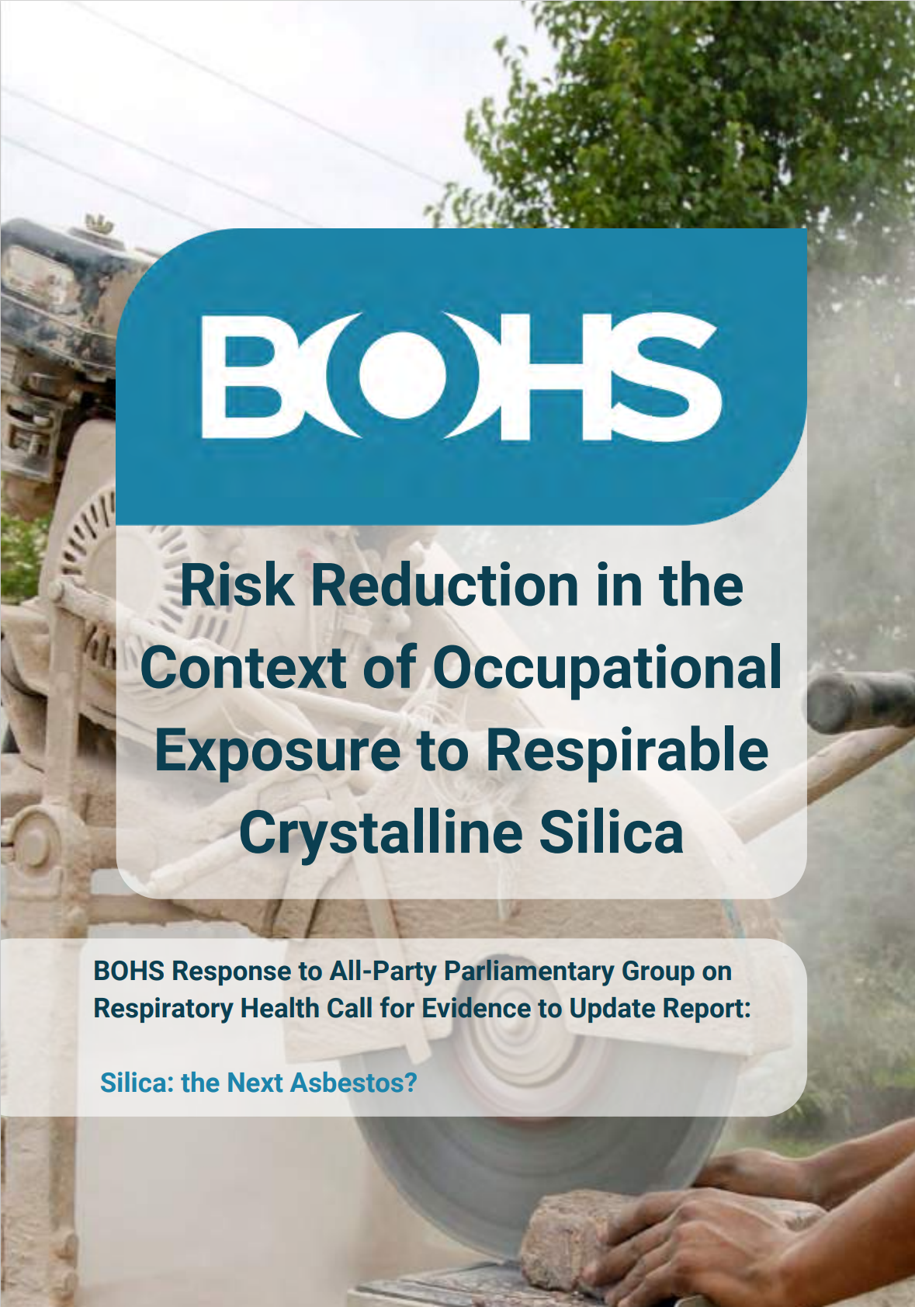
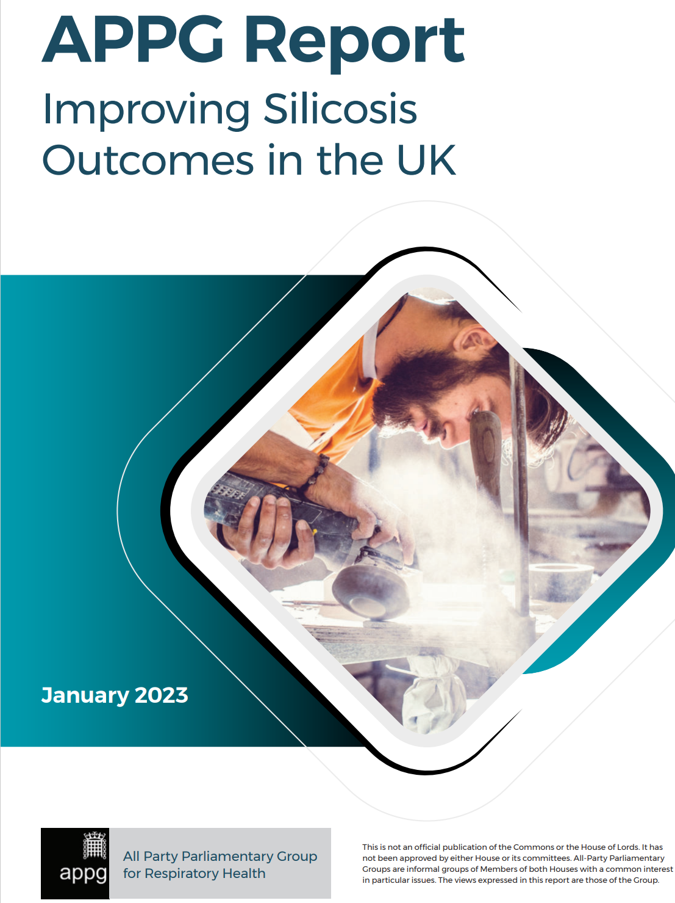

Slide 6
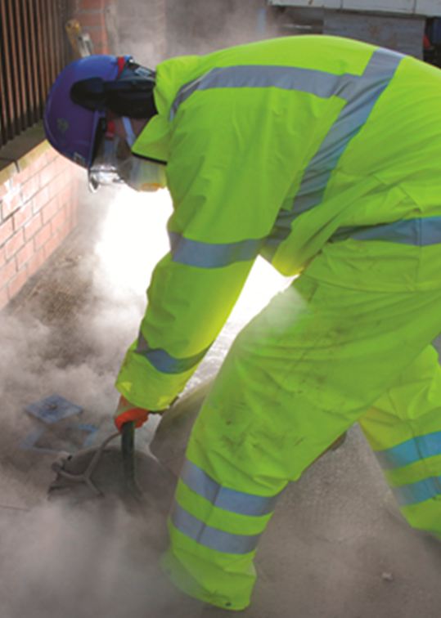
Construction
Notes:
RCS is a major component in many construction materials – bricks, stone blocks, concrete
Many activities generate airborne dust.
power tool use are commonplace – these generate a lot of very fine, respirable dust released in a very energetic way – can be very hard to control
High prevalence of RCS related ill health
Historically dust exposure seen as part of working in the industry – recent positive developments to tackle health issues in construction but it will need sustained, long term effort to change the culture in the industry.

Slide 7
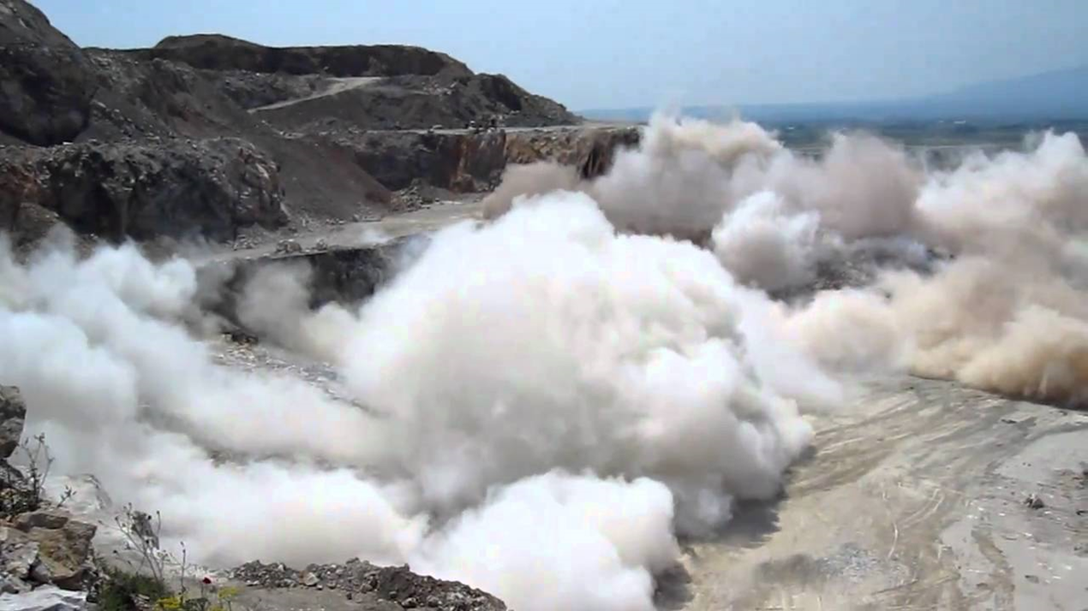
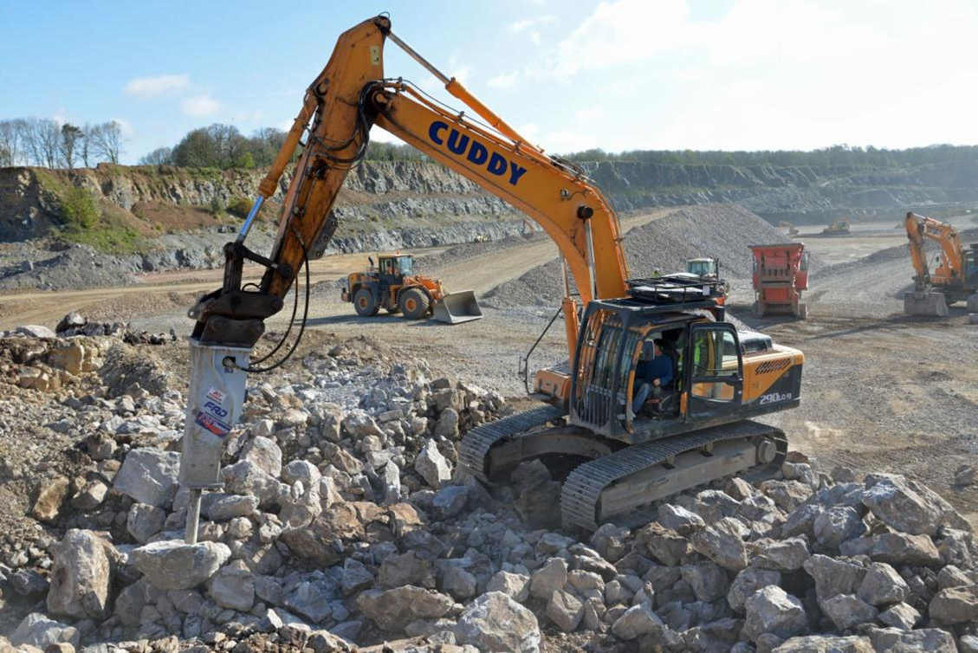
Quarries

Slide 8
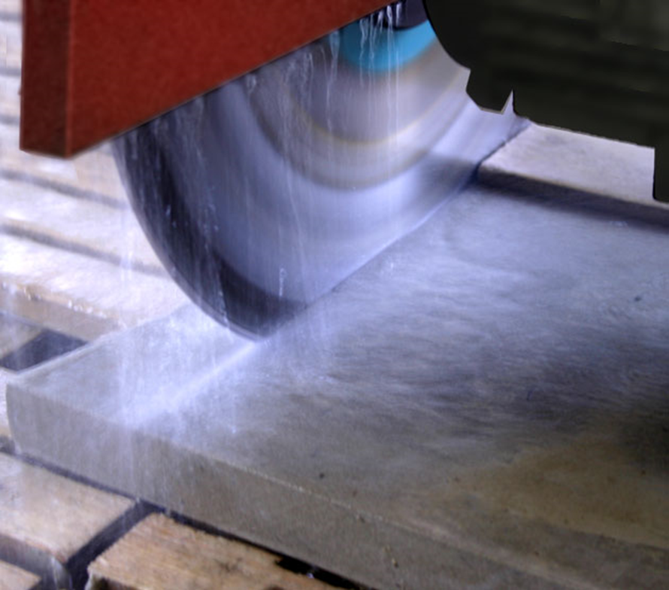
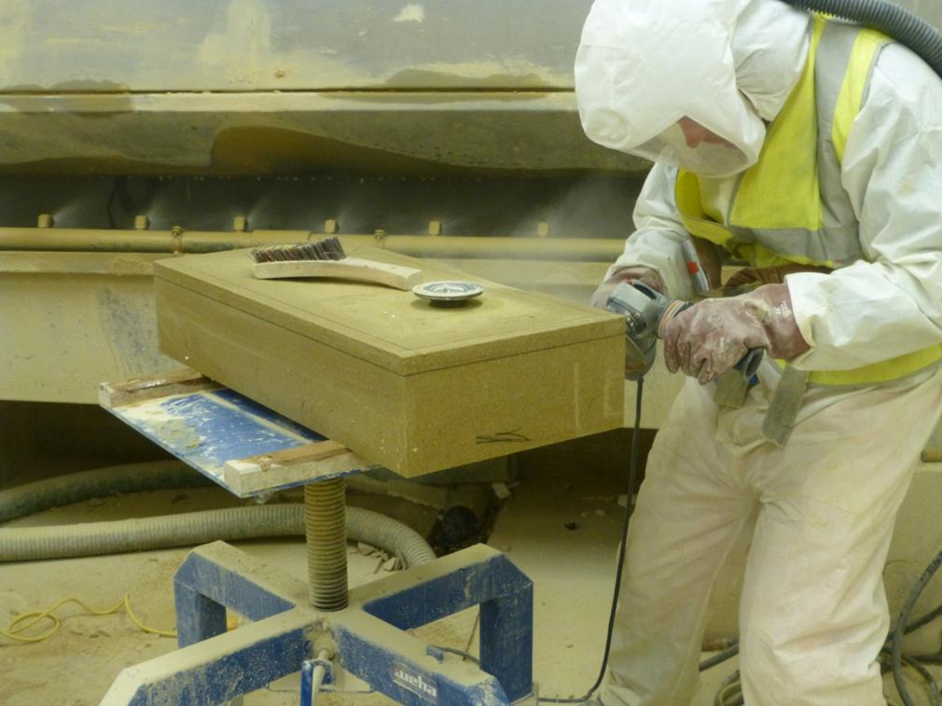
Stoneworks

Slide 9
Brickmaking
Exposure to Respirable Crystalline Silica in the GB Brick Manufacturing and Stone Working Industries, Baldwin et al, Annals of Work Exposures and Health, Volume 63, Issue 2, March 2019

Slide 10
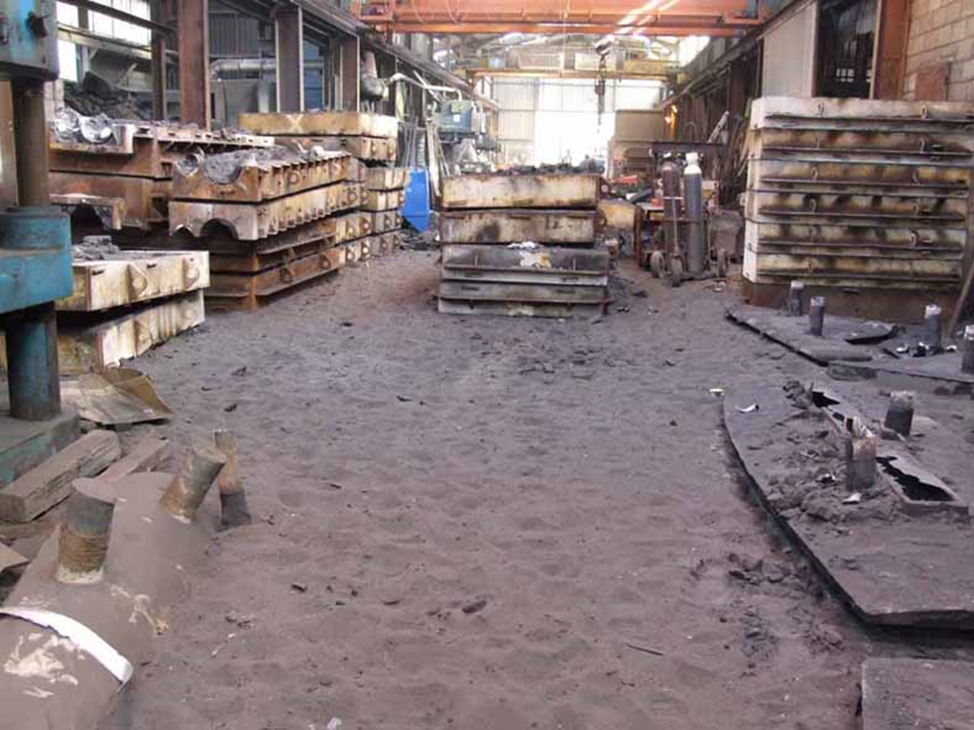
Foundries
Notes:
Foundries
Again, not as high risk as construction and stoneworking, but RCS risk still present
Silica sand used for mouldmaking – exposures in knockout, fettling, shotblasting and sand reclamation

Slide 11
Artificial Stone
A ‘new’ material
Responsible for numerous cases of acute/accelerated silicosis
VERY HIGH RISK !!

Slide 12
Legal Requirements - GB
Assess risk (Reg 6)
Prevent/control exposure (Regs 7 & 8)
Maintain controls (Reg 9)
Check efficacy (Regs 10 & 11)
Information instruction and training (Reg 12)
Notes:
Within UK, MHSW regs, COSHH and CDM all relevant.
As a hygienist, my main focus is on COSHH
Apply to all substances, including those without WEL, and process generated materials

Slide 13
Chemical Agents and Carcinogens Code of Practice 2021
RCS OEL – 0.1 mg/m³

Slide 14
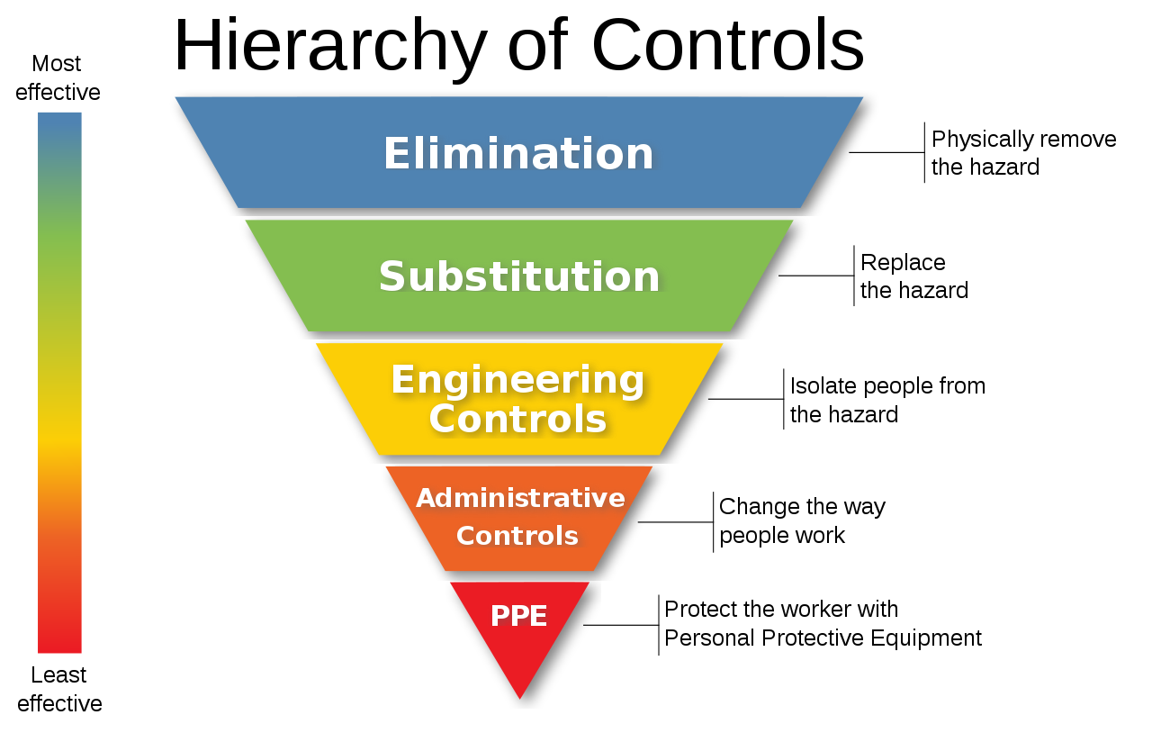
Good control practice
Notes:
Keep brief – will show examples on next slides
As we progress down the hierarchy controls become less robust and reliable

Slide 15
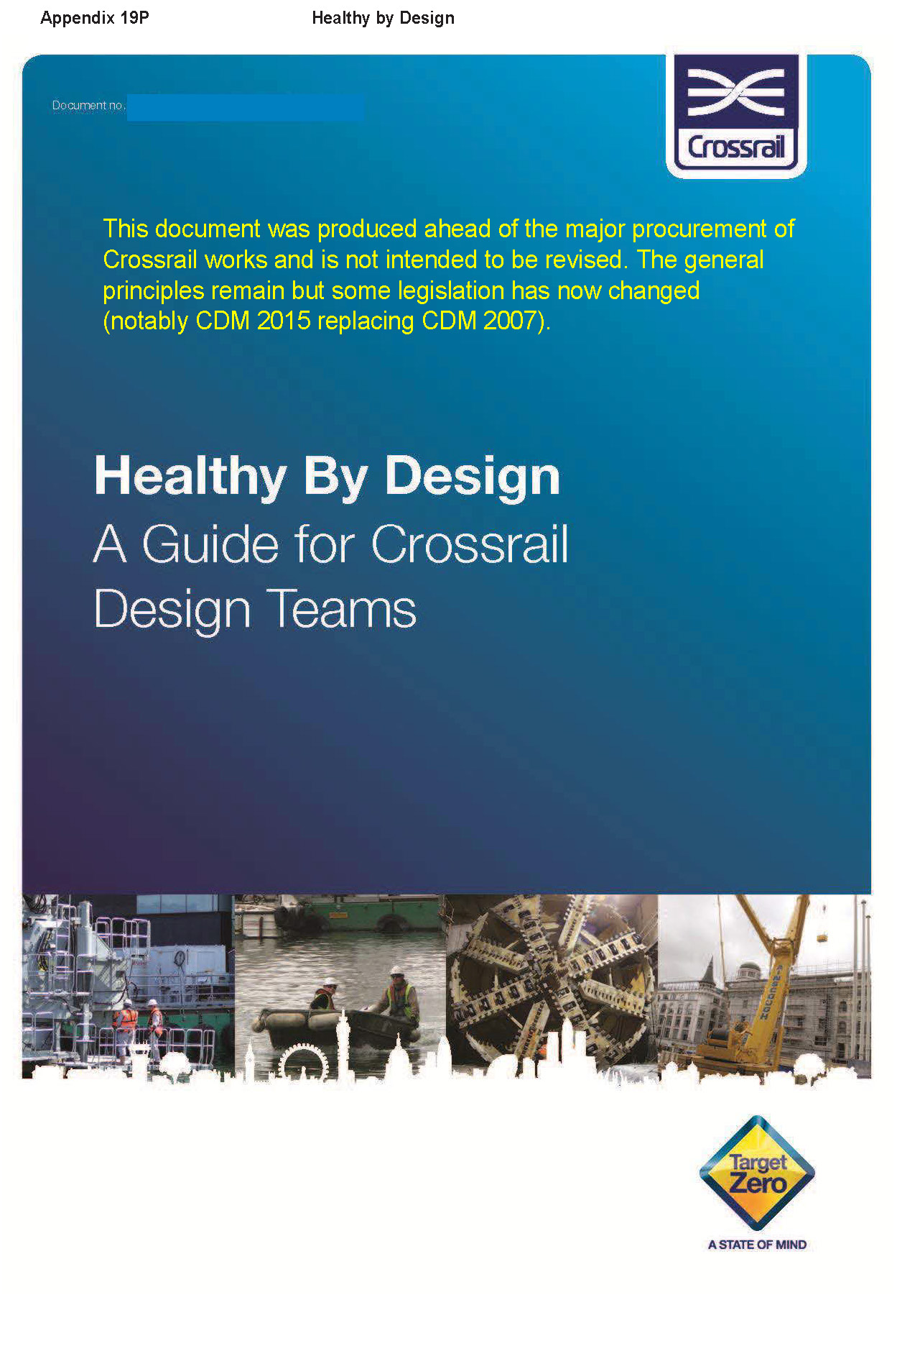
Elimination/substitution
Silica free alternatives
Lower silica content materials
Lower dust generating tools
Reduce numbers exposed by better work planning
Job rotation – NOT GREAT !!

Slide 16
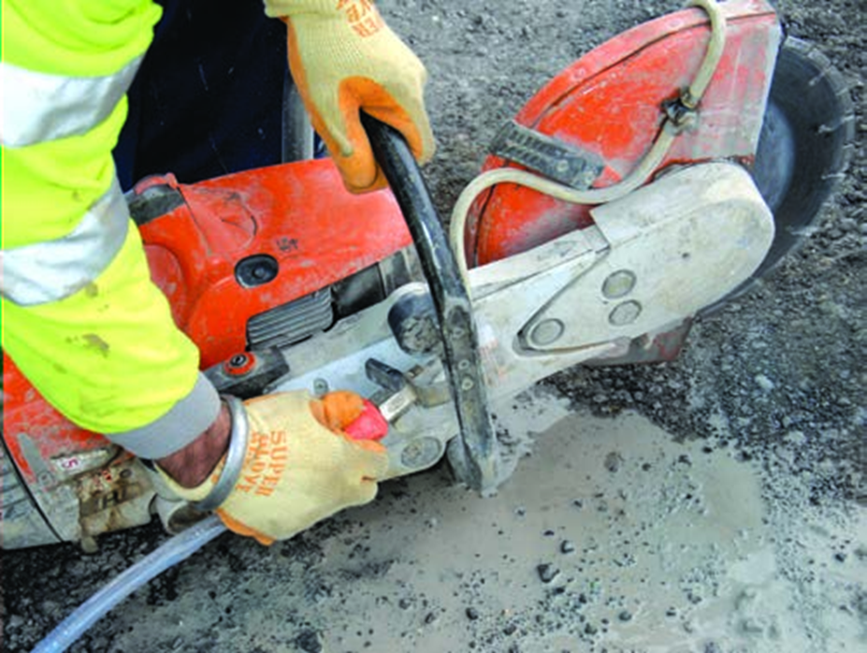
Engineering control – water suppression
Can reduce exposure by >90%
Cheap, (relatively) easy ?
Requires adequate water supply
May introduce other hazards
Notes:
If risks cannot be eliminated at design stage then engineering controls should play a part in most situations
Water suppression can be very effective for silica
Needs sufficient water supply to ‘drench’ the work area
Now common on large construction projects – less so in SMEs ?
Also applicable in stoneworking and brickmaking
Can introduce other risks – slip hazards, electrical safety

Slide 17
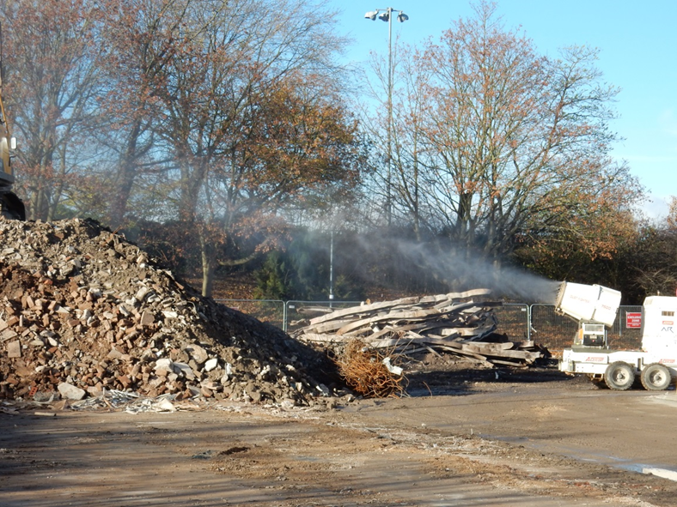

Slide 18
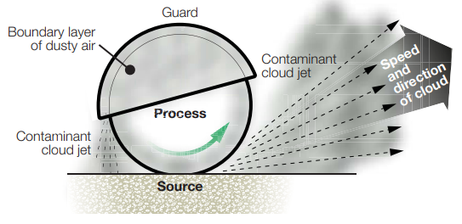
Engineering control - LEV
Notes:
LEV – common in manufacturing environments, less common in construction
The higher the energy of the dust release, the harder it is to capture
Try to design systems to take advantage of any ‘natural’ movement – correctly positioned receptor hoods can be effective
Users often over estimate the efficacy of LEV systems, and fail to maintain them properly

Slide 19
On-tool extraction
Notes:
Can be effective
Equipment for construction sector is developing quickly
Portable systems require effective filtration

Slide 20
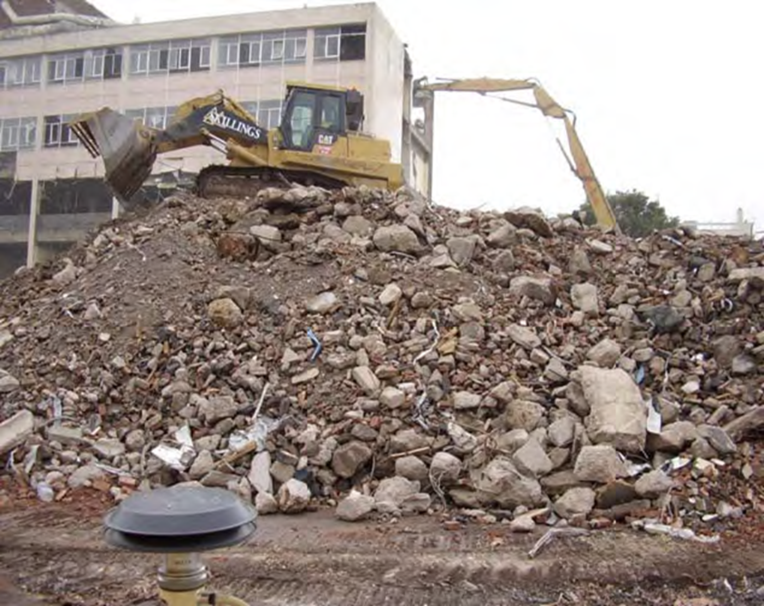
Engineering control – cab filtration
HSE Research Report RR1126 - In-cab air filtration in plant vehicles to control exposure to hazardous dust: quarry industry example
COSHH Essentials Guidance Sheet BK7
Notes:
Cab filtration can provide effective control if properly used and maintained
Often not recognised as exposure control, so not used and maintained properly

Slide 21
Engineering control
Design
Installation
Use
Maintenance
Notes:
Engineering controls can fail for a variety of reasons often fails due to a lack of thought, especially around the issues highlighted on the slide
Design – needs to be practical, consider the control challenge, operating environment and ergonomic issues. Many companies don’t have the competence to design front end (hood etc) properly
Installation – commissioning is essential – not good enough to just assume that a control measure is effective – exposure measurement may be needed
Use – workers need to know how to operate controls properly, and how they can fail. Supervision does have a role to ensure that controls continue to be used properly (or even used at all)
Maintenance – planned, preventative maintenance essential, like all other equipment – for LEV to include 14 monthly TExT and regular user checks

Slide 22
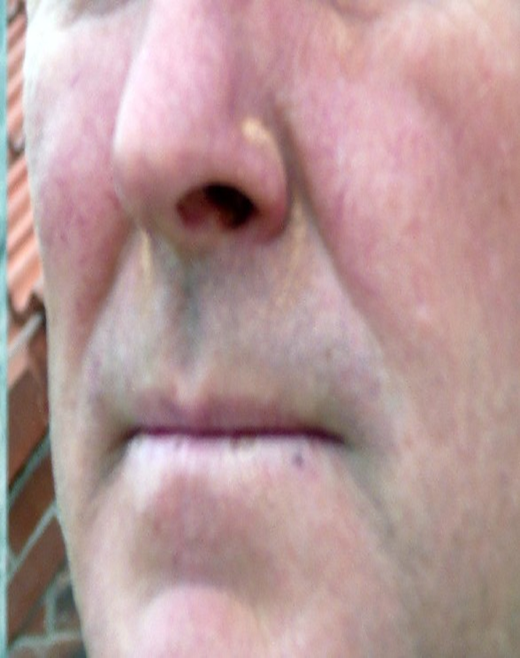
PPE – the last line of defence
Numerous failure modes – always fails to danger
Can introduce other risks :
Heat stress
Communication
Compatibility
Useful reference : HSE publication HSG 53. Respiratory protective equipment at work, A practical guide.
Notes:
Not acceptable to rely on RPE alone for control of RCS
But RCS still has an important part to play in controlling residual risk

Slide 23
RPE Programme - Steps
Risk Assessment
Justify use
of RPE
Storage
Training
Correct
RPE Selection
Cleaning
Competent
Records
Supervision
Maintenance
Use
Review

Slide 24
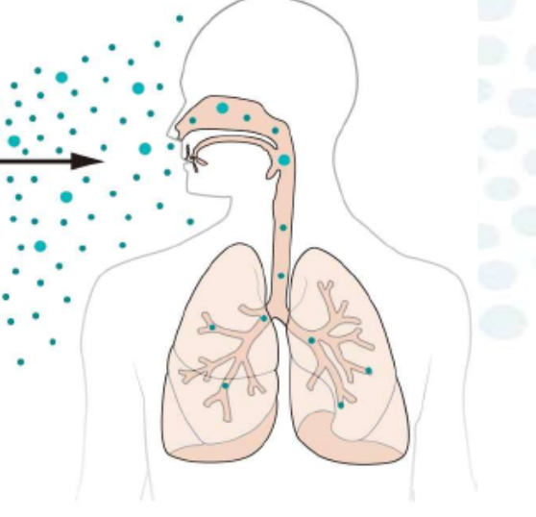
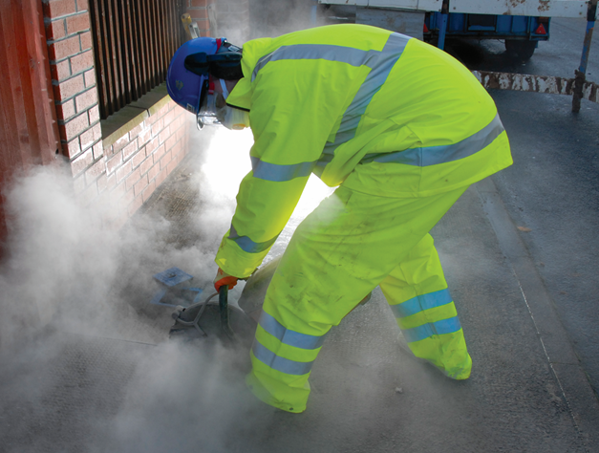

Slide 25
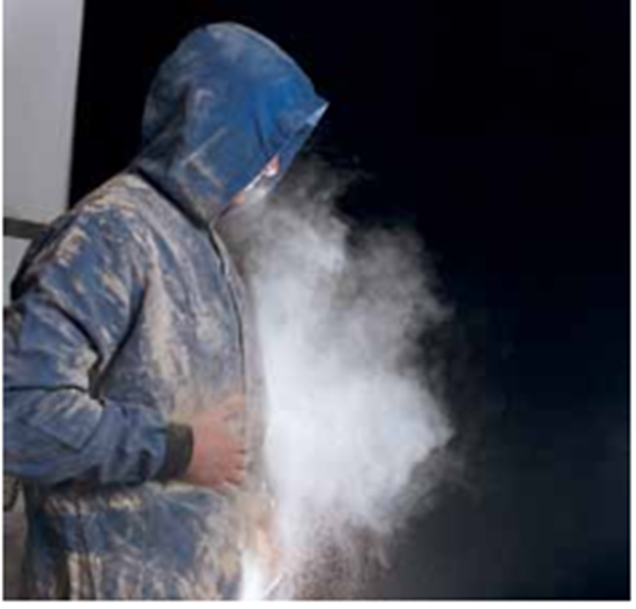
Don’t forget about this !
Notes:
RPE worn for power tool use but whole area, including clothes, become heavily contaminated – worker will be constantly exposed while wearing these overalls and there is potential to spread contamination outside the workplace – into canteen areas etc., even workers cars and homes, exposing others
Exposure can be > WEL just from wearing overalls that are as heavily contaminated as this
Mention dust lamp Backlight with Tyndall beam
Cheap models available from £30, slightly better (Cluson) ~ £120
Makes the ‘invisible’ visible – very useful for demonstrating exposure potential to workers
Highlights process emissions

Slide 26
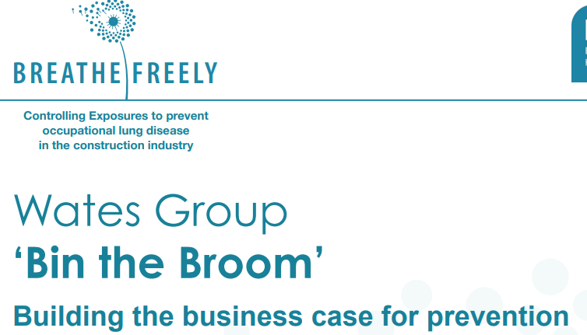

Slide 27
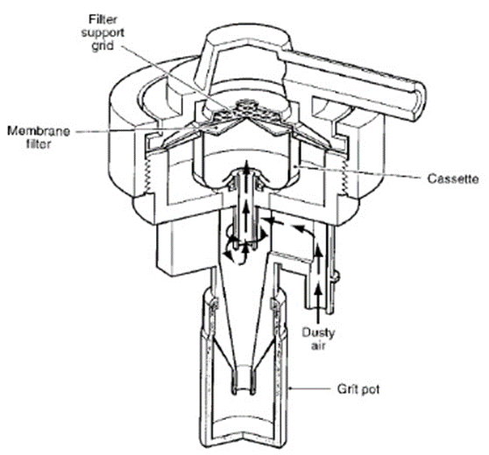
Exposure Monitoring
RCS WEL = 0.1 mg/m3 (8 hr TWA) – NOT a ‘safe’ limit
Must still apply principles of good control practice
Not good practice to control exposures up to a limit
NOT A SUBSTITUTE FOR GOOD CONTROL

Slide 28
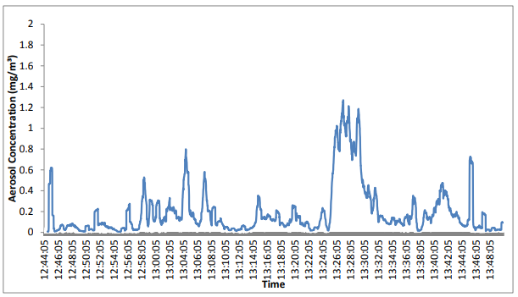
Real time monitoring
Notes:
Non specific detection systems for respirable have been around for many years – they don’t measure RCS directly and require calibration via parallel sampling with validated reference method. Instruments exist which are suitable for use as personal monitors.
That said, these systems are potentially useful for understanding exposure patterns, identifying high risk activities to focus control improvements – but so is observation and use of a dust lamp.
Effective use of these instruments requires occupational hygiene expertise.
Real time RCS specific systems are a new development – unproven accuracy, and not yet developed for personal monitoring
On-site end of shift analysis of filter samples using validated laboratory methodology is now possible
Methods exist to improve analytical limit of detection, either by increasing sample size (high volume respirable sampler) or analytical modifications to concentrate filter deposit into a smaller area

Slide 29
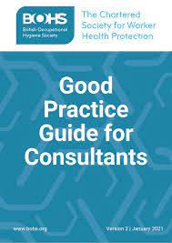
Competence
Being competent to perform monitoring is not the same as being competent to design a monitoring program, interpret results or design and implement effective exposure control strategy – these require specialist occupational hygiene expertise
Notes:
BOHS accreditation, Licentiate of chartered hygienist is guarantee of quality
List of accredited consultants on BOHS website
Given the consequences of failure to control exposure, it is vital to get the exposure monitoring right
Feedback to participants, with interpretation
Maintain records for 40 years
Results should stimulate action :
revise risk assessment
improve controls
decide on need for future monitoring
Exposure monitoring is a means to an end – keep this in mind – it is not a box ticking exercise.
Results give us important information about adequacy of controls
Should be kept in mind when conducting HS
Look for time trends

Slide 30
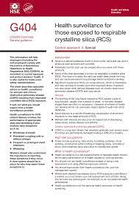
Health surveillance
Notes:
Again, not an exposure control in itself
GB Legal requirement for RCS exposed workers
As with monitoring, and all other aspects of risk management discussed, needs competence

Slide 31
Involve the workers
Information, instruction and training is VITAL for achieving adequate control
Workers need to know how to use controls, how to identify that they are working properly, and what to do if they aren’t
Notes:
A vital part of controlling exposures, often overlooked
Workers need to be aware of the risk, when and how to use controls, how to know when controls are not operating effectively

Slide 32
Summary
Elimination of RCS isn’t a practical option
Notes:
But that shouldn’t stop us from thinking about health by design, designing out risk, and at least opting for lower silica content materials and less dusty processing methods, also reducing numbers exposed by better segregation of high risk work

Slide 33
Summary
Effective control usually relies on a combination of measures

Slide 34
Summary
Consider hierarchy – do not default to RPE

Slide 35
Summary
Vital to involve workers in designing control strategy

Slide 36
Summary
Consider all tasks, (maintenance, cleaning) - not just production

Slide 37
Summary
All controls require maintenance

Slide 38
Summary
Inform, instruct and train workers

Slide 39
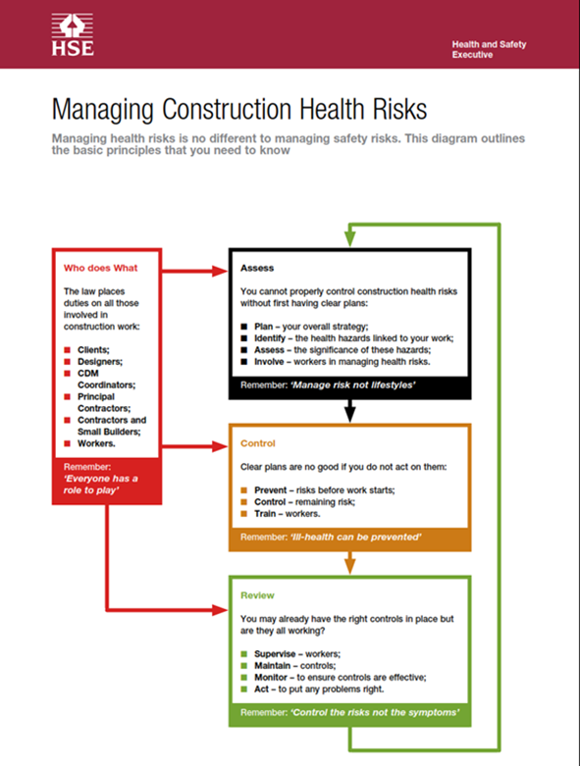
Further Information
Notes:
Lots of top quality guidance available
HSE Construction pages have guidance on managing risk, plus specific advice on controlling hazardous substances, not just silica, plus physical risks such as N&V and manual handling
CE has task specific guidance sheets on controlling silica for different activities in all high risk sectors
Other organisations also providing good quality guidance, including BOHS and NEPSI
Some resources on slide – there will be lots of others – but these are not being implemented effectively in high risk sectors
Tool manufacturers and PPE suppliers can provide useful information
Occupational hygienist best placed to help – take holistic approach to control

Slide 40
Thankyou for listening
president@bohs.org

