Slide 1

Chemical Protective Clothing
Paul Bryce, Technical Director
Microgard Ltd

Slide 2
Topics
European Directive 89/686/EEC - “The PPE Directive”
Certification of PPE
European Chemical Protective Clothing “Types”
Selection of Chemical Protective Clothing
Correct Wearing of Chemical Protective Clothing

Slide 3

European Directive 89/686/EEC
– “The PPE Directive”
The PPE Directive applies to Personal Protective Equipment (PPE) intended for use in domestic, leisure and sports activities, as well as for professional use.
The objectives of the PPE Directive are:
to provide the Basic Health & Safety Requirements which the PPE must satisfy to preserve the health and ensure the safety of intended users;
to ensure free movement of PPE within the Community
The PPE Directive does not cover;
The Use of PPE – Directive 89/656/EEC applies
Health & Safety at Work – Directive 89/391/EEC applies
The PPE Directive is a “New Approach” Directive
laying down Basic Health and Safety
Requirements (BHSRS) and leaving it to standards,
primarily European harmonised standards,
to give technical expression of the relevant requirements
contained in the directive.
Notes:
The PPE directive sets out the manufacturers obligations and that of member states with regards to market surveillance. The use of PPE and the health & safety of workers is covered in other directives
The PPE directive is a “New Approach” directive laying down Basic Health and Safety
Requirements (BHSR) and leaving it to standards, primarily European harmonised standards,
to give technical expression of the relevant requirements contained in the directive.

Slide 4
What is PPE?
Basic Health & Safety Requirements (BHSRs)
PPE must provide adequate protection against all risks encountered
Principles of design
  Ergonomics
  Highest level of protection possible
  Classes of protection appropriate to different levels of risk
Innocuousness of PPE
  Designed and manufactured as to preclude risks and other nuisance factors under
  foreseeable conditions of use
  PPE materials and parts must not adversely affect user hygiene or health
  Must be free of roughness, sharp edges etc.
  Maximum permissible user impediment
Comfort and efficiency
  Adaptation of PPE to the user morphology
  Lightness and design strength
  Compatibility of different classes or types of PPE
Information supplied by the manufacturers

Slide 5
What is PPE?
- Additional Requirements for Chemical Protective Clothing
Article 3.10 Protection against dangerous substances and infective agents;
Article 3.10.2 Protection against cutaneous and ocular contact
“PPE intended to prevent the surface contact of all or part of the body
with dangerous substances and infective agents must be capable of
preventing the penetration or diffusion of such substances through the
protective integument under the foreseeable conditions of use for which
the PPE is placed on the market”

Slide 6
Certification of PPE - Categories of PPE
Categories | Description | Definition | Requirements
Category I | “Simple Design” | Minimal risk e.g. cleaning materials of weak action and easily reversible effects | Self certification Self assessment of production
Category II | “Neither simple or complex” | Intermediate risk e.g. protection against mechanical impact | EC-Type Examination by a notified body EC Declaration of Conformity Self assessment of production
Category III | “Complex Design” | Mortal risk e.g. worn or used in situations where there is a risk of mortal danger or irreversible harm | EC-Type Examination by a notified body Notified body assessment of production (Article 11A or 11B) EC Declaration of Conformity
Clothing for protection against hazardous substances are designated as Category III PPE

Slide 7

Certification of PPE – CE Marking
Category I
(Simple Design)
Category II
Category III
(Complex Design)
Technical Documentation
EC Type-Examination
EC quality control system for the final product
Production quality monitoring system
EC Declaration of Conformity
XXXX

Slide 8
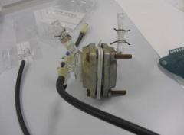
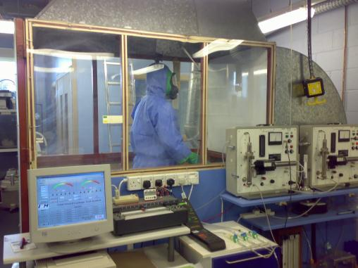
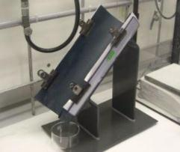
European CPC Standards and Test Methods

Slide 9
European PPE Testing
- What is covered?
Innocuousness. To ensure that no harmful, forbidden or restricted substance is used in product construction, as well as checking for sharp edges or injurious surfaces.
Ergonomics. Design, comfort, fit. Can the wearer carry out the required activity comfortably?
Protective coverage. Adequate coverage to provide sufficient protection
Protective qualities. Impact, abrasion, cut, chemical and thermal resistance
Marking and instructions
  Manufacturers name and address
  Storage/ cleaning/ maintenance
  Protective performance level
  Suitable accessories/spare parts
  Relevant warnings
  Type approval Notified Body details
The European standard which covers the “general requirements” for protective clothing is EN 340: 2003

Slide 10
“Types” of Chemical Protective Clothing
TYPE 1
EN 943-1/2
TYPE 2
EN 943-1
Gas-Tight protection against liquids, gases & solid particulates
non-gas-tight protection against liquids, gases & solid particulates
TYPE 3
EN 14605
TYPE 4
EN 14605
Protection against strong & directional jets of liquid
Protection against saturating spray of liquids
TYPE 5
EN ISO 13982-1
TYPE 6
EN 13034
Protection against solid particulates
Limited protection against liquid spray/splash
© Microgard Ltd 2011
Notes:
The six “types” offer an indication of the performance of the product to protect against one or more chemical hazards in various states, be it vapour, liquid or particulate. Conformance to one or more of these types indicates that a garment has met the minimum requirements set by the product performance standard. Users have to be aware though that there can significant performance differences between different products, even though they are certified to the same “type”.

Slide 11
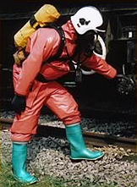
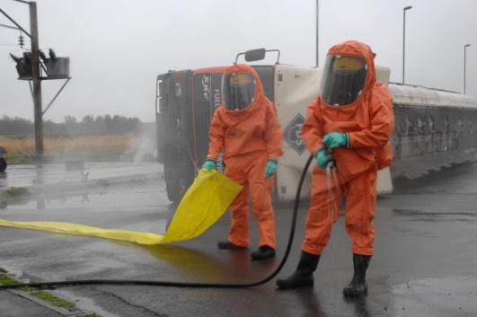
EN 943 – TYPE 1 Gas tight protective clothing
– suits are intrinsically sealed against the environment

Slide 12
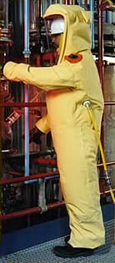
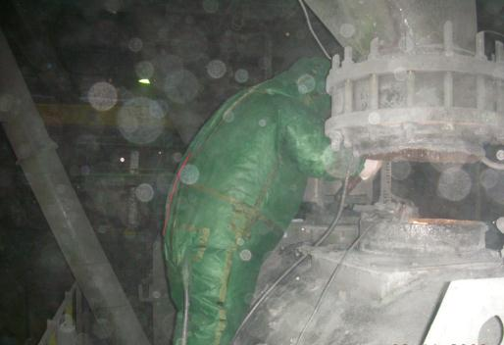
EN 943 – TYPE 2 Non-gas tight (positive pressure) protective clothing – suits which retain a positive internal pressure to prevent ingress of dusts, liquids or vapours

Slide 13
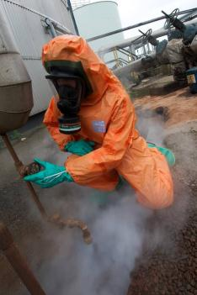
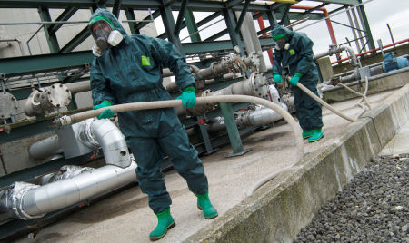
EN 14605 – TYPE 3 Liquid tight protective clothing
- Suits which can protect against strong and directional jets of a liquid chemical.

Slide 14
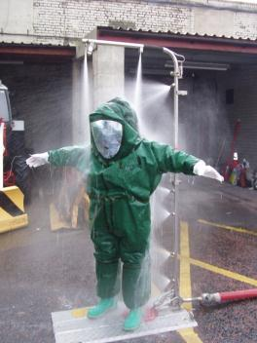
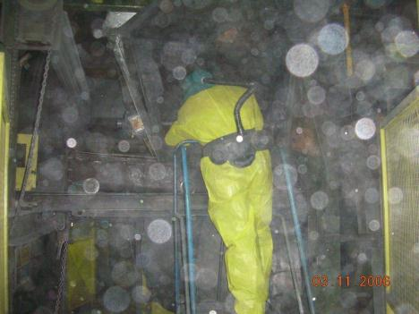
EN14605 / ISO 16602 – TYPE 4 Spray tight protective clothing
- Suits which can protect against saturation of liquid chemicals where volume
of the liquid builds up on the suit, causing pools and rivulets

Slide 15
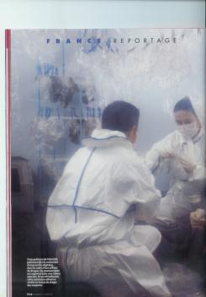
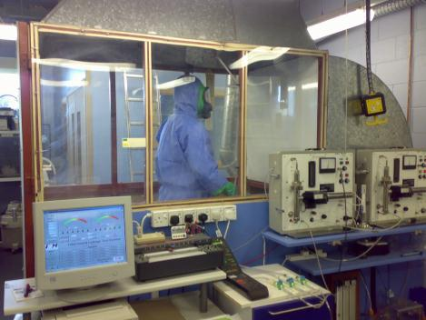
EN ISO 13982-1 – Type 5 Protection against solid particulates
- Suits for protection against hazardous dusts and dry particles

Slide 16

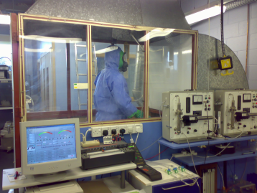
Whole Suit Requirements
Type 5 Inward Leakage Test
Test Method: EN ISO 13982-2
Test substance: Sodium Chloride Aerosol
Particle size range: 0.06 to 2µm (0.6 average)
Key test parameters;
  10 wearers (10 coveralls)
  Standing still, walking and squatting
  3 probes inside suit (chest, waist, knee)
  continually measuring the ratio of particle
  concentration inside and outside the suit
Test Duration: 9 min standing, 9 min walking and 9 min squatting
Pass Criteria: 82 of 90 measurements ≤30%, 8 of 10 coveralls total inward
leakage (average) ≤15%
EN ISO 13982-1
Notes:
Basic principle: Sodium Chloride (salt) particules are flooded into the chamber and measurements taken inside & outside of the suit during various exercises including standing still, walking & squatting.
A total of 90 measurements are taken from 10 wearers (i.e. 10 suits) at the chest, waist and knee. For the suits tested, 8 out of the 90 measurements are allowed individual leakages greater than 30% but the Total Inward leakage (TIL), or average, for 8 of the 10 suits must be less than or equal to 15% !! Hence our expression that “there and Type 5 suits and then there are Type 5 suits!”
Particle size within the test chamber ranges from 0.06 to 2 microns, with a mean/average of 0.6 microns

Slide 17
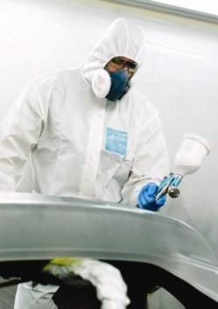

EN13034 / ISO 16602 – Type 6 Reduced spray protection
- Suits for protection against light spray and splashes of liquid chemicals

Slide 18

PPE Directive 89/686/EEC
Category III – Complex Design
EN340: 2003 Protective Clothing General Requirements
EN 943-1: 2002
Type 1
EN 943-1: 2002
Type 2
EN 14605: 2005
Type 3
Article 11A or B
Manufacturer
Assessment & Certification
EN 464
Leak Tightness
EN 943-1, Annex A
Inward Leakage Test
EN ISO 17491-3
Jet Spray Test
EN 943-1, Annex A
Inward Leakage Test (Type 1b* & 1c)
Article 10
Product EC-Type Examination Certificate
EN 943-1: 2002
Test methods and performance classification**
EN 14325: 2004
Test Methods and performance classification of chemical protective clothing materials, seams, joins and assemblages
EN530
Abrasion Resistance
EN530
Abrasion Resistance
EN530
Abrasion Resistance
Manufacturers EC Declaration of Conformity
EN ISO 7854
Flex Cracking Resistance
EN ISO 7854
Flex Cracking Resistance
EN ISO 7854
Flex Cracking Resistance
EN ISO 9073-4
Trapezoidal Tear Resistance
EN ISO 9073-4
Trapezoidal Tear Resistance
EN ISO 9073-4
Trapezoidal Tear Resistance
EN ISO 13934-1
Tensile Strength
EN ISO 13934-1
Tensile Strength
EN ISO 13934-1
Tensile Strength
XXXX
EN 863
Puncture Resistance
EN 863
Puncture Resistance
EN 863
Puncture Resistance
EN 374-3 / ISO 6529
Chemical permeation resistance
(Materials & Seams)
EN 374-3 / ISO 6529
Chemical permeation resistance
(Materials & Seams)
EN 374-3 / ISO 6529
Chemical permeation resistance
(Materials & Seams)
ISO 13935-2
Seam Strength
ISO 13935-2
Seam Strength
ISO 13935-2
Seam Strength
© Microgard Ltd 2008. All Rights Reserved
Notes:
To carry the CE mark, under Category III of the European PPE Directive (EU Regulation 89/686/EEC), Chemical Protective Clothing in most cases will conform to one or more of the “Type” standards. As shown on the previous slide there are 6 types in total. Microchem’s expertise for the moment focuses on liquid and particulate chemical hazards, in other words Types 3, 4, 5 and 6
Note: European standards are a recipe for proving that a product conforms to the basic health & safety requirement of the European PPE directive. Conformance to standards is not the only way of proving compliance….
This slide sets out the test methods within each of these “Types”. Fundamentally, conformance to one or more of these types ensures that;
Products are made in accordance with the highest quality standards
Product are correctly identified and labelled (instructions for use documentation to be provide with the smallest commercial sales unit, i.e. each coverall, is a legal requirement!)
Products meet or exceed the minimum performance requirements for physical performance and chemical barrier specified within the “Type” standard
And finally, this system provides a common means for the comparison of product performance across different products and manufacturers
(no one can pick a different test method just because it suits their product!!)
*Type 1b suits are only subjected to the inward leakage test of the face mask is not permanently joined to the suit
** EN 942 is out of sync with the other “Type standard” in that the test methods and performance classifications are specified within the standard and not referred to EN 14325
Note: the inward leakage test for Type 1b, 1c and 2 suits is virtually the same as EN ISO 13982-2 (for Type 5 suits) only there is the option within EN 943 to use Sulfur Hexafluoride gas instead of sodium chloride particles in the inward leakage is measured from directly in front of the wearers mouth (EN ISO 13982 the measurements are taken from the chest, waist and knee). Also, the limit for inward leakage is set at “not greater than 0.05%” which is much more stringent than for Typ3 5 suits as we will discover later…

Slide 19
PPE Directive 89/686/EEC
Category III – Complex Design
EN340: 2003 Protective Clothing General Requirements
EN 14605: 2005
Type 4
EN ISO 13982-1: 2004
Type 5
EN13034: 2005
Type 6
Article 11A or B
Manufacturer
Assessment & Certification
EN ISO 17491-4, Method B Spray Test
EN ISO 13982-2
Inward Leakage Test
EN ISO 17491-4, Method A
Reduced Spray Test
EN14325: 2004
Test Methods and performance classification of chemical protective clothing materials, seams, joins and assemblages
EN530
Abrasion Resistance
EN530
Abrasion Resistance
EN530
Abrasion Resistance
Article 10
Product EC-Type Examination Certificate
EN ISO 7854
Flex Cracking Resistance
EN ISO 7854
Flex Cracking Resistance
EN ISO 9073-4
Trapezoidal Tear Resistance
EN ISO 9073-4
Trapezoidal Tear Resistance
EN ISO 9073-4
Trapezoidal Tear Resistance
Manufacturers EC Declaration of Conformity
EN ISO 13934-1
Tensile Strength
EN ISO 13934-1
Tensile Strength
EN 863
Puncture Resistance
EN 863
Puncture Resistance
EN 863
Puncture Resistance
EN 374-3 / ISO 6529
Chemical permeation resistance
(Materials & Seams)
ISO 6530
Chemical penetration/repellence
XXXX
ISO 13935-2
Seam Strength
ISO 13935-2
Seam Strength
ISO 13935-2
Seam Strength
© Microgard Ltd 2008. All Rights Reserved
Notes:
The previous two slides can also serve as a checklist to spot potentially non-conforming/illegal product, since each of the test methods listed (excluding EN 14325 / EN 340) should be referenced on the product user instructions. This is in addition to the CE XXXX mark, reference to the Type standards (including the year of the standard) etc.

Slide 20

So what product should I choose…..???

Slide 21
The Use of Personal Protective Equipment
Questions to ask before considering PPE
Can I get rid of the hazard altogether?
If not, how can I control the risks so that harm is unlikely?
Controlling risks – options;
Try a less risky option, e.g. use alternative chemicals
Prevent access to the hazard, e.g. by guarding
Organise work to reduce exposure to the hazards, e.g. automatic rather than manual transfer of hazardous substances
If after all of the above there is still residual risk, then PPE will need to be provided
RISK = (Probability of an accident occurring) x (expected loss in case of an accident)

Slide 22
The Use of Personal Protective Equipment
Assessing suitable PPE
Questions to ask when assessing PPE suitability
Is it appropriate for the risks involved and the conditions at the place where exposure to the risk may occur?
Does it prevent or adequately control the risks involved without increasing the overall level of risk?
Can it be adjusted to fit the wearer correctly?
Has the state of health of those who will be wearing it been taken into account?
What are the needs of the job and the demands it places on the wearer?
If more than one item of PPE is being worn, are they compatible?

Slide 23
The Use of Personal Protective Equipment
Directive 89/656/EEC
ARTICLE 3
Identify & evaluate the risks
Use where the risks cannot be avoided or limited technically
Only use PPE products as a final protection alternative
ARTICLE 4
Ensure the PPE conforms with EU Regulations
Inform the user of the risk
involved and train them about the right use of
the PPE
Supply PPE free of charge
that is :
- fit for purpose and of
appropriate size and comfort
Define the conditions of use, especially the period
the PPE is worn
ARTICLE 5
Assess whether the item(s)
of PPE conform with EU
Regulations
Analyse and assess the
risks involved
Define characteristics the
PPE must have and compare
with the PPE selected
Reanalyse the risk in case of
a process change
These are the obligations of the employer!

Slide 24
Selection of Chemical Protective Clothing
- Seven Key Factors
Can the job be done without chemical protective clothing?
The type of exposure most likely to occur?
  Immersion (continuous or intermittent)
  Spray (pressurised or not)
  Splash (continuous, intermittent, or not expected)
  Mist (continuous or intermittent)
  Vapours (Gaseous contact)
What are the adverse effects of contact with the chemical?
The physical demands on the suit?
The chemical resistance properties required?
The human factors? (i.e. ergonomics, wear ability, heat stress etc)
The cost in use?

Slide 25
The six “types” offer an indication of the protective performance of the product ……
TYPE 1
EN 943-1/2
TYPE 2
EN 943-1
Gas-Tight protection against liquids, gases & solid particulates
non-gas-tight protection against liquids, gases & solid particulates
TYPE 3
EN 14605
TYPE 4
EN 14605
Protection against strong & directional jets of liquid
Protection against saturating spray of liquids
TYPE 5
EN ISO 13982-1
TYPE 6
EN 13034
Protection against solid particulates
Limited protection against liquid spray
© Microgard Ltd 2011
Notes:
The six “types” offer an indication of the performance of the product to protect against one or more chemical hazards in various states, be it vapour, liquid or particulate. Conformance to one or more of these types indicates that a garment has met the minimum requirements set by the product performance standard. Users have to be aware though that there can significant performance differences between different products, even though they are certified to the same “type”.

Slide 26
MICROGARD®
CPC Selection
Process Flow
Perform a Risk Assessment
Identify the chemical hazard
Determine potential for exposure
Determine exposure consequence(s)
Skin Protection Required?
No
Chemical Protective Clothing may not be required
Yes
Consider Type 5
Note: for higher concentrations of fine particulates a positive pressure suit (i.e. Type 2, PAPR or Air-fed should be considered)
Liquid, Gas or
Particulate
Particulate
Gas
Consider Type 1 or 2
and Permeation data
Liquid
Risk of vapour exposure at hazardous concentrations?
Yes
Consider Type 1 or 2
and Permeation data
No
Exposure to liquid expected?
Liquid under pressure?
Chemical Protective Clothing may not be required
No
Yes
Yes
Consider Type 3
and Permeation data
No
More than light spray expected?
Liquid classified as harmful, carcinogenic or otherwise toxic?
Yes
Consider Type 4
and Permeation data
Yes
No
Consider Type 4
and Penetration data
No
Light spray,
splash or aerosol
Liquid classified as harmful, carcinogenic or otherwise toxic?
Yes
Consider Type 4 or 6
and Permeation data
Yes
No
Consider Type 6
and Penetration data
Notes:
Important note: This guide is simplified and as such a chemical Protective clothing’s suitability for a particular use should only be determined by a trained expert in occupational health & safety. In accordance with the PPE at Work regulations the responsibility for selecting the correct PPE remains that of the employer.
Guidelines/ international standards to consider when utilising this flowchart:
NFPA 1992 – Liquid Splash Protection (utilises penetration under pressure ASTM F 903/ISO 13994 testing)
Clause 1-1.4 This standard shall not apply to protective ensembles or clothing for hazardous materials emergencies involving known or suspected carcinogens, hazardous materials with known skin toxicity, or hazardous material vapor atmospheres
EN 943-2 – Performance Requirements for “Gas-Tight” (Type 1) chemical protective suits for emergency teams
Clause 5.2 If Class 2 (>30mins normalised breakthrough time at 1.0ug/cm2/min) is not achieved for any material or component part tested the instructions for use shall identify that this chemical protective suit is not suitable for use with this chemical under continuous exposure
PD CEN/TR 15419: 2006 Protective clothing — Guidelines for selection, use, care and maintenance of chemical protective clothing
Breakthrough times should be considered as an indication of the resistance of materials to diffusive permeation, not as real use times. Real use times depend on a lot of other factors, e.g. temperature, movements, pressure etc.
- Although class 6 performance is to be preferred, fabrics that only achieve class 2 or 3 may still give adequate protection, provided that any surface contamination is washed off the garment promptly and that no gross chemical degradation is apparent.
3.6.2.1 General
These tests intend to assess the barrier properties of materials against the ingress of chemicals by a diffusive molecular process (permeation test) or through small openings in the material (penetration test). The permeation test is performed on air-impermeable materials, whereas the penetration test is more appropriate
for air-permeable materials.

Slide 27
Selection of Chemical Protective Clothing
- Considerations
Breakthrough time alone is not sufficient to determine how long a garment may be worn once the garment has been contaminated. Safe user wear time may be longer or shorter than the breakthrough time depending on;
  the permeation behaviour of the substance
  the toxicity of the substance
  the exposure conditions (i.e. temperature, pressure etc.)
Permeation characteristics of a mixture can often deviate considerably from the behaviour of the individual “pure” chemicals
Very little is known about the relationship between the breakthrough of CPC and human toxicity, when permeation rates are extremely low
What about cumulative permeation? But without more toxicity data on chemicals this is potentially another means of comparing different materials resistance to permeation, rather than safe wear time
Laboratory testing is not necessarily reflective of “real-life”

Slide 28


Correct wearing
of chemical protective clothing

Slide 29


Correct wearing of Chemical Protective Clothing

Slide 30
Correct wearing of Chemical Protective Clothing

Slide 31
Correct wearing of Chemical Protective Clothing
Notes:
Tips;
Put on under-gloves (i.e. disposable nitrile). This helps later when removing contaminated suit and provides additional protection in case of leakage
Where the under-glove under the suit sleeve and where applicable use the thumb loop to prevent sleeve movement when working
Tips;
Help from colleagues (the buddy system) – to make sure the garment is properly sealed a colleague should be on hand to help
Use a suitable liquid proof tape i.e. PVC gaffer tape. Do not use a porous tape (I.e. masking tape) for obvious reasons.
Leave a looped end to make it easier to remove the tape later

Slide 32
Correct wearing of Chemical Protective Clothing

Slide 33
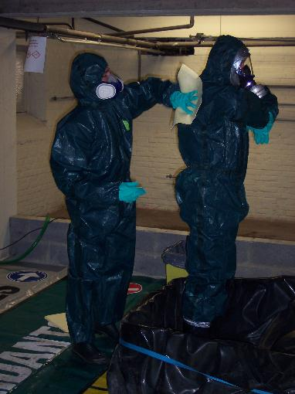

Correct wearing of Chemical Protective Clothing

Slide 34

Working in your protective garment - Best Practice
Do not remove your protective clothing and/or ancillary PPE while working in a hazardous area.
Prevent the spread of hazardous substances by not leaving the hazardous zone to go into other areas,
like the office prior to removing your protective
clothing and equipment.
Be considerate to colleagues working in the vicinity.
Non-active people in the hazardous area should wear
a protective garment in case of emergency.
In areas with an explosion risk (Ex-zones) always wear a garment which is anti-statically treated, to
ensure electrostatic discharges if earthed correctly.
Take care in the work area to prevent damage to your
protective equipment e.g. avoid hot surfaces and
sharp edges.

Slide 35
Correct wearing of Chemical Protective Clothing
Remember....
You have your limitations, and so does protective clothing
Always check the label
Take of your shoes/boots
Don’t rush!
Use your buddy
You are responsible for your own safety and well-being!

Slide 36


Correct wearing of Chemical Protective Clothing
Notes:
Tips;
Put on under-gloves (i.e. disposable nitrile). This helps later when removing contaminated suit and provides additional protection in case of leakage
Where the under-glove under the suit sleeve and where applicable use the thumb loop to prevent sleeve movement when working
Tips;
Help from colleagues (the buddy system) – to make sure the garment is properly sealed a colleague should be on hand to help
Use a suitable liquid proof tape i.e. PVC gaffer tape. Do not use a porous tape (I.e. masking tape) for obvious reasons.
Leave a looped end to make it easier to remove the tape later

Slide 37
Thank you
Any Questions?
www.microgard.com

