Slide 1
Developing a Proactive Safety Culture
OHSI conference
Presented by John Dillon
Principal Consultant, Ryder Marsh Safety Ltd

Slide 2
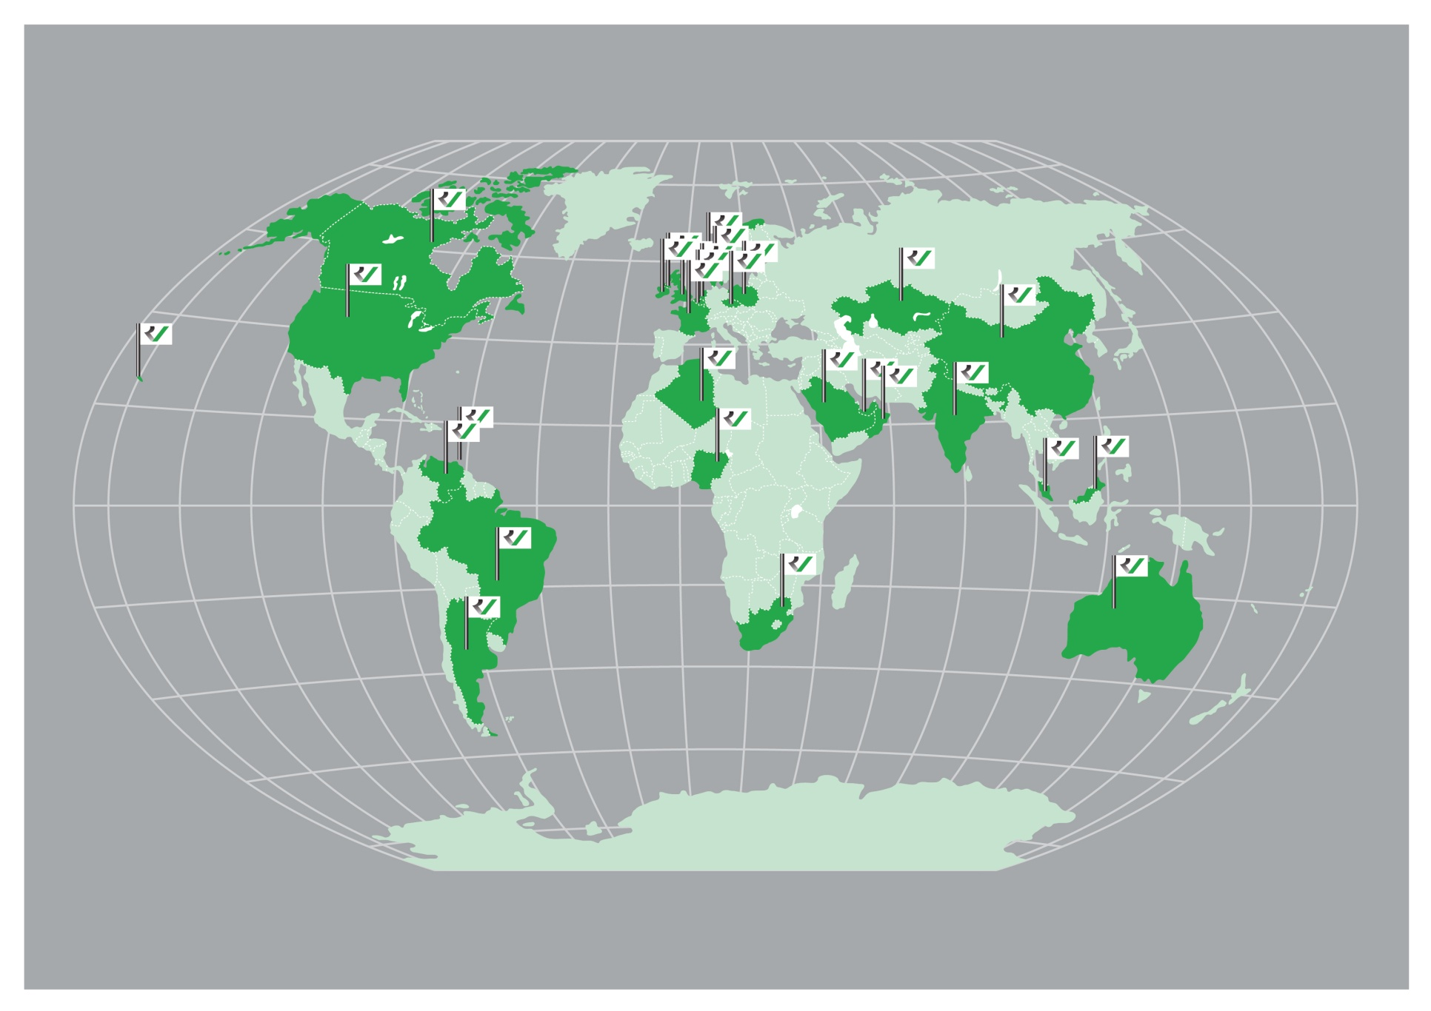

Slide 3

What is a Safety Culture?
Notes:
KLP: What is YOUR safety culture?
Safety Culture:
- organisation’s beliefs
- systems and processes
- expectations
- behaviours
Line managers have the biggest impact as they are visible and set the standards (worker’s perception)=what is acceptable and important to the organisation
1st impression (see, hear, feel)=how well managed is the workplace=effect on visitors and new starters
Reference Company in Safety
Trainer note
The following slides including the Parker and Hudson model are designed to get delegates to think about safety culture in general but also to identify what they believe their safety culture is at the moment, why it is the way it is and what needs to be done to improve. Remember you want to be the reference company that means climbing to the top of the model.
Safety Culture is made up of an organisation’s beliefs, systems, processes, expectations and day to day behaviours. Line managers have the biggest impact on local safety cultures within an organisation as they are seen as setting the standards. People’s perception of what is important on a day to day basis comes from their line managers. If a line manager is somebody who likes to shout and scream at people to get the job done this will affect the work force’s perceptions of what is acceptable and important to the organisation as a whole.
The safety culture of an organisation is what you feel and see and hear when you enter a workplace, if the workplace is well organised and maintained and you see people following the local rules and procedures it gives you an immediate feeling for how well managed the workplace is. This initial perception will have an effect on any visitors or new starters to that workplace and their behaviour will reflect what they see around them.

Slide 4
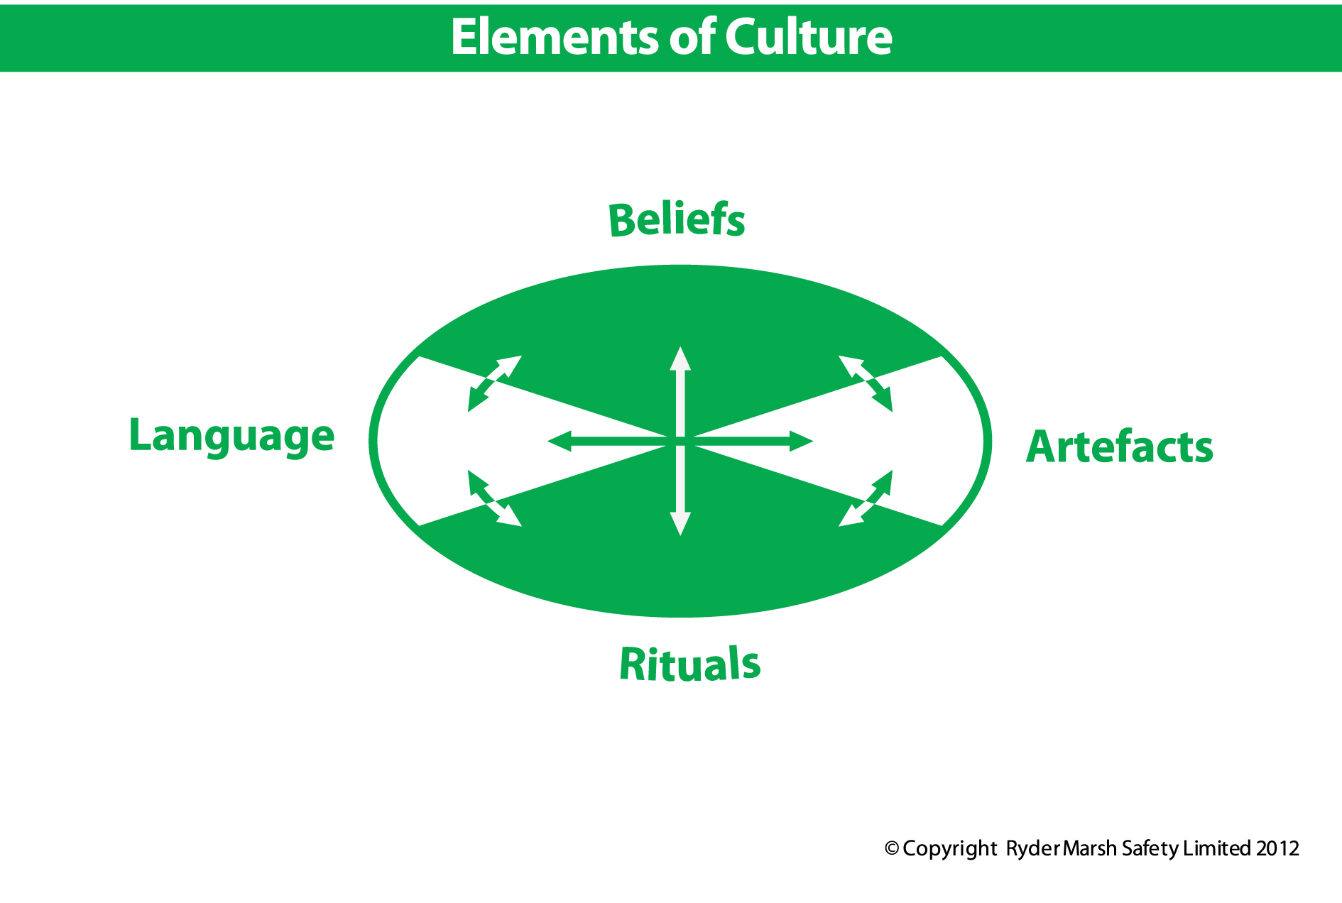
Notes:
KLP: Elements of Culture
Culture is made up of four elements:
Beliefs: The commonly held views of the people who work in the company
Artefacts: The physical environment that people work in
Rituals: All of the things that have become “normal” in the culture (both safe and unsafe)
Language: How we talk about safety

Slide 5
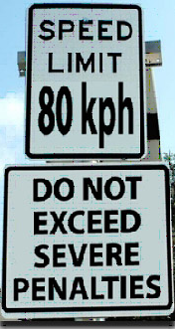
Notes:
5

Slide 6
Safety Culture Development Model
Generative
Safety is how the company runs its business, possesses a healthy safety paranoia
Proactive
Safety managed with workforce involvement and lead indicators
Calculative
Safety is managed on the basis of procedures and documentation and uses trail indicators
Reactive
Safety an issue once an accident has occurred
Pathological
Safety, something that prevents the company doing business. Do not get caught!
Notes:
KLP: Parker and Hudson model
5 key levels that an organisation can be in
As organisation matures & grows=culture should improve
Pathological:
- avoid getting caught breaking the law
- small low profit margins
- no management systems
- rely on luck to avoid injury
Ask or give example of pathological organisation (local if possible)
Reactive:
- Safety important only when something has gone wrong
- HSE policy on wall (from internet)
- procedures in folder on shelf for client’s benefit
- procedures don’t reflect reality (too slow & inconvenient)
- blame culture does not fix problems after accidents
Ask or give example of reactive organisation (local if possible)
Calculative:
- The norm today – focus on compliance
- HSE managed with standard tools (policy, procedures, SSOW, Risk Assessment etc…)
- Regulatory HSE department
- Managers enforce rules
- Workers follow rules to not get in trouble
- Workers not encouraged to think about/solve problems
- paperwork
- belief that if system is followed=no accidents
- use lagging indicators as a success measure
Ask or give example of calculative organisation (local if possible)
Proactive:
- strong HSE systems using leading indicators
- improve systems before incidents occur
- involve front line workers with knowledge why they do what they do
- line management lead by example and communicate with all levels of organisation
- use behaviour as lead indicator
- improve, not discipline, unsafe behaviour
Ask or give example of proactive organisation (local if possible)
Generative:
- Safety - Quality – Productivity always balance
- nothing ever goes wrong
- no HSE department required=all staff are QHSE and productive
- organisation always striving to improve
Ask:
- do generative organisations exist
- where does your organisation stand?
Trainer note
The model we use to measure safety culture is the Parker and Hudson model. We use this model as it shows five key levels that an organisation can be in. The theory is that as an organisation matures and grows then the culture should improve.
Pathological type organisations
The key thing for a pathological organisation is to avoid being caught breaking the law. This type of organisation is normally quite small and carrying out work which has low profit margins. The organisation will have no management systems and will rely on luck to carry out tasks without causing injury.
Think of examples that you have seen of pathological type organisations in the country where you carry out the training. In the developing world many organisations will be at this level (Construction workers, taxi drivers etc working around you). In the developed world pathological type organisations are normally small business such as sub contractors to sub contractors or back street garages.
Reactive Type Safety Culture
As an organisation matures it should move from pathological to reactive. A reactive type safety culture will only see safety as being important when something has gone wrong. This type of organisation may have a Health and Safety Policy on the wall (probably printed from the internet) and a folder of procedures for the workforce to follow. The procedures will probably have been written to show that the organisation is capable of undertaking larger projects and normally because a client has requested them. These procedures will not realistically reflect the way work is carried out by the workforce as this would make the job too slow or inconvenient.
When an accident does occur the organisation will normally blame those closest to the task and feel that they have stopped the accident from happening again because they have disciplined or fired the guilty parties. In reality they have not fixed anything and we can expect the accident to re-occur as nothing has really been fixed.
Calculative Type Safety Culture
The norm within the developed world is for larger organisations to have a calculative safety culture. A calculative culture is one where Health and Safety is managed using all the standard tools such as Policy, Procedures, Risk Assessment etc.
This type of culture normally has a Health and Safety Department which advises and regulates on the Health and Safety Performance of the organisation. Managers are expected to enforce rules and procedures and tell the workforce what to do. The workforce is expected to follow the rules and procedures because if it does not, it will get into trouble. This type of culture does not encourage people within the frontline workforce to think for themselves and solve complex problems. Many calculative organisations become over reliant on the paperwork systems and believe that if the systems are followed then nothing will go wrong.
A calculative type culture measures how successful their system is according to how many times it fails. Failures of the system are recorded in lost time injuries and at worst in fatalities. These are trailing or lagging indicators resulting in the organisation only being able to fix things after they have gone wrong.
Proactive Type Safety Cultures
Proactive safety cultures need to have strong Health and Safety systems in place. These systems however are measured for effectiveness by using leading indicators. By using leading indicators the organisations is trying to improve systems without waiting for accidents or incidents to occur.
For an organisation to become proactive they need to start involving the front line workforce as the people have knowledge about why tasks are undertaken the way that they are. For an organisation to be proactive the line management always has to lead by example and open communication must exist with all levels of the organisation to find out what is happening. The organisation uses behaviour as a lead indicator which tells them how to improve rather than just discipline unsafe behaviour without analysis.
Generative Type Safety Culture
A generative type safety culture is one where there is always total balance between safety, quality and productivity, where nothing ever goes wrong. This type of safety culture does not require a Health and Safety Department as all members of staff are totally involved in improving quality, safety and productivity. The organisation, even though nothing ever goes wrong, is continually striving to improve.
Summary and Exercise

Slide 7
Reported fatalities 2012 (HSA)

Slide 8
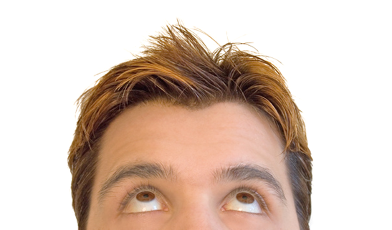
Beliefs
How people within the company feel about health, safety and wellbeing versus productivity, efficiency and cost saving. In other words, what do we they value?
Notes:
KLP: Beliefs
Peoples belief have a profound effect on their behaviour as they are based on how they perceive the world.
Beliefs within an organisation spread as people adapt to the culture

Slide 9
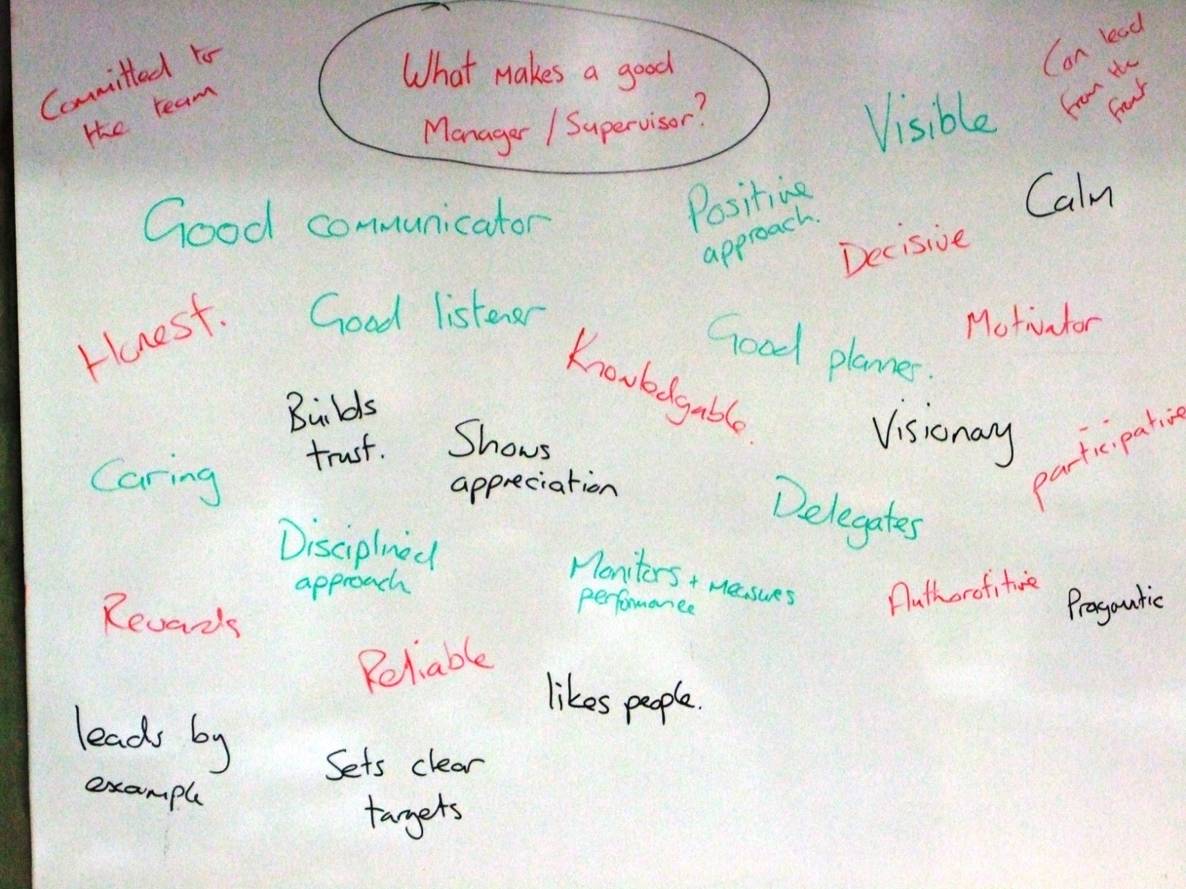
Notes:
19 min.
End 11:58
R

Slide 10
Who we rate above all others
Committed to the team
Good communicator
Good listener
Honest
Caring
Leads by example
Builds trust
Visible
Calm
Decisive
Builds trust
Fair
Positive approach
Visionary
Able to delegate
Knowledgeable
Motivates
Shows appreciation
Self disciplined
Likes people
Encourages others
Respectful
Supportive
Open to new ideas

Slide 11
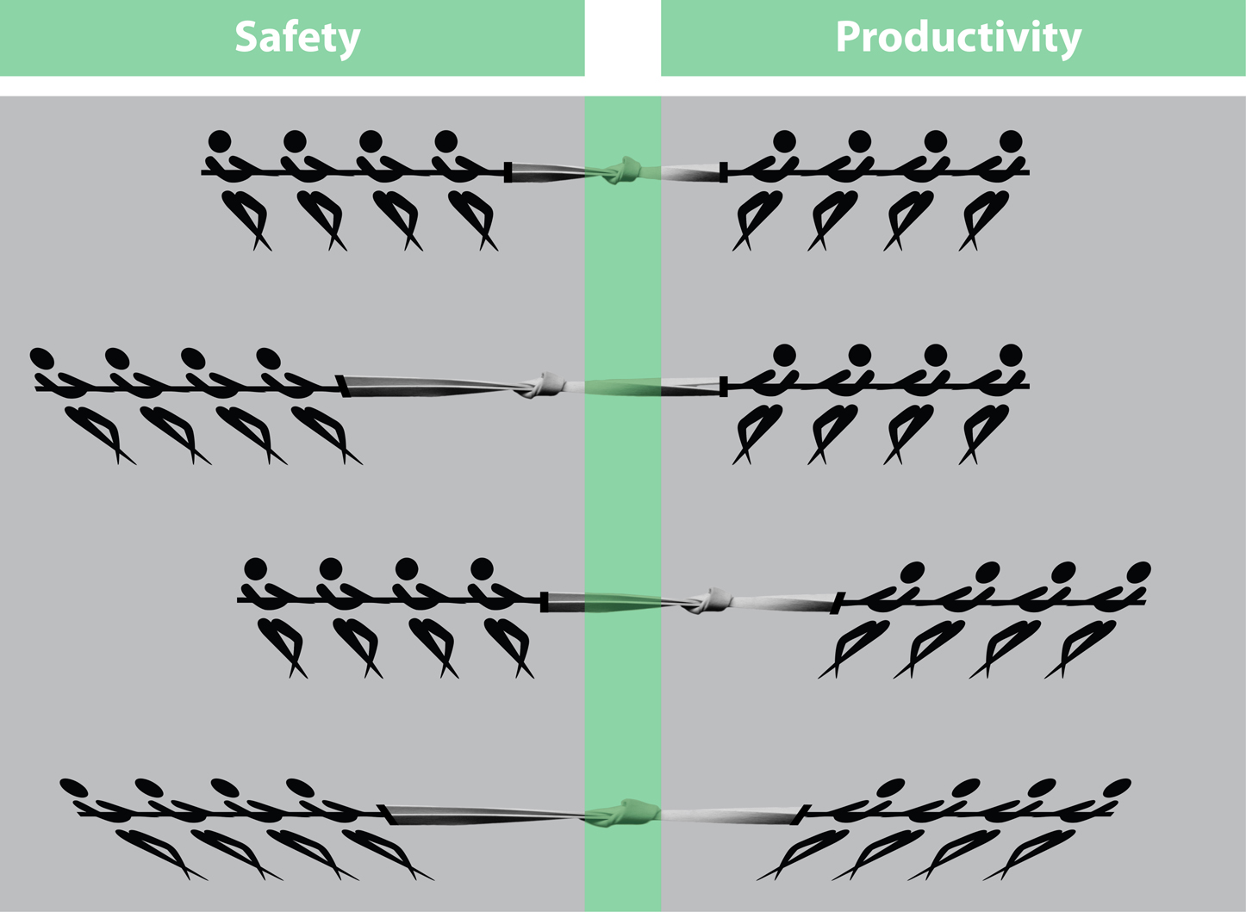

Slide 12
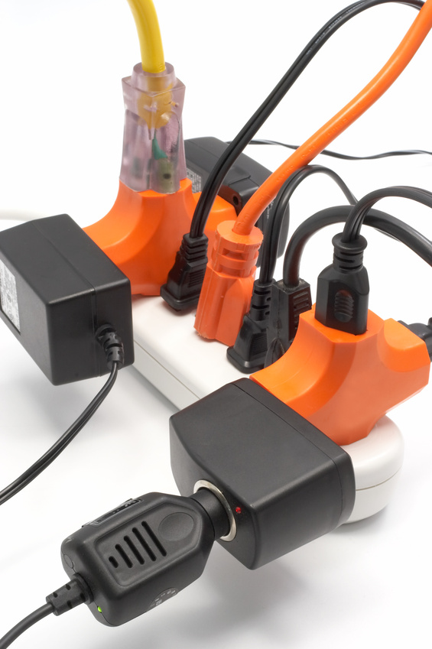
Rituals
Rituals are the collection of behaviours which become “normal” over time.
Notes:
KPI Rituals:
Rituals are all the things that become normal
They are often the things we do by habit
Anything can become a ritual and when it does we stop seeing the danger in it.
Example:
Ask the group if they remember when they first stated to drive? How safe did they feel? How aware of every movement they made?
Now, how often do they do a regular journey and can’t remember any of it?

Slide 13
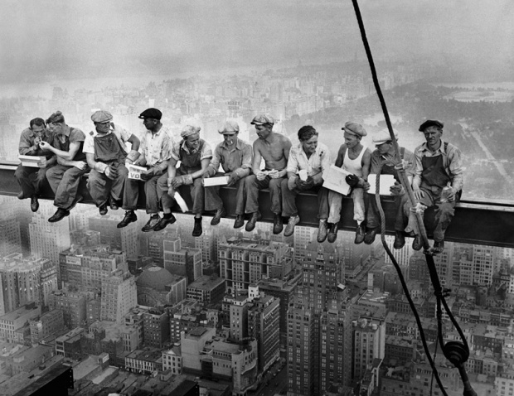
Fire-fighters
Notes:
KLP: Rockefeller
Rockefeller centre under construction
- 1930
Standards have improved in 90+ years
Ask:
How safe do these people look, do they look like they feel unsafe or do they look relaxed?
This is an example of how we can get used to anything, no matter how dangerous
Trainer note
The picture on the slide shows the Rockefeller Centre under construction in the 1930’s, looking at the picture it is quite obvious that standards have improved in the last ninety plus years.
This picture shows us that as humans, we can become used to anything. Over time we not only become used to the danger, we start to increase it, and at each level that too becomes normal.
Ask: When you first started driving, how safe did you feel? How aware were you of every gear change?
Now how often do you do a familiar journey (e.g. home to work) and not remember it?
Anything can become normal, and as this happens we stop seeing the danger in it, as we become used to the new level of danger we again slightly increase our perception of the risk. When you first start driving 30mph seems fast, now you can do 70mph on a motorway without being conscious of it.
So to conclude what must be done.
Explore these issues today

Slide 14
What is a habit?
Something we develop by repetition
Something we do unconsciously
Something we have little control over
Notes:
KLP: Habits
How we develop habits through repetition
How dangerous habits can be as we are not aware that we have them ot even when we use them
How when a habit has several steps, we easily miss a step
Trainer note
Video: Ask the group to watch the video and note what habits this taxi driver has developed, ask why they think he has developed them?
Once they have seen the video point out the arm on the back of the opposite seat, and how this has become a habit. This may have developed as it is easier to speak to the person in the passenger seat this way. Get them to notice that the reason that he flips the car over is that he is driving with one arm and over steers the car.
This is a classic example of a habit which has been developed over time, one that he is not aware of and that is very dangerous.

Slide 15
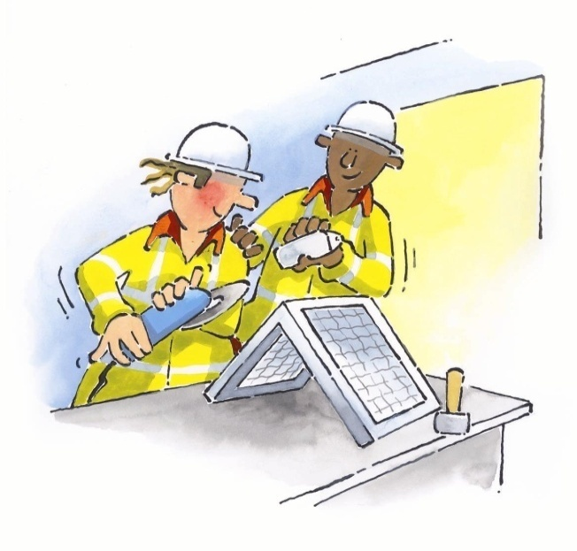
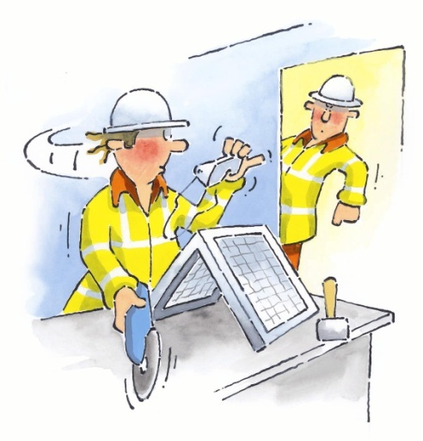
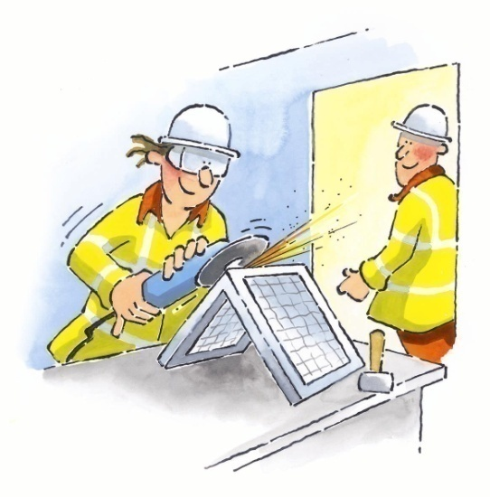
Bradley Curve
Injuries
Dependent
Independent
“I do it so I don’t
get into trouble”
“I do it so I don’t
get hurt”
Interdependent
“I do it so no
one gets hurt”
Time
Leadership
Individual
Team
Notes:
KLP: Bradley curve (Dupont)
Improve by involving the people
3 levels of culture:
- Reactive
Dependent: While there is some management commitment, supervisors are generally responsible for safety control, emphasis, and goals. Attention to safety is made a condition of employment, but with an emphasis on fear and discipline, rules and procedures. Such companies do value all their people and will provide safety training.
Independent: These companies stress personal knowledge of safety issues and methods, as well as commitment, and standards. Safety management is internalized and stresses personal value and care of the individual. These companies engage in active safety practices and habits and recognize individual safety achievements.
Interdependent: These companies actively help others conform to safety initiatives – they become “other’s keepers,” in a sense. They contribute to a safety network and have a strong sense of organisational pride in their safety endeavours.
Trainer note
Another way of measuring safety culture is to use the Bradley Curve which was developed by DuPont. The Bradley Curve describes three levels of culture the dependant level is where individuals follow rules because if they don’t then they will get into trouble. This level is driven by the management of the organisation so if no managers are present then rules are broken as the individuals see no benefit for themselves in following rules.
Think of examples from the outside world. If we lived in a truly dependent type culture then the only reason we would not want to break the law is because of a fear of being caught. If this was the case then the only reason that people would not deal drugs or carry out murders would be because of a fear of going to jail, not because we find it morally reprehensible.
The next level of the Bradley Curve is the Independent Level where the workforce understands why rules and procedures are in place and follow these rules because they see a benefit for themselves. This level is driven by individual competence.
The final level of the Bradley Curve is the Interdependent Level where both management and workforce are involved in developing procedures and everybody understand the benefits for the organisation. This team level is supported by members of the workforce looking out for each other to prevent injuries.
Again link this to the outside world, if we were truly interdependent we would not need a criminal justice system as we would be constantly looking out for each other's needs.

Slide 16
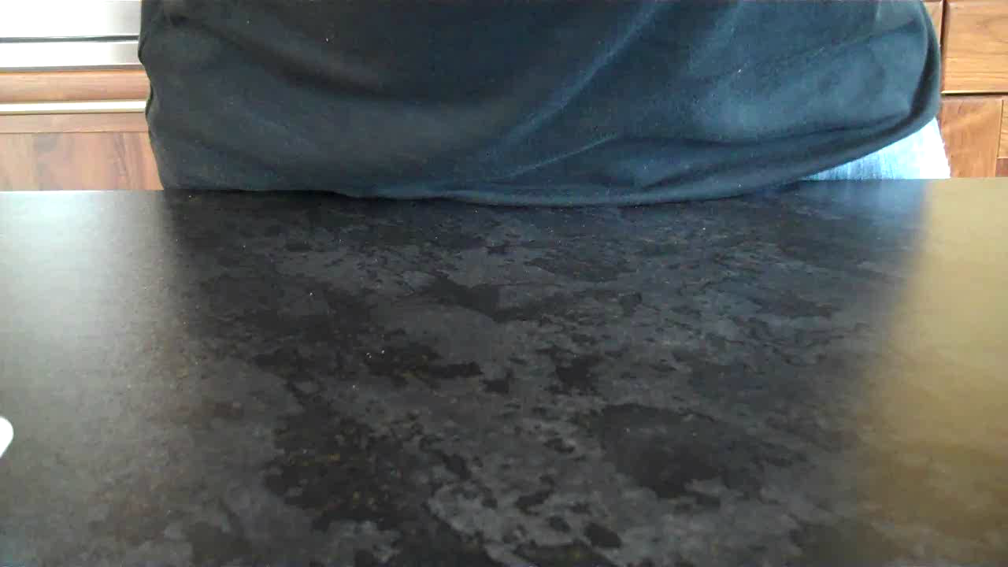

Slide 17
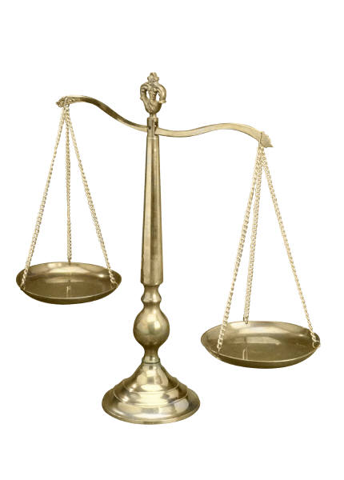
No Name, No Blame
&
Just Culture
Notes:
KLP: Just Culture
No name No blame=find what is happening=more reports when things go wrong
No name No blame never really existed
- blame was sometimes necessary
- distrust from workers
Just Culture=analysis based
- blame only after full analysis and if necessary
- reducing blame to benefit analysis and communication
Trainer note
Just Culture is the only way forward, blame destroys communication and trust and no blame never really existed.
No Name No Blame:
Historically some organisations said that they had a ‘no name no blame’ culture. The driver behind this culture was the feeling that they needed to get more people to report when things had gone wrong, so they were not interested in who did what, they just wanted to find out what was happening. This was mainly occurring in the Oil, Gas and Nuclear Industries as there was more of a driver from the regulators to report as much as possible.
In real terms the ‘no name no blame’ culture never really worked because if an individual had gone to cause damage without caring about the outcomes then organisations would be legally driven to discipline these individuals. Because individuals were blamed when blame was deserved the workforce saw that if something did go wrong they could be blamed which lead to a lack of trust within organisations.
Just Culture:
Just culture is an analysis based culture where people can still be found culpable for their actions but blame is only ever applied after full analysis. In most cases individuals do not go out to cause harm or damage there are normally systematic issues such as lack of training or unclear procedures which drive people to break the rules. If we use a Just culture model, then we are trying to reduce blame and by reducing blame improve analysis and communication.

Slide 18
The phenomenal power of the human mind
I cdnuolt blveiee taht I cluod aulaclty uesdnatnrd waht I was rdanieg.The phaonmneal pweor of the hmuan mnid! Aoccdrnig to a rseecherar at Cmabrigde Uinervtisy, it deosn't mttaer in waht oredr the ltteers in a wrod are, the olny iprmoatnt tihng is taht the frist and lsat ltteer be in the rghit pclae. The rset can be a taotl mses and you can sitll raed it wouthit a porbelm. Tihs is bcuseae the huamn mnid deos not raed ervey lteter by istlef, but the wrod as a wlohe. Amzanig huh? And you awlyas thought slpeling was ipmorantt?!
Notes:
They like all the error slides

Slide 19
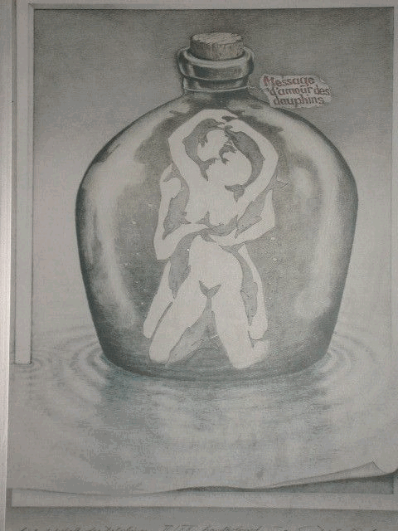

Slide 20

.
Notes:
KLP: rotating figure
Ask:
- clockwise or anticlockwise?
- think of something else
- change direction?
Use of right or left hand side of the brain
We can see the same thing but make sense differently
Trainer note
Get the delegates to watch the rotating figure and ask for a show of hands whether the figure is rotating in a clockwise or anti clockwise direction. Hopefully delegates will see the figure rotating in different directions. Then get the delegates to keep watching the moving figure but to try and think about something else hopefully the figure will start rotating in different directions. This is due to using either the right hand side or the left hand side of the brain and proves we can see the same thing but make sense of it differently.

Slide 21
NOW TRY AND
REMEMBER
T DYW R E E N B M O A N RM R
Notes:
The more logically it’s organised… the easier to get right…
Other exercise is the phone number example – most people can remember a string of 7 digits – but not all… (why numbers are never longer than 6 digits…) read out a random list of 6 then 8 then 10.. Or ask people to name 10 outfield players from England world cup winning team… almost impossible totally off the top of your head unless you’ve rote learned it – but much easier if you break it down to 442.

Slide 22
Human Failure
Slips (of action)
Skill-based errors
Lapses (of memory)
Errors
Rule-based mistakes
Mistakes
Knowledge-based mistakes
Unsafe Act
Routine
Situational
Violations
Exceptional
Optimising
Notes:
12 min
End 14:39
F
KLP: Human failure
Human failure=analyse what really happened
Unsafe act=error or violation
Error=no formal rule to follow:
- skill based=automated/unconscious behaviour(eg. driving)=slips and lapses (eg. slip=wrong sequence; eg. lapse= forget)
- rule based=regular scenario (eg.car wipers, driving on wrong side)
- knowledge based=conscious control (eg.novel situations)=lack of information/knowledge (eg. emergency situations)
Violation=have rules to follow:
- routine=rule impractical=everyone is doing it (eg. speeding on motorway)
- situational=pressure (eg. time)=break in usual (eg. Texas City key supervisor)
- exceptional=something already gone wrong (eg. solving a problem)=take a risk (eg. jumping from Piper Alpha)
- optimising=bored (eg. Worker shooting bolts across cement yard)
Trainer note: 12min
We have to understand what is going to provoke errors and violations, if we can do this then we can prevent them from happening.
If we are going to have a Just Culture this has to be based on analysis of what has really happened.
Describe the slide beginning with looking at errors and describing the different types of errors as shown below. Describe where these can occur in everyday life and what can provoke them. Errors occur when we do not have any formal rules or procedures to follow.
Violations occur when we do have rules to follow. Using the descriptions below get delegates to think about when they have been guilty of any violations. The easiest violation type to relate to is routine violation such as breaking the speed limit, of which we are all guilty of at times.
Skill based behaviour = Generally automated/unconscious mode of control used for tasks we do frequently. Errors here can be made by the most highly trained and motivated people. Two types of error here:
Slips = Failure in successfully executing an action or actions not conducted as planned. eg. Picking up the wrong tool from a toolbox; pressing the wrong key when typing; operating the wrong switch; transposing digits when copying a sequence of numbers; doing tasks in the wrong order or applying the wrong amount of force to something.
Lapse = A momentary lapse of attention, aka a ‘senior moment’! We may forget to execute an action, lose our place in a series of tasks or forget what we had planned to do. Because we are working at an automated level, these can often be caused by interruptions/ distractions such as phones. eg. you may complete a long series of actions, but omit one in the middle because the phone rang and you re-started at the wrong place, but were not conscious of this.
Lapses and slips are errors which result from a failure in the storage and/or execution of an action sequence, regardless of whether or not the plan which guided you was adequate to achieve its objective.
Driving a car is a typical activity which we control on skill based mode. How often have you driven home on your regular route and could not recall the drive at the end? Operating in a highly automated mode!
Rule Based Behaviour = Mode of control which requires recognition of regularly encountered scenarios and selection of an appropriate “rule” or response from stored knowledge.
Rule based mistakes = These are more complex errors where we carry out the action we planned, it’s just that the plan may be flawed. In this control mode, we will usually revert to the more familiar because it uses less mental energy, so we can either: (i) incorrectly identify the situation and therefore select an inappropriate response rule or (ii) we may correctly identify the situation, but select the incorrect response rule. eg. putting the wipers on when we try to indicate for the first time in a hire car because the controls are the opposite way round to our own car. Driving abroad: you manage OK until something unusual happens, then you revert back to driving on the left (until you see the car coming towards you).
Knowledge based behaviour = Largely conscious mode of control used when we encounter novel situations or problems to solve. We plan a response based on our first principles knowledge we may have on the subject. We make incorrect decisions in these situations when we do not have enough of the correct information and/or insufficient time to perceive and process the information, so we make a mis-informed plan to solve a problem. E.g. errors made by people new to any job; decisions made during emergencies.
Proportionally, we are more likely to make errors during knowledge based control mode, but we spend more time using skill and rules based control modes.
Routine violations = Everyone is doing them; it is the norm, therefore such violations tend to go unchallenged. These usually occur because the rule is impractical or impossible within the design of the system and because there is a culture of accepting this. Speeding on the motorway; not wearing PPE, etc...
Situational violation = Where a rule would normally be followed by most people, specific job pressures may occasionally encourage a rule violation. Time pressure is the most commonly cited situation, as well as equipment suitability and availability, or insufficient staff due to illness. eg. a key supervisor at Texas City leaving early due to a family emergency.
Exceptional Violations = These are much less frequent than routine or situational and tend to only occur when something has already gone wrong (i.e. When people are trying to problem solve). To solve a problem, you may be aware you are breaking a rule, but “take the risk” anyway to solve the (bigger) issue as you see it. eg. jumping from the burning Piper Alpha oil rig!
Optimising violations = When people do not have sufficient workload and are bored, they will do things to liven up their day. eg. the highly intelligent and motivated staff in the control room at Chernobyl conducting unapproved “tests” to gain a better understanding of the control system.

Slide 23
Typical ‘Just Culture’ Process
Were the actions
Pass Equivalence
Were the actions
Knowingly Violating
Knowingly Violating
History of Violating
NO
History of Violating
NO
YES
NO
YES
as intended?
NO
as intended?
Procedures?
Procedures?
Test?
Test?
procedures
procedures
NO
YES
NO
YES
NO
YES
NO
YES
YES
NO
YES
NO
Defective
Defective
Training
Were the results
Training
Were the results
Procedures Clear
Procedures Clear
Training, Selection
Error
Training, Selection
Required
as intended?
Required
as intended?
and Workable?
and Workable?
Experience?
Experience?
YES
YES
YES
YES
NO
NO
NO
NO
YES
YES
*
System
*
System
System
Negligent
System
Induced
Negligent
Induced
Produced
Sabotage or
Produced
Sabotage or
Violation
Violation
Error
Error
Violation
Violation
Violation
Malevolent
Violation
Malevolent
Act
Act
Diminishing Individual Culpability
Coaching
Coaching
Verbal
Verbal
First Warning Letter
First Warning Letter
Final Warning
Final Warning
Letter
Letter
Dismissal
Dismissal
* Management/supervision responsibility to correct root causes of system issue
Increasing Individual Culpability
Notes:
15 min
End 15:39
15:59 End of day one
F
KLP: Decision tree
Start top left corner, use OIM Claymore:
- actions intended=yes
- results intended=no
- knowingly violating procedure=no
- equivalence test=yes
- history=?
- therefore either tolerable error or training required
Reality=totally inadequate management systems
Personal story to illustrate the Just Culture process,
The more to the right of decision tree=the less culpable the individual(s) culpable
Just Culture possible only after full analysis
Just Culture process:
- fair
- seen to be fair and consistent
Trainer note: 15min
The Just Culture Process can only be followed when we have carried out a full analysis of what actually happened. By applying a Just Culture process we are not only being fair we are being seen to be fair and consistent.
Starting in the top left hand corner box and using the OIM of the Claymore as an example go through the process.
1. Where the actions as intended, did he mean to keep pumping oil and gas – yes
2. Where the results as intended, did he mean to assist in the deaths of hundred and sixty seven people – no
3. Was he knowingly violating a procedure – no
4. Would he pass the equivalence test, would somebody else with the same knowledge, experience and training in the same situation do the same thing – yes
5. Has the person got a history of violating procedures, we do not know, so this was either a tolerable error or training is required. In reality the failure was caused by totally inadequate management systems.
Using examples from own experience and the experience of the delegates walk through the Just Culture process.
A useful example is:
“You are driving at 20% above the speed limit on a clear and open road. You crest a hill and front of you are several stationery vehicles blocking the road, you break but still crash into the stationery vehicles causing injury to occupants.”
Using the Just Culture model:
1. Where the actions as intended? – yes
2. Where the results as intended? Did you mean to injury people? – no
3. Where you knowingly violating procedures? – yes
4. Where the procedures clear and workable, is the speed limit clearly known? – yes
5. This is a reckless violation and the police will see it as such.
The more we move to the right hand side of the model the less culpable the individual becomes.
END of DAY 1
NOTES:
________________________________________________________________________________________________________________________________________________________________________________________________________________________________________________________________________________________________________________________________________________________________________________________________________________________________________________________________________________________________________________________________________________________________________________________________________________________________________________________________________________________________________________________________________

Slide 24

Communicating the Message
When trying to promote an idea you need to show that you can save them:
Time
Effort
Money
Or that it will be pleasurable
Notes:
KLP: Communicating the message
Too often H&S takes control away from people and is often focused on the negative.
When were are communicating the idea of Behavioural Safety we need to ensure it’s a positive message.

Slide 25
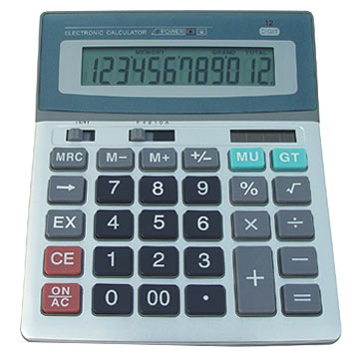
Vroom’s Model of Motivation
X
X
They know what they have to do & why
They know how to do it
They value the outcome
Notes:
Victor Vroom is a professor at the Yale School of Management in the US.
His expectancy theory of motivation says that an individual’s motivation to do something will be a multiplication of the following three factors:
Whether they know what they are required to do and why
Whether they feel they have the skills to do it effectively
Whether they value the outcome.

Slide 26
Thank You
John Dillon
john.dillon@rydermarsh.co.uk
Ryder Marsh Safety Ltd
Notes:
KLP: British Ploythene Safety Leadership
Thank everyone for their participation
Offer people YOUR contact details for future support incase they need it.

