Slide 1


Occupational Hygiene Society of Ireland (OHSI), 31st Annual Conference, Limerick, Ireland
March 30, 2023
IOHA Update
Addressing Occupational Hygiene Priorities
Quality Assurance in Exposure Risk Assessment
Maharshi Mehta, CIH, CSP, FAIHA
President IOHA
South Brunswick, New Jersey, USA
Maharshi.mehta@ioha.net
Maharshi.mehta@issehs.com
+2036858808

Slide 2



International Occupational Hygiene Association
Association of occupational hygiene organisations:
Created in 1987
Currently 39 members (representing 35 countries)
US, Japan, Argentina, and Colombia have two member organisations
Represents 20,000 occupational hygienists globally
NGO, recognised by:
  International Labour Organisation (ILO)
  World Health Organisation (WHO)

Slide 3


Slide 4
IOHA National Accreditation Recognition Scheme
Vision:
A world in which there are sufficient Occupational Hygienists certified by credentialing organisations recognised by the IOHA NAR Scheme to make an impact on the reduction in the global burden of occupational disease
Mission:
to promote global respect for and recognition of professional certification programmes which meet or exceed the "IOHA Model Certification Programme"

Slide 5
IOHA National Accreditation Recognition Scheme
Scheme administered by the National Accreditation Recognition Committee
Committee comprises one (1) representative from each credentialing body
Currently 17 credentialing bodies recognised by IOHA under the NAR scheme
Credentialing programmes must satisfy the NARC IOHA Model Certification Programme to be recognised.
Compliant credentialing programmes permitted to use the IOHA logo in conjunction with the wording “IOHA Recognised Certification Scheme”
Voluntary process
Open to any OH credentialing body

Slide 6
IOHA Updates
Webinars on applied OH
  12 offered in 2022 and 23
  Metal and metalloids, noise control technologies, biosafety
  Free to all IOHA member associations
Updated websites
  Resource (Risk Assessment, Exposure Controls)
  Bachelors and Masters degree programs globally including distance learning https://www.ioha.net/training/
Active partnership with all member associations
NAR process review
Global Exposure Manager

Slide 7
The global challenge
35 million new cases of work related illness each year due to exposure to chemicals¹
194 million Covid 19 Cases
2 million lives per year lost to occupational disease²
4 million deaths due to Covid 19
Total 44,000 NAR occupational hygienists³ required
BUT
only 7,576 available – (6,506 in North America)³
(Source: ¹ ILO, 2004, 2005, 2013; ² Takala, 2012; ³ Tresider, 2015)

Slide 8
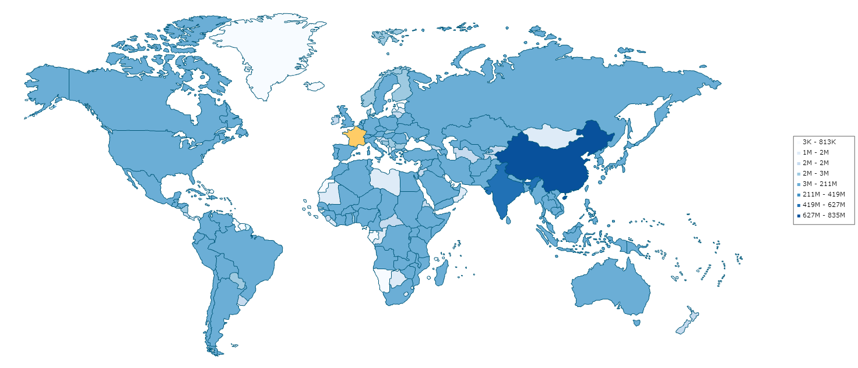
Paradigm shift-Labor Force-Hence EHS Priorities
CIA World Fact Book http://www.indexmundi.com/map/?t=0&v=72&r=xx&l=en

Slide 9
Priorities
Emerging Economies
Resources
  Availability of competent professionals
  Infrastructure – accredited labs and cost
  Service providers – Value addition, sustainability
Quality Assurance in Risk Assessment
Data interpretation and analysis
  Leverage exposure controls with limited IH monitoring

Slide 10
Degree Programs
Ireland – Two Programs Dublin and Galway
Several related programs – University of Limerick
Distance Learning Programs
  Montana Technological University (https://www.mtech.edu/gradschool/distancelearning/ih.html)
  University of Greenwich (https://www.gre.ac.uk/postgraduate-courses/ach/occhyg)
  One in Australia
  University of California – Berkley

Slide 11
India: Master in Industrial Hygiene and Safety
First time in India started 25 years ago
350+ graduates
35+ CIHs
One semester on safety added
  Program then is recognized by government as essential qualification to work as “safety officer”

Slide 12
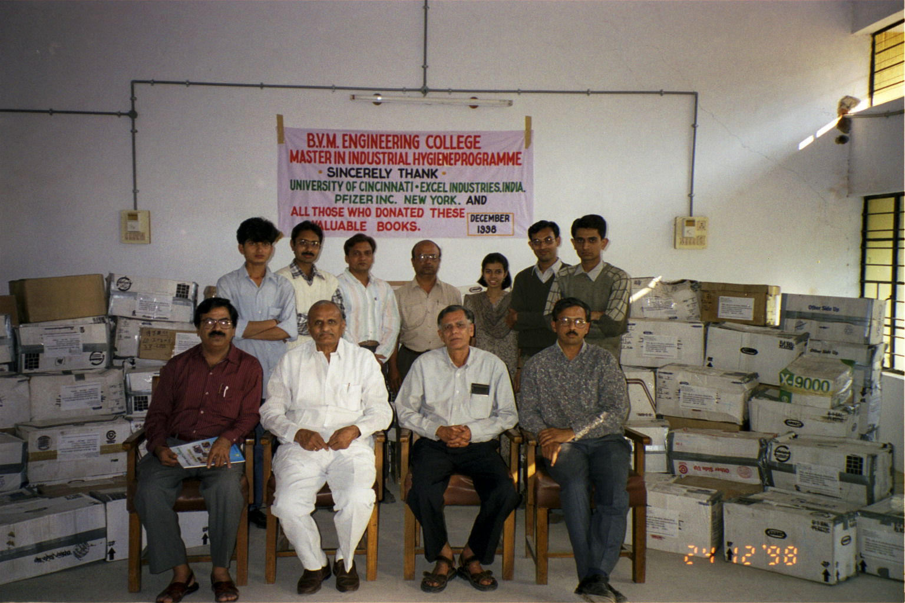

Slide 13
Partnering with IOHA Associations, industry associations and Individuals
Free access to publications and books
Visiting faculties from associations and industries
Student mentoring
Internship opportunities
Participating OHSI, BOHS and IOHA committees and activities
Pharmaceutical Supply Chain Initiatives (PSCI)

Slide 14
Quality Assurance in Exposure Risk Assessment
>50% of exposure results are questionable
Health of people depends on exposure results/biological monitoring results we provide
Of the all professions, QA/QC and business ethics have pronounced impact in IH/OH
Key Elements
  Reliability, reproducibility and representativeness of the results
  Robust analytical methods for air sampling and biological monitoring, validated by globally recognized independent agency
  Statistical analysis of data
  Exposure profiling for decision making

Slide 15
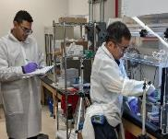
Value Addition- Industrial Hygiene services
Risk assessment to reduce monitoring costs , prioritize monitoring for high risk activities.
Exposure Monitoring
  Reproducible- 3 to 6 repeat samples per exposure group.
  Representative – full shift monitoring by being onsite 1 hour before shift start for calibration and preparation. Our IH is onsite at 5 am if shift starts at 6 am.
  Reliable- quality controls (pre & post calibration with primary calibrator)
Statistical analysis of monitoring data
Detailed field notes documenting exposure contributory factors
15

Slide 16
Exposure Profiling Process and lessons
Based on analysis of > 5000 datasets
Process: Conduct statistical analysis of unit operations’ sampling results
  Stainless steel welding – Hexchrome
  Mn exposure during MS wedling
  Lead in soldering
Lessons (Examples)
  Lead airborne exposure is unlikely to exceed exposure limits during soldering
  Electric arc welding on stainless steel for > 30 min with LEV – exposure is likely to be above the exposure limits
  Weighing Dispensing of potent API is likely to be above limit
Future
  IOHA would like to work in developing globally acceptable standards (Similar to EN689) for detailed exposure assessment
  Work with industry in developing exposure profiles, redact sensitive information and share with global community

Slide 17
Summary
Thank you for inviting me
Participate in OEHS, IOHA, AIHA-IAC
IH capacity building and quality assurance in IH Monitoring seem to be highest priorities
Inhouse capacity building seem to be the best option
Opportunity exists on leveraging lessons learned from analyzing IH results. Benefits include effective utilization of resources and managing IH monitoring cost.
Consider contribution in emerging economies where the need is enormous and IH resources are limited.

Slide 18


