Slide 1
Building Awareness of Occupational Hygiene
Mike Slater
BOHS President 2014/15
Notes:
On Sunday 13th April 2014 there was a two page spread in the Observer

Slide 2
Approximately 13,000 deaths each year due to occupational diseases

Slide 3
At least 13,000 died from work related disease
99%
health
1%
safety
133 workers died in accidents at work

Slide 4
An estimated 1.2 million people who worked in 2012/13 were suffering from a work-related illness
Notes:
And it’s not just about fatalities
Occupational disease affects quality of life
According to the HSE over a million people believe their health has been affected by their work
Many of these diseases are caused by the “traditional” agents

Slide 6
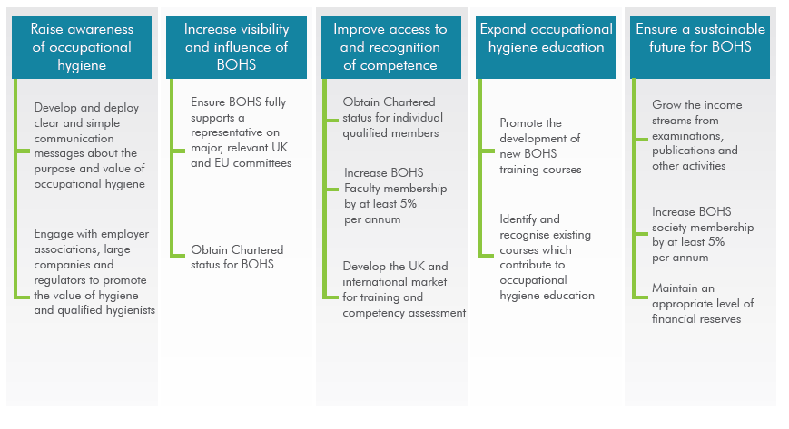

Slide 7
“Develop and deploy clear and simple communication messages about the purpose and value of occupational hygiene”

Slide 8
“Engage with employer associations, large companies and regulators to promote the value of hygiene and occupational hygienists”

Slide 9
HOW ?

Slide 10
Strategy
Respiratory disease
Target ONE industry sector

Slide 11
Why Construction?
Notes:
This compares with an average of 53 over the previous five years
Although it accounts for only about 5% of the employees in Britain it accounts for 27% of fatal injuries to employees and 10% of reported major injuries.

Slide 12
About 5 500 new occupational cancer cases in construction every year
Notes:
This compares with an average of 53 over the previous five years
Although it accounts for only about 5% of the employees in Britain it accounts for 27% of fatal injuries to employees and 10% of reported major injuries.

Slide 13
over 500 workers believed to die from exposure to silica dust every year
Notes:
This compares with an average of 53 over the previous five years
Although it accounts for only about 5% of the employees in Britain it accounts for 27% of fatal injuries to employees and 10% of reported major injuries.

Slide 14
76 000 cases of work-related ill health
Notes:
Source: HSE

Slide 15
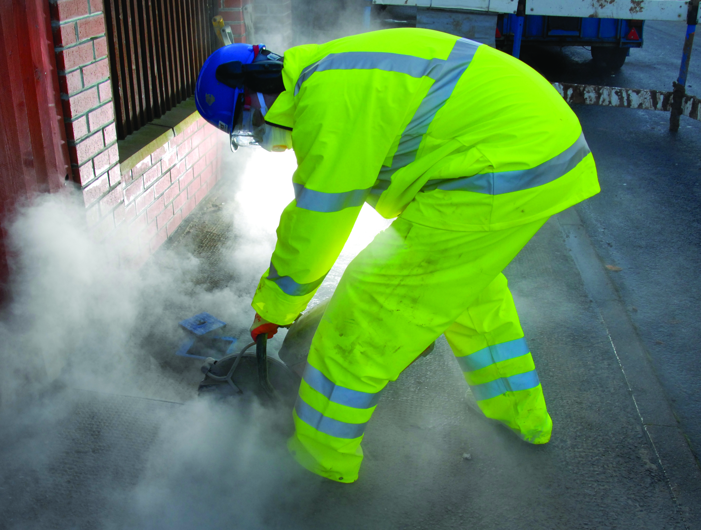

Slide 16
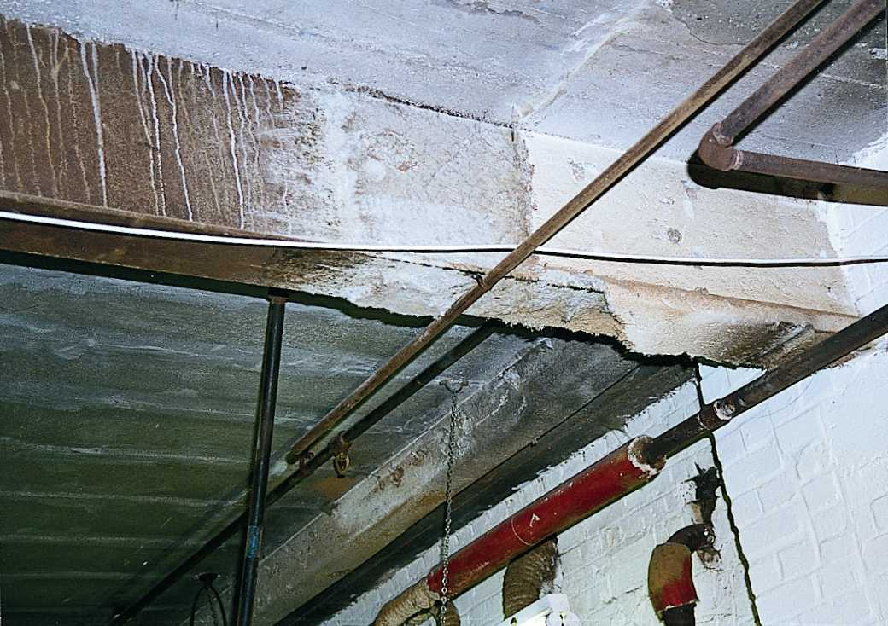

Slide 17
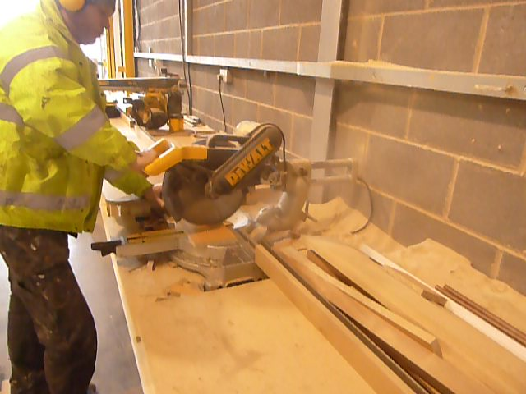

Slide 18
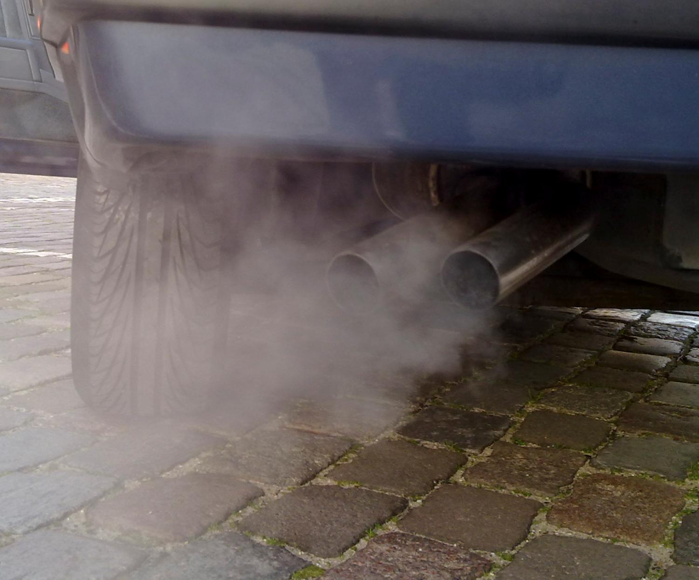
Notes:
Approx 1000 cases of cancer every year due to exposure to DEEs at work

Slide 19
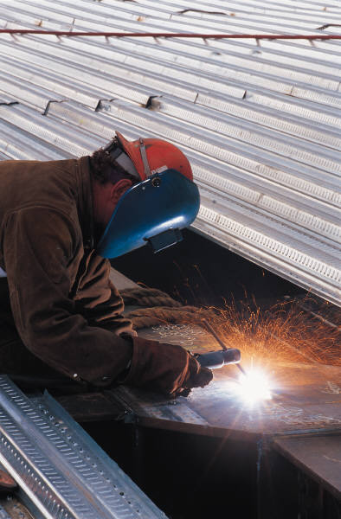
Stick Welding

Slide 20
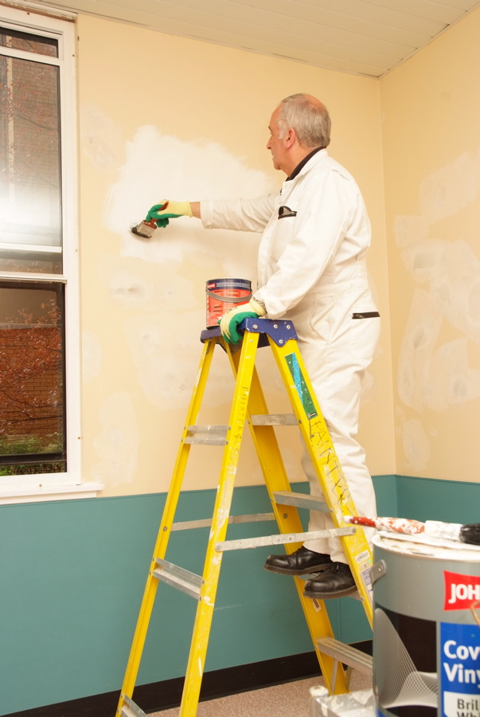
Notes:
Painters are exposed to solvents and other chemicals in paints, thinners etc
Potential respiratory health issues include asthma and cancer (6 to 7% of cases of cancer in construction due to painting)

Slide 21
Convert the need for preventative ill-health solutions into demand

Slide 22
Employers have the key role to play in minimising health risks at work.
Notes:
http://turnerfox.co.uk/employers/

Slide 23
Politicians
Trade Unions
Construction clients
HSE
Trades associations
BOHS
Relevant charities
Construction companies
Other professional bodies
Commercial providers
Media partners
Notes:
BOHS will collaborate with a number of other bodies and stakeholders, making the best available use of resources to tackle head-on this serious issue of occupational disease.

Slide 24
Helping employers to protect workers
by controlling exposures
What’s needed?
Notes:
5 slides one for each

Slide 25
Helping employers to protect workers
by controlling exposures
What’s needed?
Evidence that OH is good for business
Notes:
5 slides one for each

Slide 26
Helping employers to protect workers
by controlling exposures
What does ‘good’ look like?
What’s needed?
Evidence that OH is good for business
Notes:
5 slides one for each

Slide 27
Helping employers to protect workers
by controlling exposures
What does ‘good’ look like?
Who’s doing this well?
What’s needed?
Evidence that OH is good for business
Notes:
5 slides one for each

Slide 28
Helping employers to protect workers
by controlling exposures
What does ‘good’ look like?
Centre of excellence for information
Who’s doing this well?
What’s needed?
Evidence that OH is good for business
Notes:
5 slides one for each

Slide 29
Helping employers to protect workers
by controlling exposures
What does ‘good’ look like?
Centre of excellence for information
Who’s doing this well?
What’s needed?
Good Business Case
Notes:
5 slides one for each

Slide 30
Helping employers to protect workers
by controlling exposures
Management Standard
Centre of excellence for information
Who’s doing this well?
What’s needed?
Good Business Case
Notes:
5 slides one for each

Slide 31
Helping employers to protect workers
by controlling exposures
Management Standard
Centre of excellence for information
Case Studies &
Good Practice
What’s needed?
Good Business Case
Notes:
5 slides one for each

Slide 32
Helping employers to protect workers
by controlling exposures
Management Standard
Information Hub
Case Studies &
Good Practice
What’s needed?
Good Business Case
Notes:
5 slides one for each

Slide 33
Politicians
Trade Unions
Construction clients
HSE
Trades associations
BOHS
Relevant charities
Construction companies
Other professional bodies
Commercial providers
Media partners
Notes:
BOHS will collaborate with a number of other bodies and stakeholders, making the best available use of resources to tackle head-on this serious issue of occupational disease.

Slide 34
Working in Partnership
Supporters
Partners
Sponsors
Notes:
Split into 2
Blobs own slide – start with blobs
Add more boxes for each thing

Slide 36
APRIL
28

Slide 37
Notes:
Following on from the launch we will be holding a series of Regional Meetings around the UK
Details to follow

Slide 38
Conference on
“Best practice in the Construction Industry” October 2015
Notes:
We’ll be holding a National Conference focusing on best practice of occupational health and hygiene in the construction industry in October 2015
An opportunity to find out “who’s doing well” and how they are doing it and discuss innovative ideas.
More details will follow

Slide 39
Notes:
Join us
Help the construction industry to Breathe freely!

